Slide 1
PRICING
Mrs. Morris’

Slide 2
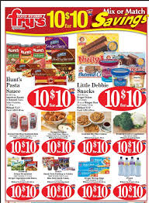
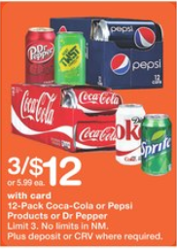
Multiple Unit Pricing
The combination of several like products as a unit of one

