Slide 1
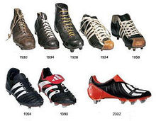
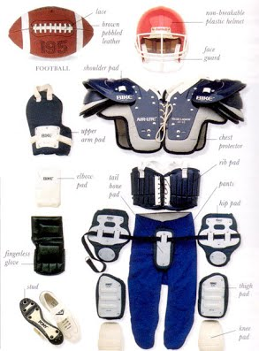
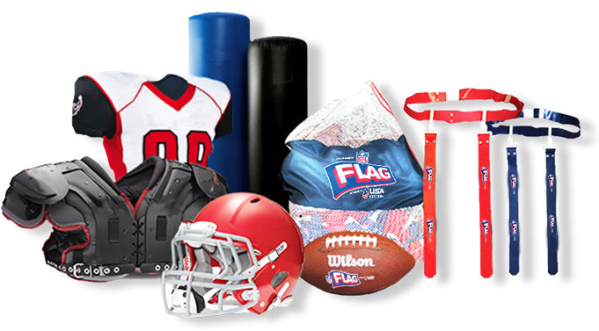
Flash Football

Slide 2
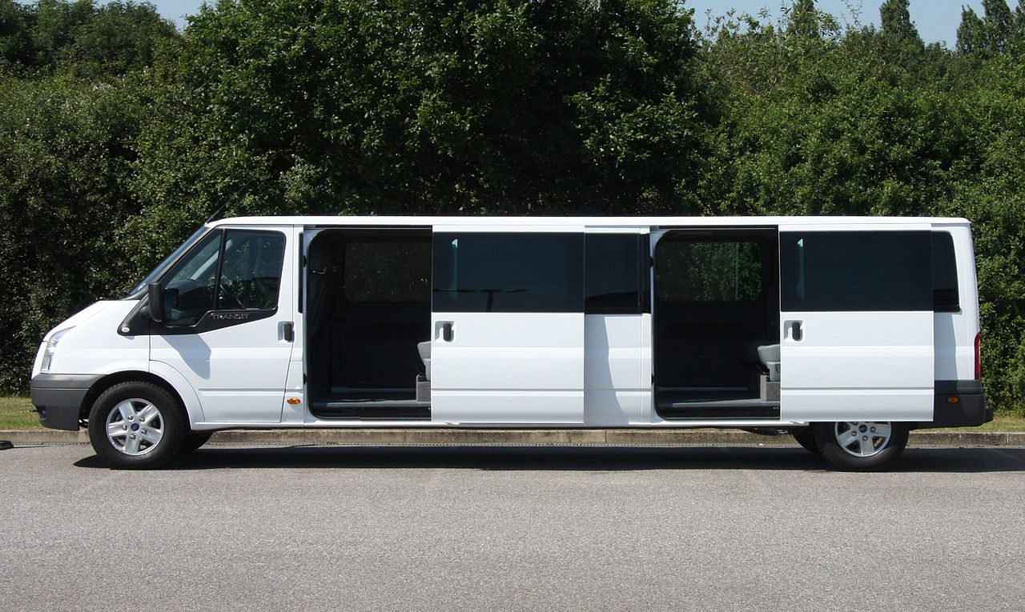
transit
Flash football

Slide 3
Specialty media
Flash Football

Slide 4
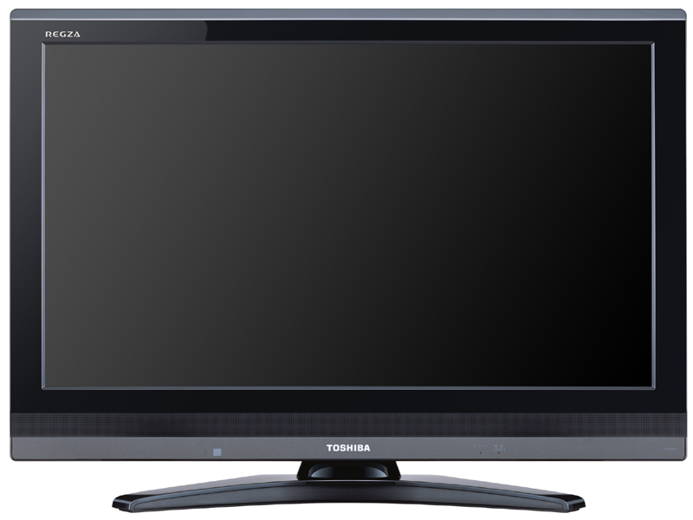
Broadcast Media
Flash Football sales!

Slide 5
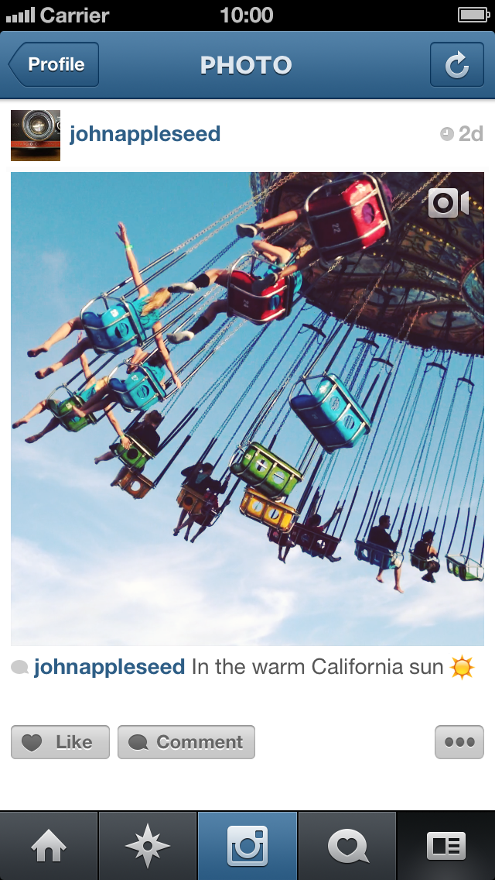
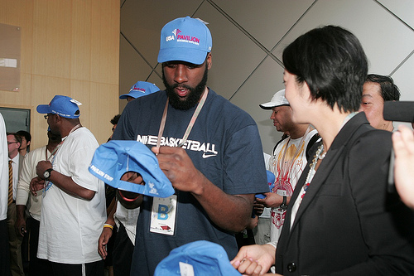
Publicity
James harden
FLASH FOOTBALL
James harden
Huge flash football sale! Shop now guys!

Slide 6
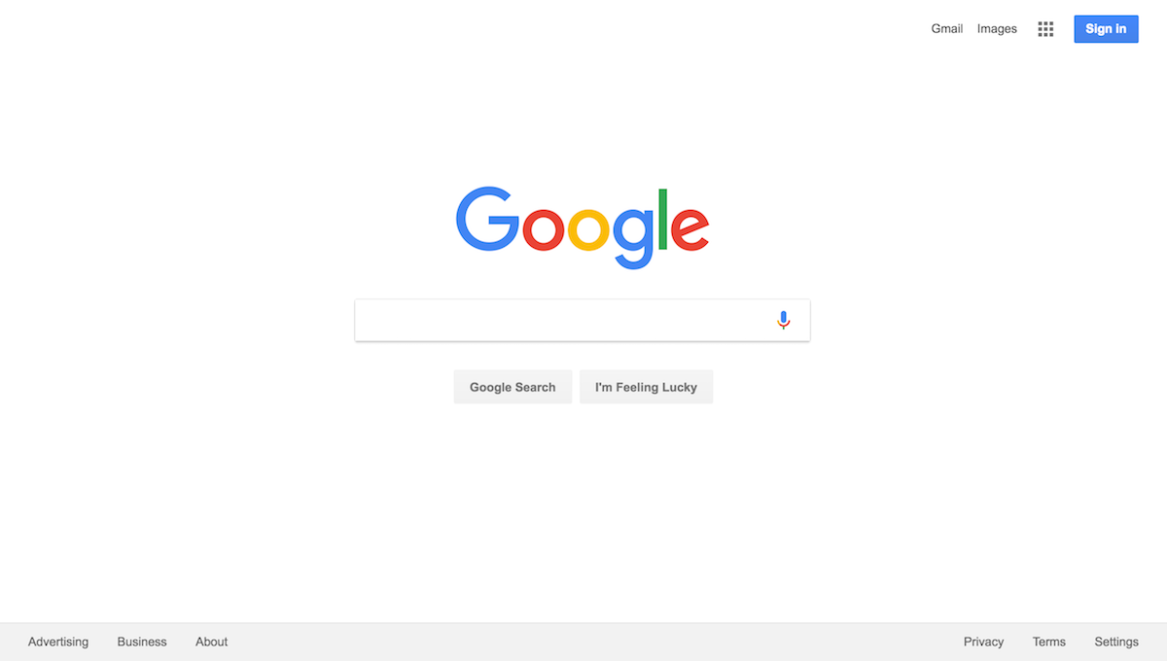
online
Flash football

Slide 7
Personal selling
Thank you for calling Flash Football, This is your local football store, on and off the field gear for pewee players to NFL players. This is ______ how may I help you today?

Slide 8
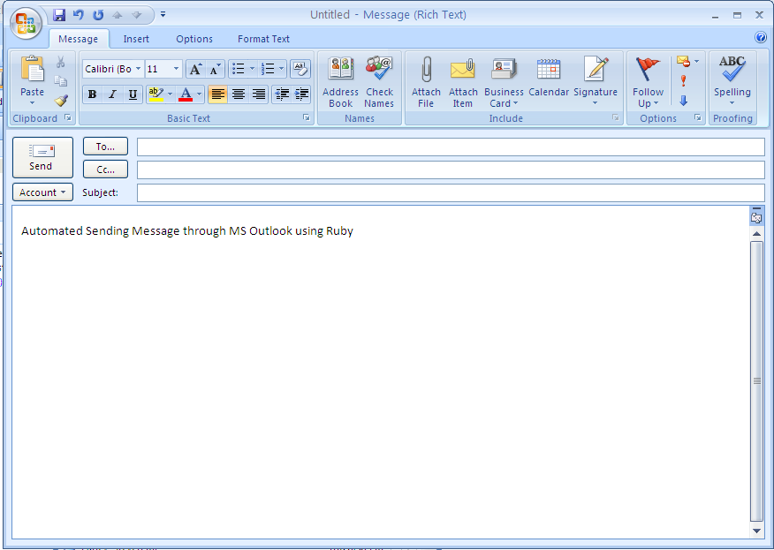
Direct Marketing
customers
Flash football

