Slide 1
Mrs. Morris
Morehead State University – Business & Information Technology Education
Morehead State University – Master of Arts of Teaching (MATH)
University of the Cumberlands – supervisor of Instruction

Slide 2
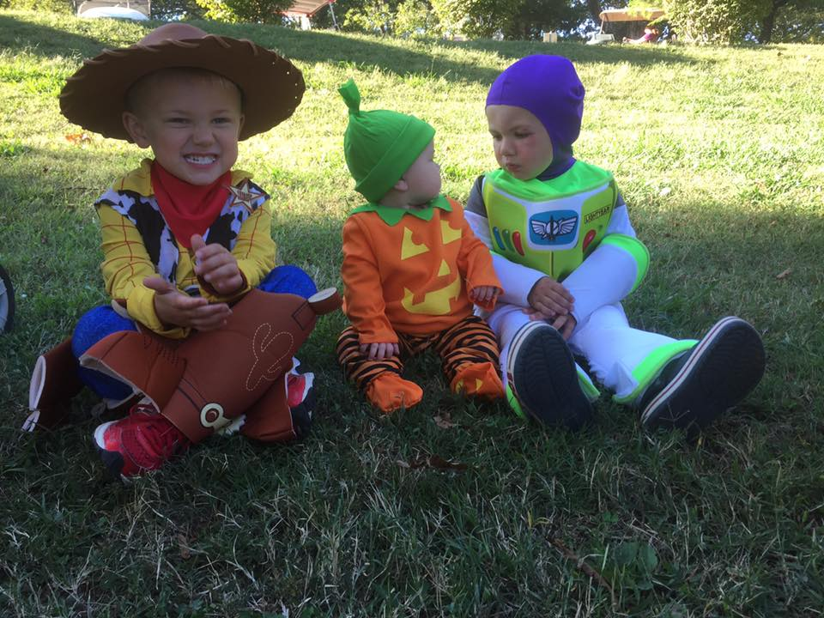
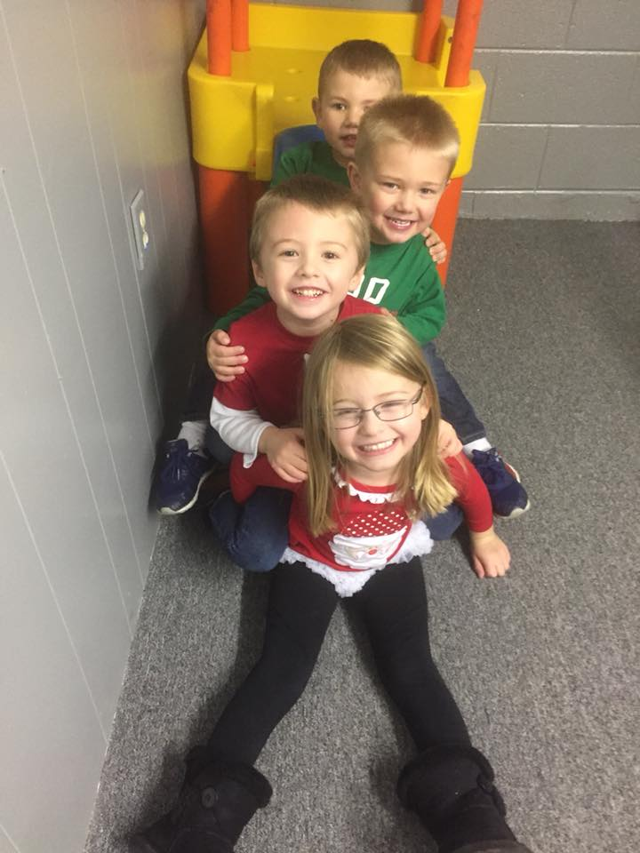
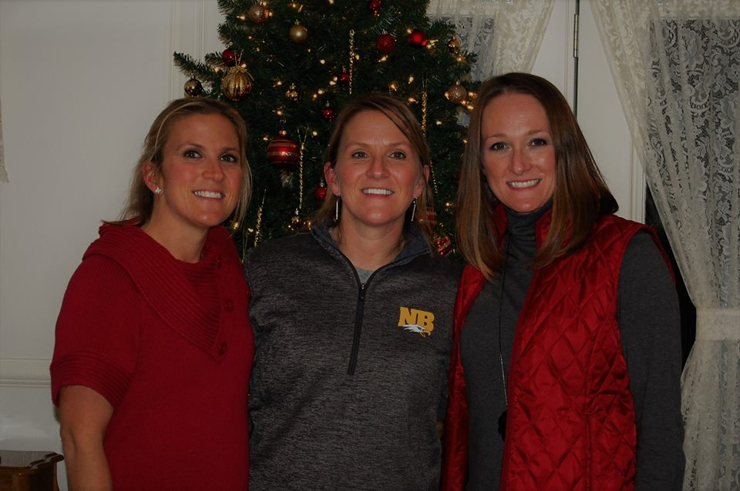
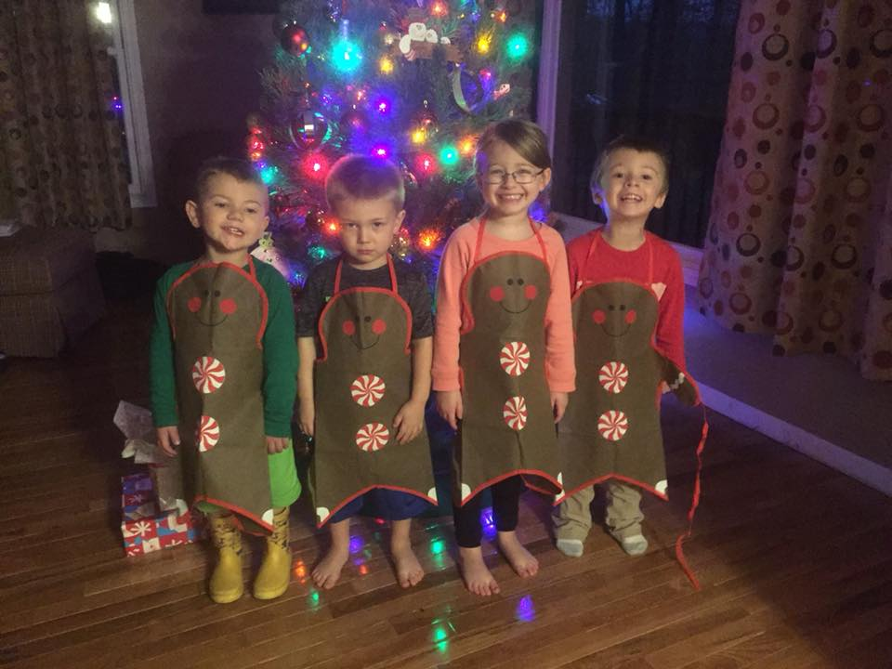
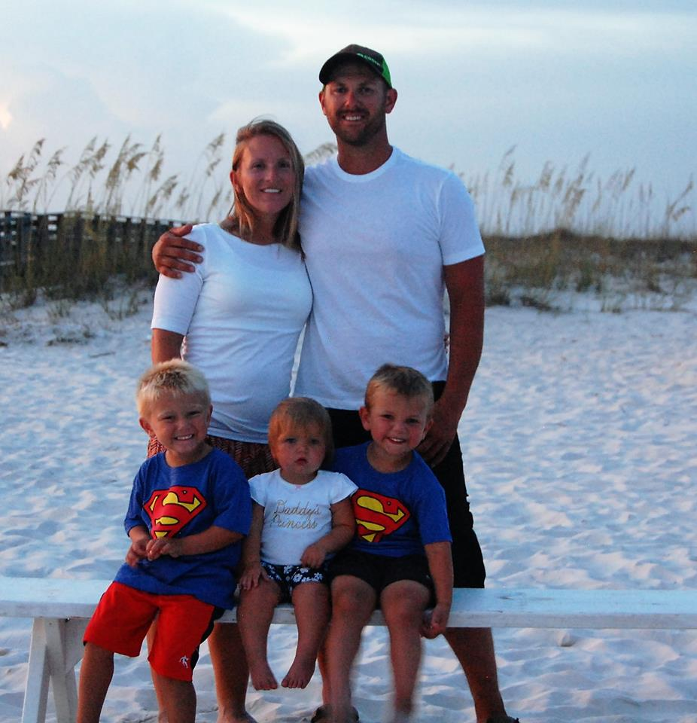
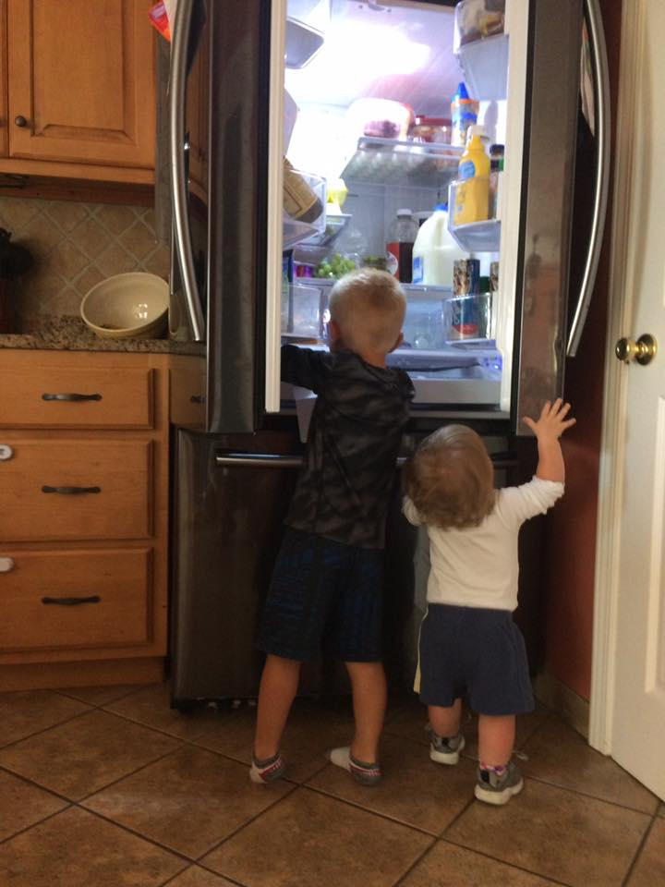
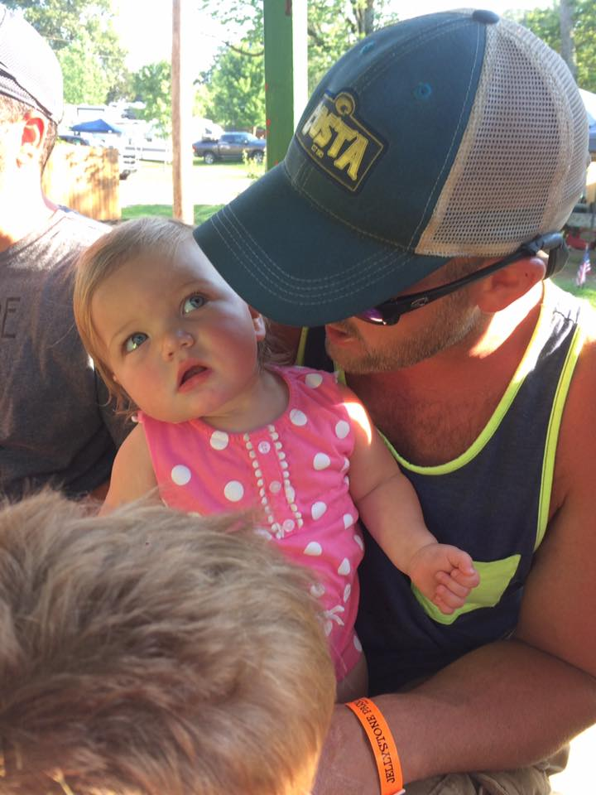
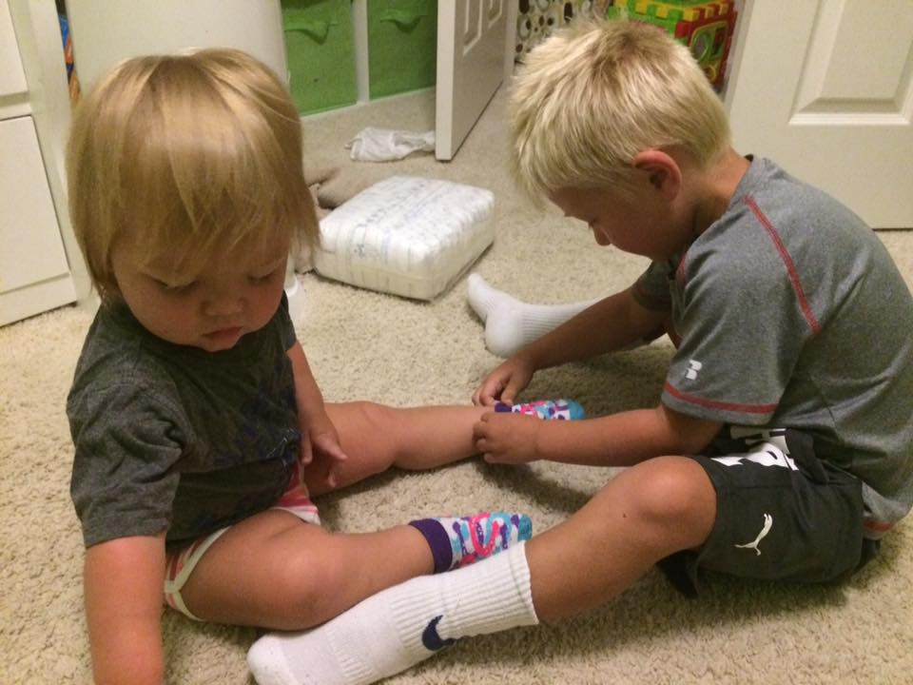
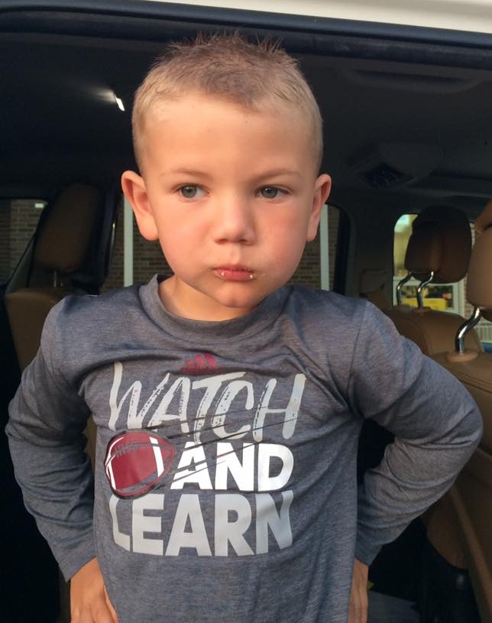

Slide 3
Future Business Leaders of America (FBLA)
All business students are encouraged to join FBLA
FBLA-PBL is the largest business career student organization in the world
The high school division has 215,000 members
The NBHS chapter had 50 members last year and participated in the following:
Reality Store
Leadership Night with Nashville Predators
American Red Cross blood drives
Regional Leadership Conference
State Leadership Conference

Slide 4
Community Service
Reality Store
Pink Ribbons
Candy Stockings to support Santa’s Helpers

Slide 5
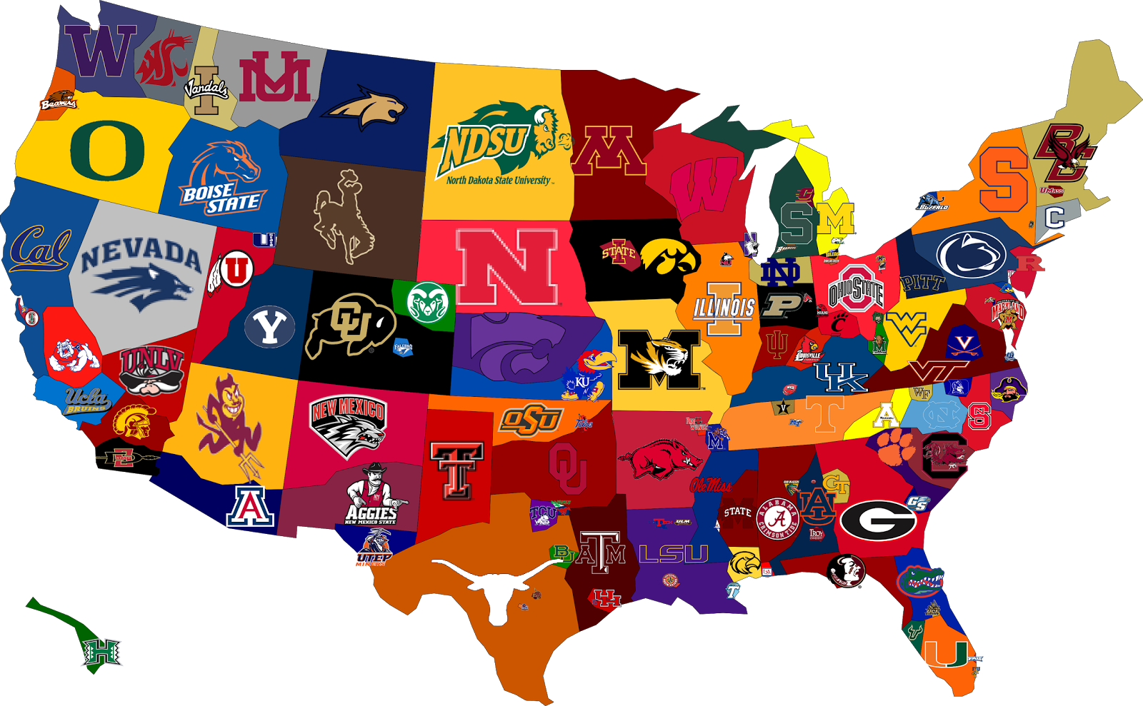
COLLEGE READY
CAREER READY
ACT
English – 18
Mathematics – 19
Reading – 20
Examples are (but not limited to):
Servsafe
CNA –Certified Nursing Aide
NCCER – Carpentry
AWS – Welding
CCNA – Cisco Networking
Adobe Certified Expert
PrintEd / Skills USA – Graphic Communications
MOS – Microsoft Office Specialist
MNA – Medicaid Nurse Aide
KY Food Handlers
Commonwealth Child Care
END OF PATHWAY (KOSSA)
Adobe Certified Associate (Dreamweaver, Photoshop, Flash)
NATE / ASE - Automotive

Slide 6
WARNING!
If a student waits until their junior or senior year to make plans, they could be in serious jeopardy of not graduating!

Slide 7
Business Majors
Courses Offered
Digital Literacy
Accounting
Multimedia Publishing
Adv. Multimedia Publishing
Adv. Computer Applications Co-op
Sports and Event Marketing
Principles of Marketing
Business Management
Advanced Marketing

Slide 8
Administrative Support
Required Courses
Digital Literacy
Principles of Marketing
Accounting or Financial Literacy
Business Management
Microsoft Office or Co-op
Exams/Industry Certifications
KOSSA- Administrative Support
Microsoft Office Specialist (MOS) and ASK Exam

Slide 9
Ecommerce
Required Courses
Digital Literacy
Principles of Marketing
Accounting or Financial Literacy
Business Management
Microsoft Office or Co-op
Exams/Industry Certifications
Microsoft Office Specialist (MOS) and ASK exam
Adobe Certified Associate
End of Pathway (KOSSA) (Marketing)

Slide 10
MARKETING
Required Courses
Digital Literacy
Principles of Marketing
Accounting or Financial Literacy
Entrepreneurship
Advanced Marketing
Retail Marketing
Exams/Industry Certifications
KOSSA- Marketing or ASK for Business or Marketing

Slide 11
Management & Entrepreneurship
Required Courses
Digital Literacy
Principles of Marketing
Accounting or Financial Literacy
Business Management
Entrepreneurship
Exams/Industry Certifications
End of Pathway – Business Management
Assessment of Skills and Knowledge for Business (ASK)- Business Management

