Slide 1
Strike 10 bowling
Slogan- Roll on in.
Andrew Ellison

Slide 2
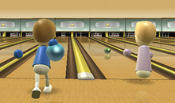
Print media
STRIKE 10 BOWLING
ROLL ON IN!!!

Slide 3
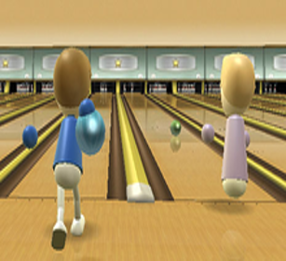
Print media
STRIKE 10 BOWLING
OPEN ALL NIGHT!!!

Slide 4
Online
STRIKE 10 BOWLING

Slide 5
Specialty media
STRIKE 10 BOWLING
Hosting a $100 giveaway for everyone who plays a game, drawings will be on Dec. 6th

Slide 6
Broadcast media
STRIKE 10 BOWLING is the best!

Slide 7
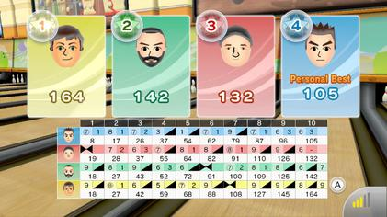
Sales promotion
BUY ONE GAME GET THE NEXT FOR FREE!!!

Slide 8
Sales promotion
COMPETITION: WINNER EARNS $1K PRIZE!!!

Slide 9
Sales promotion
BOWLING AVE
STRIKE10BOWLING.COM

Slide 10
Direct marketing
Postcard
STRIKE 10 BOWLING
STRIKE 10 BOWLING

Slide 11
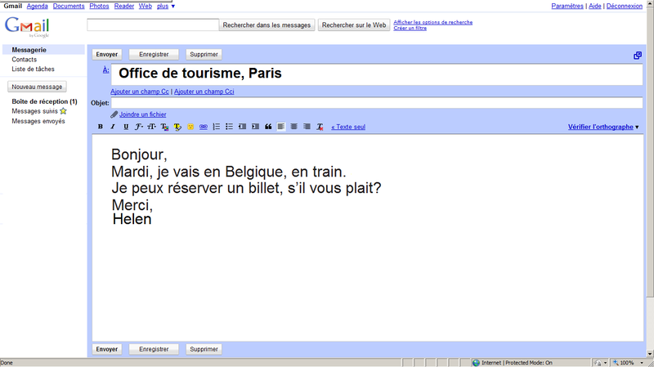
Direct marketing
STRIKE 10 BOWLING
Come out and bowl a game at the best bowling alley around!

Slide 12
Personal selling
This is STRIKE 10 BOWLING how may I help you?
I would like to know how much it is for a game?
STRIKE 10 BOWLING

Slide 13
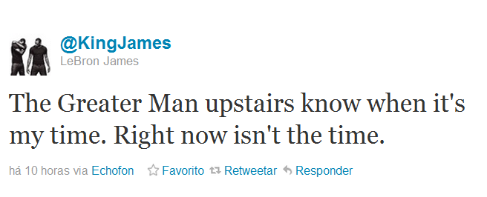
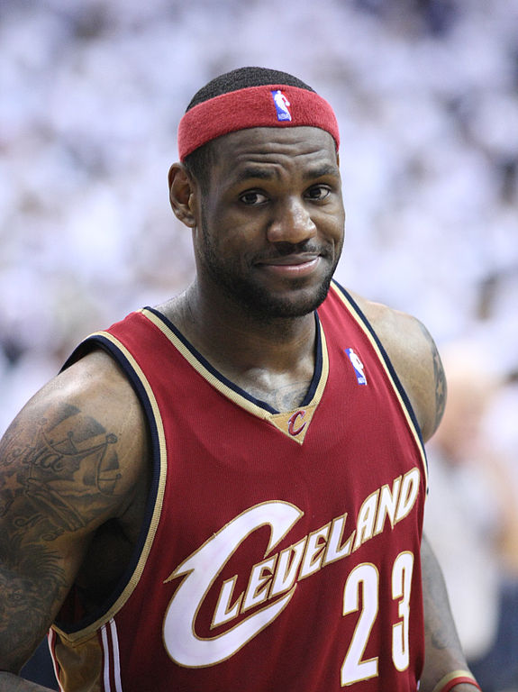
Publicity
g
Strike 10 bowling is the best!

Slide 14
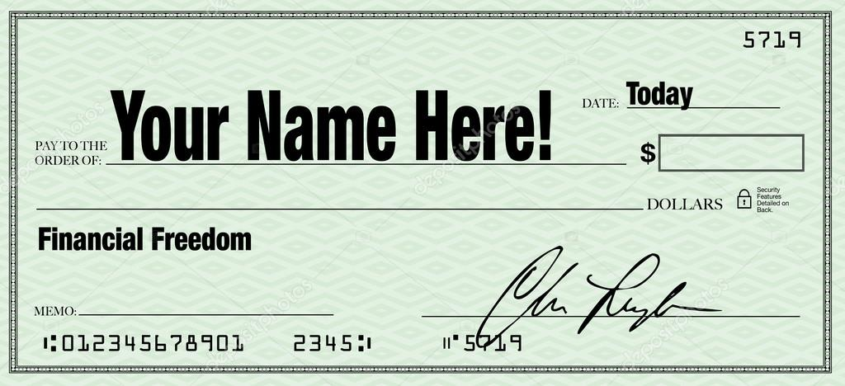
Public relations
STRIKE 10 BOWLING
STRIKE 10 BOWLING
1000---
Childrens Charity

