Slide 1
Innocent candles
Calming for the soul

Slide 2
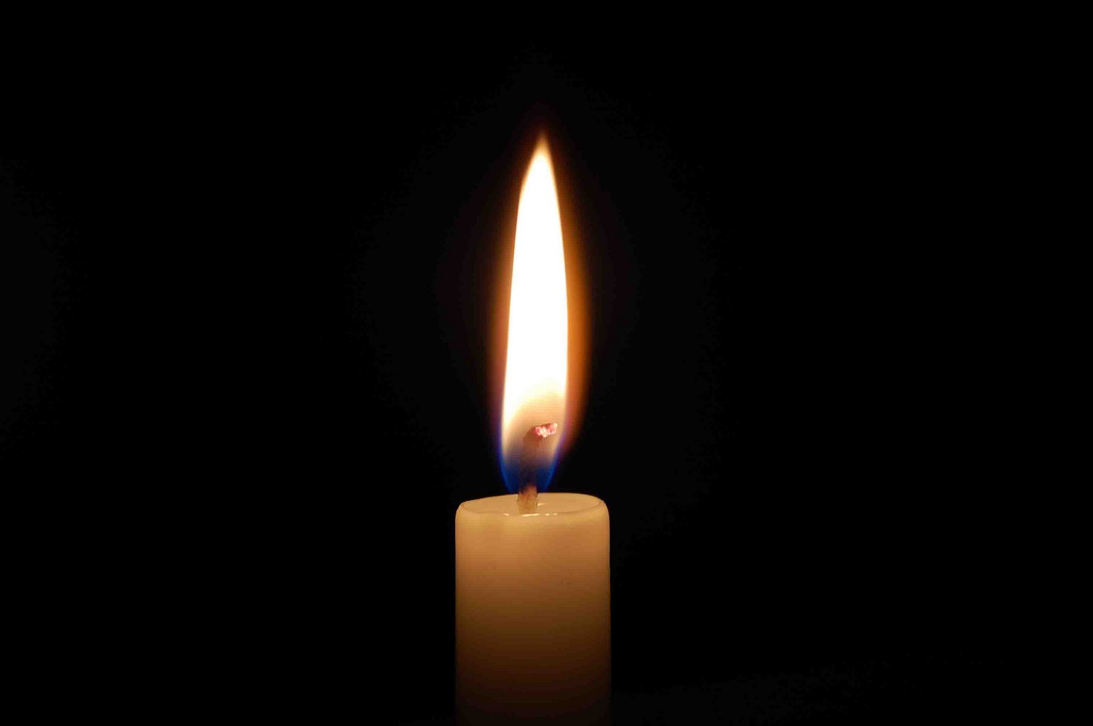
Advertising Print Media
Innocent candles located at 178 candles lane. GET 10% OFF
For a limited time only
Now 10% off all candles at the Innocent Candle
Come down to 178 candle lane to get your discounted candles
today!!
Only for a limited time

Slide 3
Online
Now and for a limited time at Innocent candles located at 178 candles
lane

Slide 4
Specialty Media
Innocent Candles

Slide 5
Broadcast Media
Go down to the Innocent Candle to get your candles at 10% off at 178 candles lane
Go down to innocent candles at 178 candles lane to get your candles 10% off

Slide 6
personal selling
Hello this is Jamie at Innocent Candles how may I help you?

Slide 7
Publicity
OMG!!! Have you guys been to Innocent Candles Yet they sell really good smelling candles at a low price and for the holiday season its 10% off EVERYTHING

Slide 8
Public Relations
Pure Integrity Innocent Candles are scented above & beyond your best scented candles! Our candles burn clean and even from top to bottom! Our innocent candles are made with a proprietary 100% all natural stabilized innocent wax. What really sets our Innocent Candles apart from other candles is our strong and healthy fragrances. Our "Innovative Fragrance Technology" uses a unique 7 Step Pouring Process, the latest innovation in candle making!

Slide 9
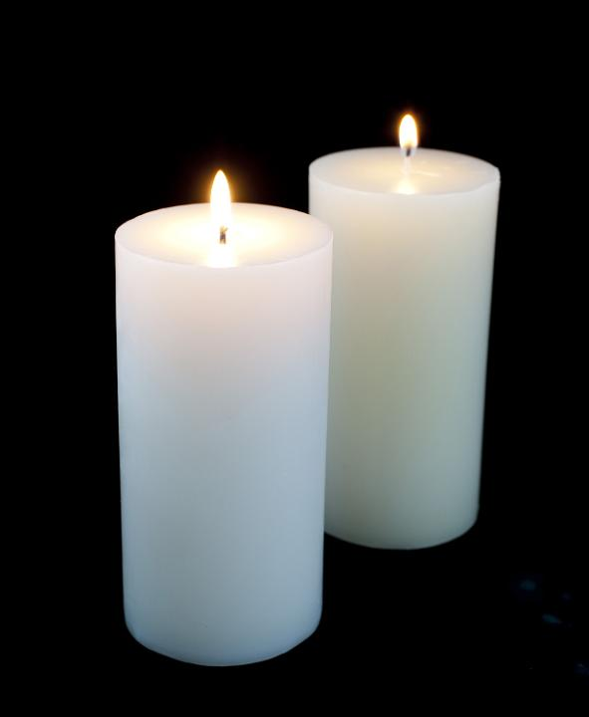
Sales Promotion
Innocent
Candles
i
Thank you for your loyalty with the Innocent Candle this card is to represent your loyalty toward us

Slide 10
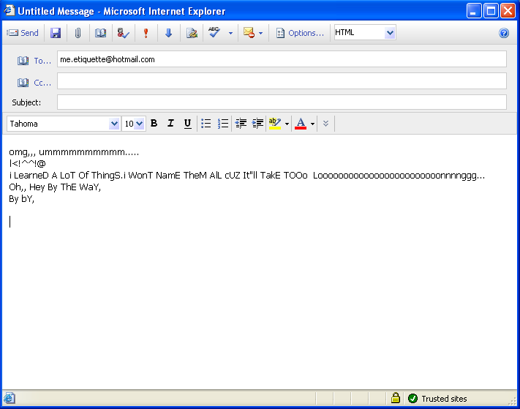
Direct Marketing
Worker
Hello this is the Innocent Candle I was letting you know that we have a sell going on here at our store at 10% off your purchase of any candle. Hope to see you here
Customer

