Slide 1
Print Media
Foot Works
W
F
Made just how you imagined.
Shoes, its that easy!

Slide 2
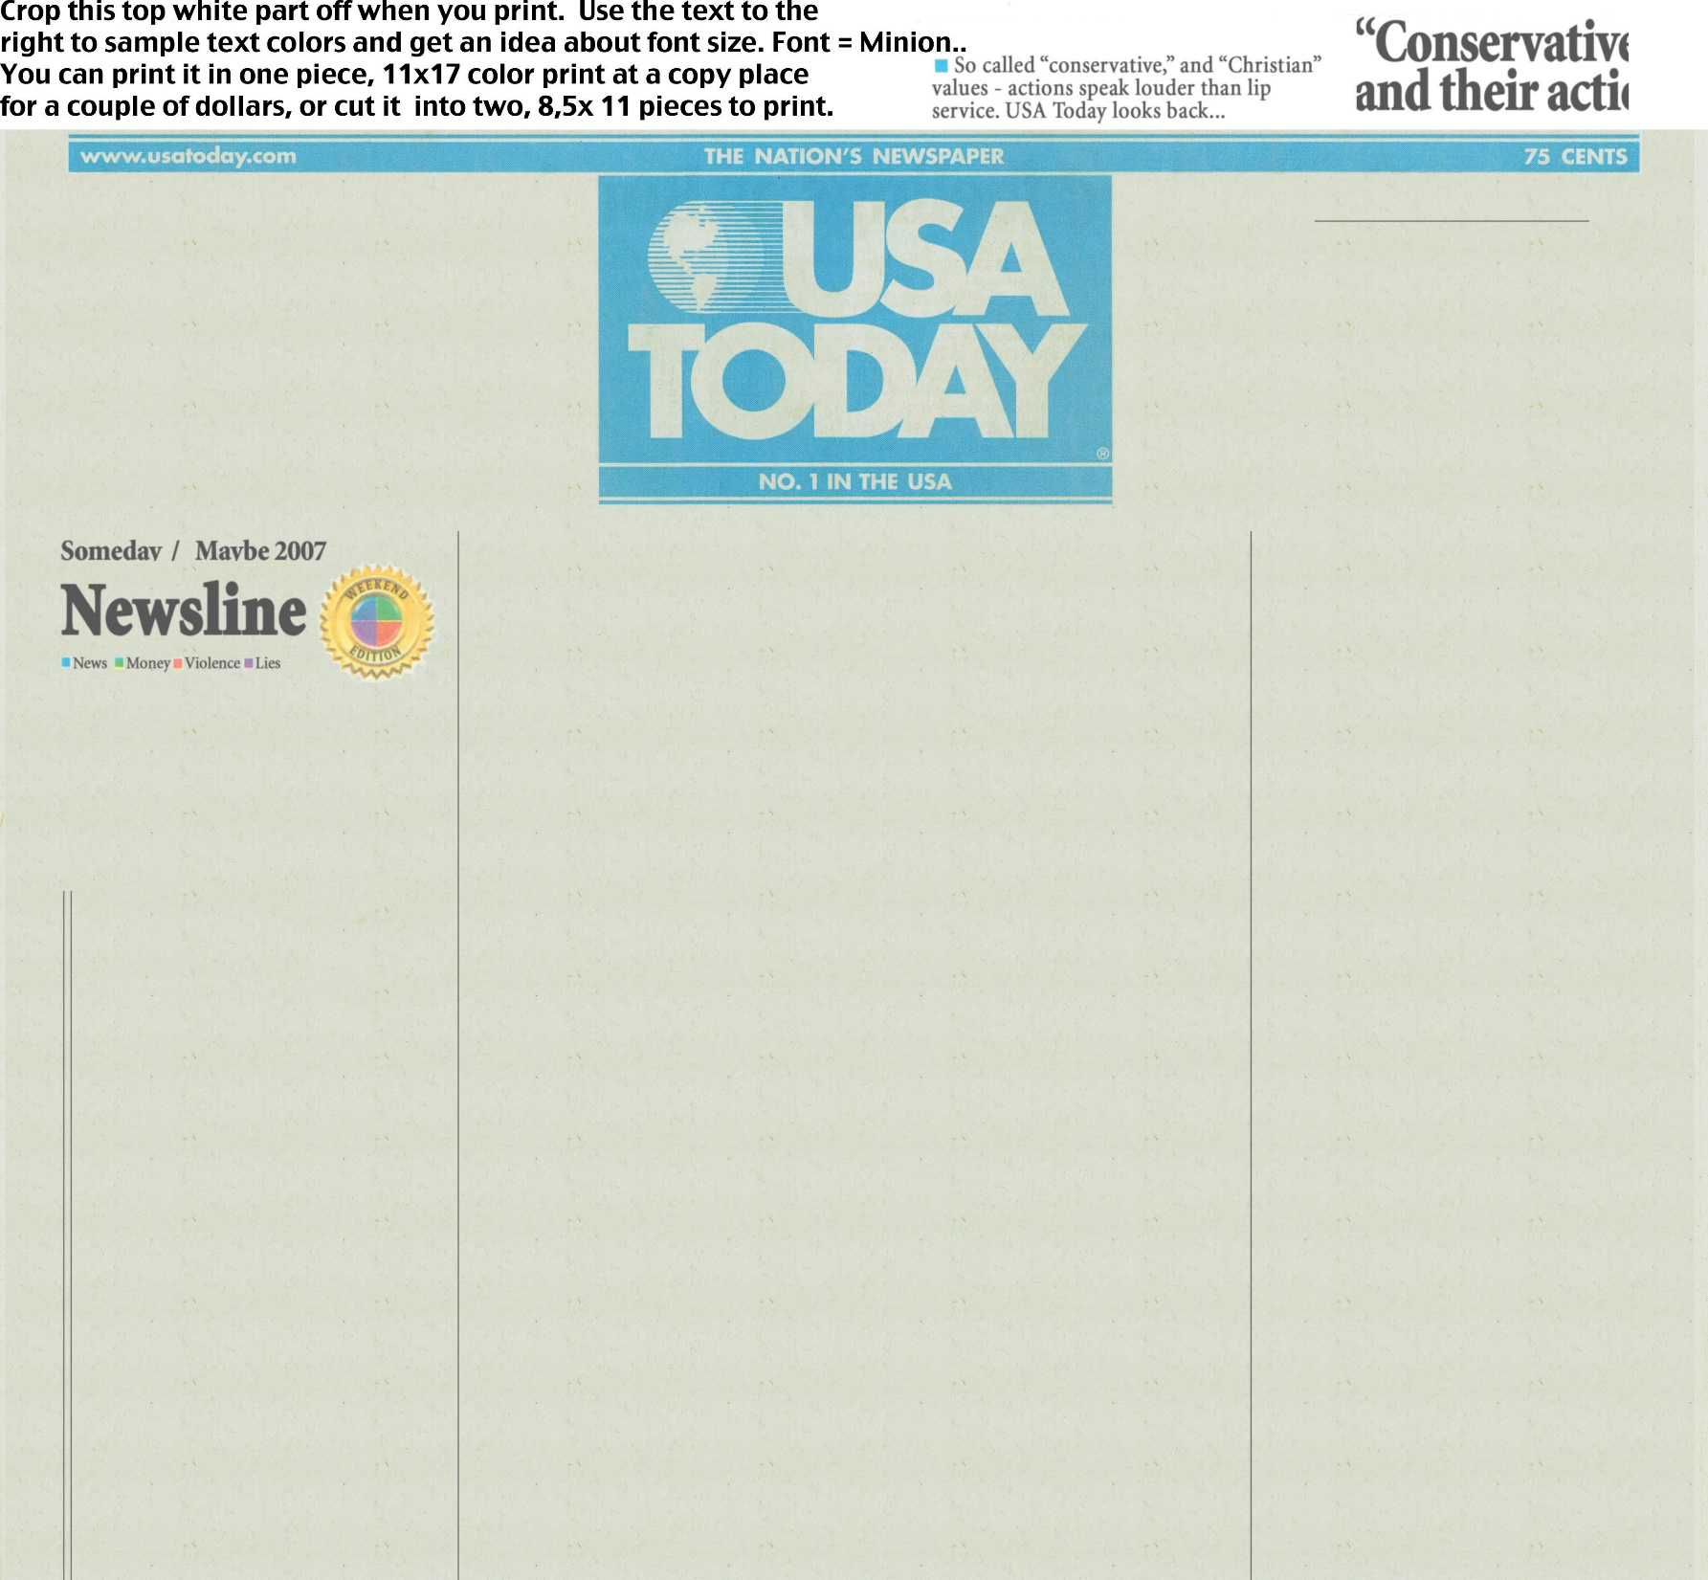
Print Media
“I cant wait to use my new cleats this season, It will be an honor to play and his cleats and all the work he put into them.”
This is a new start for his business and I am really excited to see how it all comes out for him.
W
FootWorks
F
The business “FootWorks” just opened today and the business is just ran by 1 man. He says “I already have 3 NFL players wanting me to make them a new pair of cleats and I couldn’t be more than happy to do that for them.
One of the players is Johnny Manziel and he is excited to see the finish product of his new cleats and says
Footwork's
Leg works is doing a 50% off from now to December 10th. Don’t miss this opportunity.

Slide 3
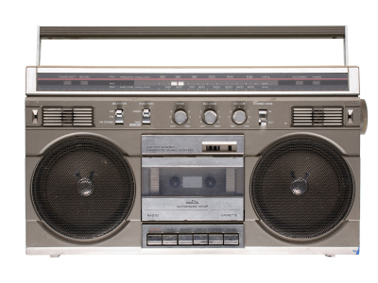
Broadcast Media
Order from our website today and get 25% off your order!

Slide 4
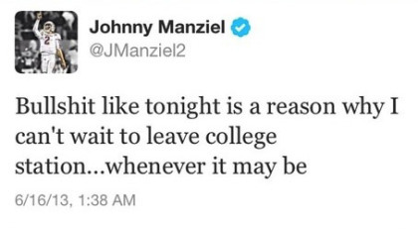
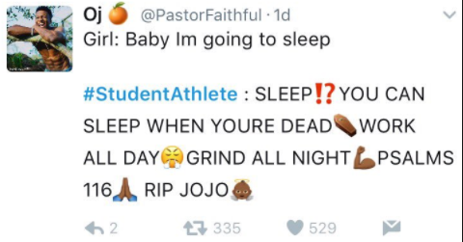
Publicity
Just asked the owner of @FootWorks to build me a new pair of cleats for this upcoming season. Cant wait to see the finished product! Big shout out to @FootWorks for doing this for me! #Blessed

Slide 5
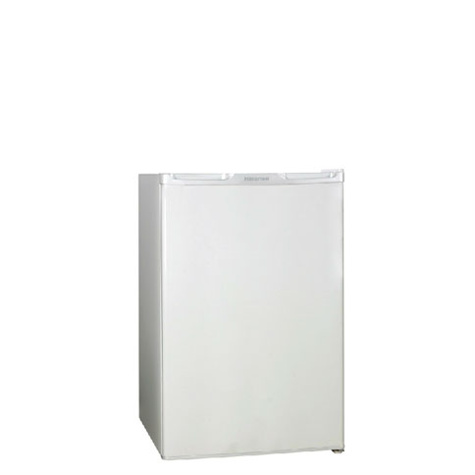
Specialty Media
F
W
FootWorks
Shoes, Its that easy

Slide 6
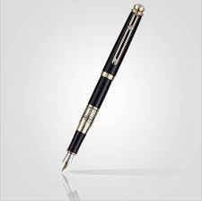
Specialty Advertising
Footwork's

Slide 7
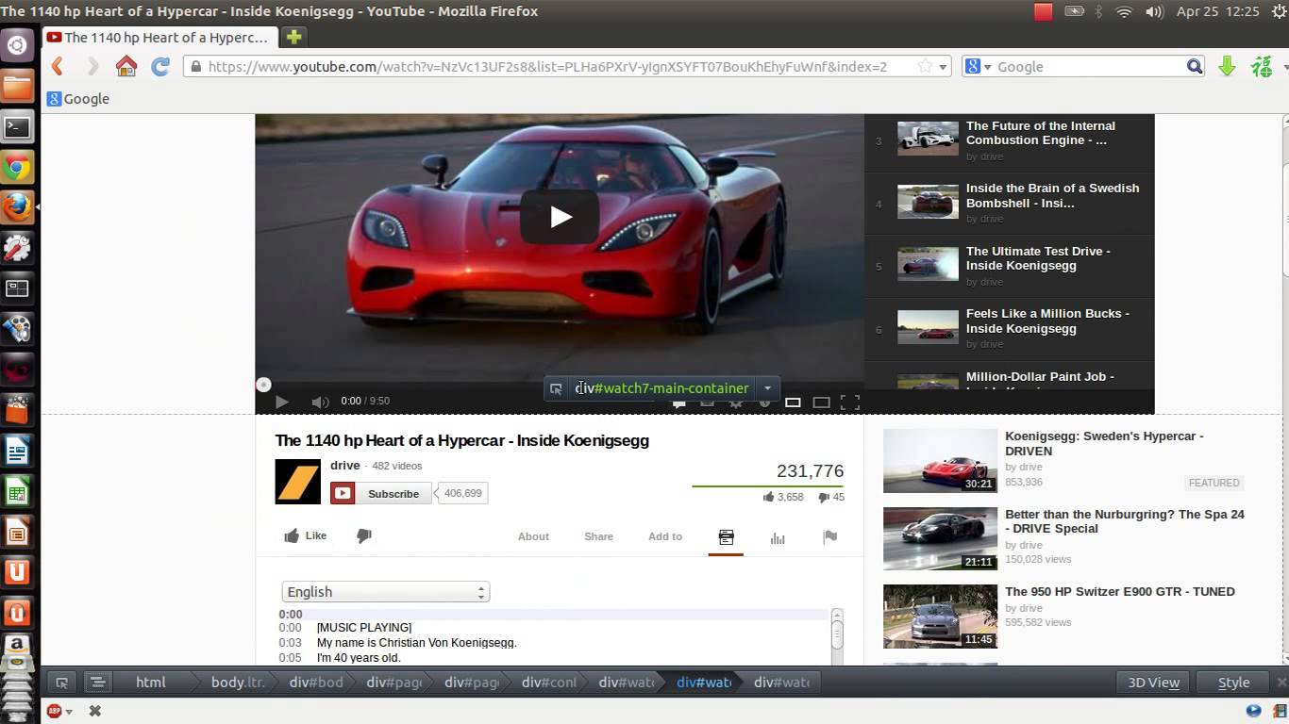
Online
Click here for 50% off your next order at footwork's!

Slide 8
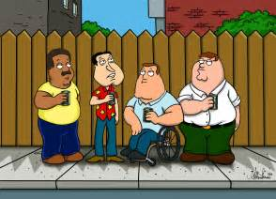
Sales Promotion
Foot Works
F
Made just how you imagined.
W
Shoes, its that easy!

Slide 9
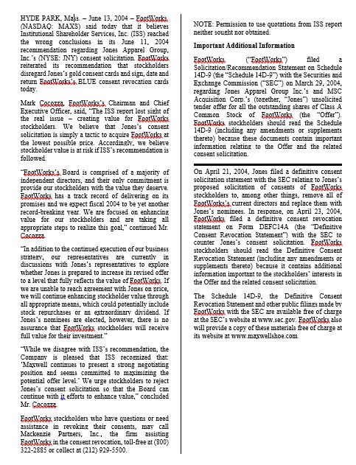
Public Relations

Slide 10
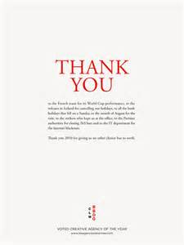
Direct Marketing
Thank you from purchasing from our website. We hope you enjoy your new shoes! Make sure to come back and check out our deals! -Footwork's

Slide 11
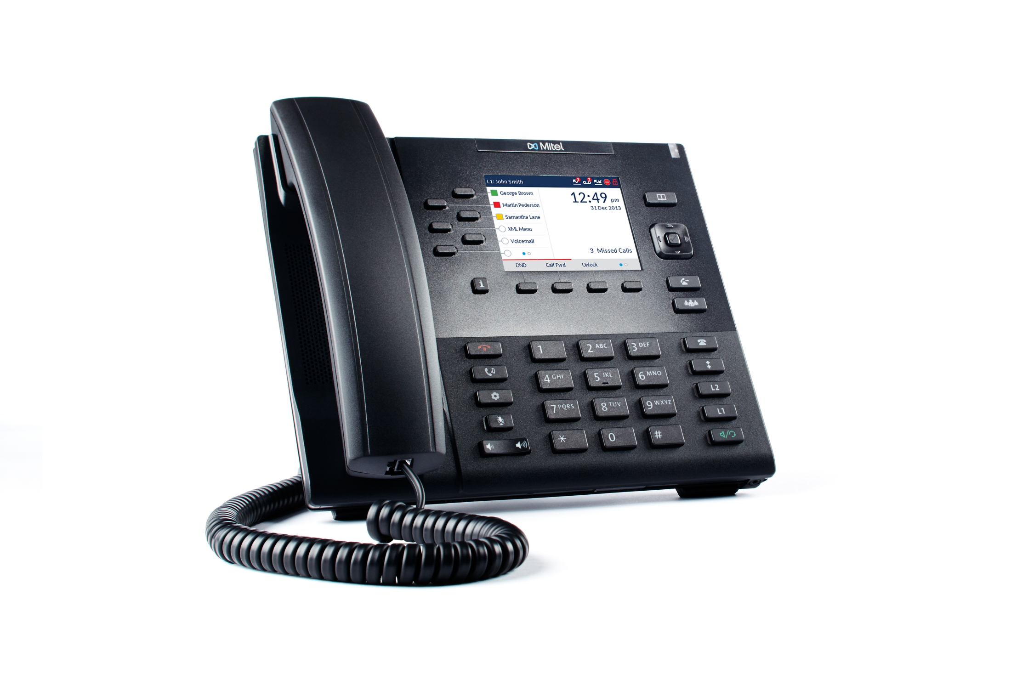
Personal Selling
This is Footwork's, What can I help you with today?

Slide 12
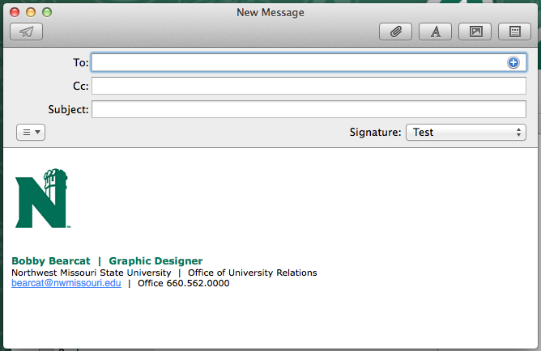
Direct Marketing
Johnny.Manziel@outlook.com
Don’t forget on our new sale starting this weekend through the 13th. 75% Off your order if you spend more than $200 through the 13th!

Slide 13
Sales Promotion
Footwork's
Shoes, its that easy
RewardsCard
223-5669-233-65

