Slide 1
The Global Marketplace
Eagle Challenge
7minutes
Learning Target:
Describe ways competition affects business decisions
Standard OA10

Slide 2
International Trade LT: The benefits of international trade

Slide 3
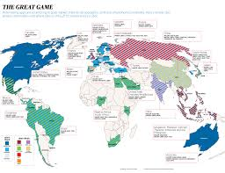
Global vs Domestic
Within your home nation (one country)
Multiple Countries

Slide 4
International Trade
Involves the exchange of goods and services between nations.
Imports are goods and services purchased from other countries
Exports are goods and services sold to other countries.

Slide 5
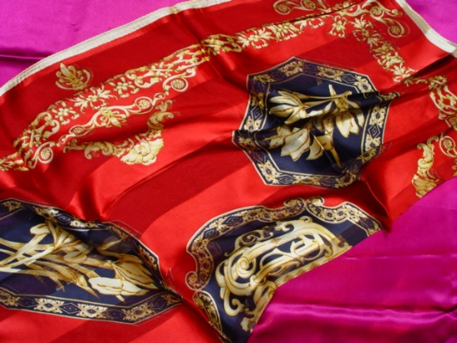
Absolute Advantage
When a country has a natural resource or ability that allow it to produce a product at the lowest cost possible.
Example: China produces nearly 80% of all silk.
Trade is still valuable even when absolute advantage does not exist.

Slide 6
Comparative Advantage
The value that a nation gains by selling the goods that it produces most efficiently.
Examples: High tech equipment and goods may be produced in the U.S. or Japan.
Products that are labor intensive may be produced in emerging nations giving them a comparative advantage.

Slide 7
Balance of Trade
The difference in value between exports and imports of a nation
Trade Deficit – importing more than exporting
Trade Surplus – exporting more than importing

Slide 8
Licensing
Involves letting another company (licensee) use a trademark, patent, special formula, company name, or some other intellectual property for a fee or royalty
With licensing, a foreign company make the product using the info or guidelines provided by the licensor.
If the product is a success in the foreign country, the licensor has gained entry with minimal risk.

Slide 9
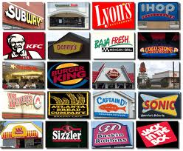
Franchising
A special type of licensing.
In a franchise agreement, a franchisor grants the franchisee the rights to operate under the company name.

Slide 10
Types of Businesses
Size and Scope
Large vs. Small – size – small businesses have less than 100 employees, large more.
Domestic vs. Global – domestic market is a single country, global is among nations.

Slide 11
Types of Businesses
Purpose
Profit (Microsoft, McDonald’s) vs. Nonprofit (YMCA, Boys/Girls Clubs of America)
Public (government services) vs. Private
Public organizations provide a non-profit service or are associated with the government.

