Slide 1
Chedwins sporting goods
@123 bigwood way

Slide 2
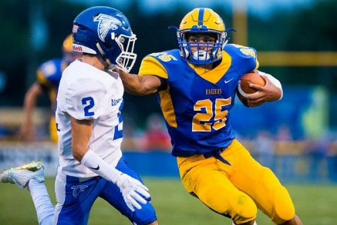
Advertisement
High schools player of the week
With the right equipment any thing is possible .Congrats on David Peterson for being the player of the week @Christian academy high

Slide 3
Advertisement/specialty media
Chedwins sporting goods

Slide 4
Online advertisement
Chedwins sporting goods

Slide 5
Print media
Chedwins sporting goods

Slide 6
1.Broadcast media
Chad sporting good is have a buy one get one sell. Just come on down @142 big wooded way

Slide 7
Sales promotion, sponsorship
Chedwins
Sporting goods

Slide 8
Public relation
Chedwins sporting goods is have a committee cook out if you live in the metro booming you can get your equipment free if your son/daughter play a sport we can get what you need !!!! But limited time offer

Slide 9
Direct
Chedwins sporting goods
Hi there !!. I am from Chedwins sporting and good and just wanted to tell you about are summer sport sell that have soccer, football, tennis, basketball etc. , They all are on sell . Or go online use the cod sells for 27% of your order
402287
324 big wooded

Slide 10
Personal selling
Hay sir did you know Chedwins sport is have a sell and their sell is 50% percent off this is the best time to get the right equipment for your sun/daughter

Slide 11
publicity
“I went to Chedwins sporting goods on Monday to buy my son basketball shoes. and I would say it was one of the best place I have seen ,but the basketball court !!!
I would say if you every need sport equipment go there for sure”

