Slide 1
The stellar cafe
Its out of this world
By: Chloe Trundy

Slide 2
Specialty media
The
Stellar
Cafe
THE STELLAR
CAFE
Stellar cafe

Slide 3
Print Media
K
Open mon.-sat. closed sun.
The stellar cafe

Slide 4
Print media
The Stellar Café
456 East Star Street

Slide 5
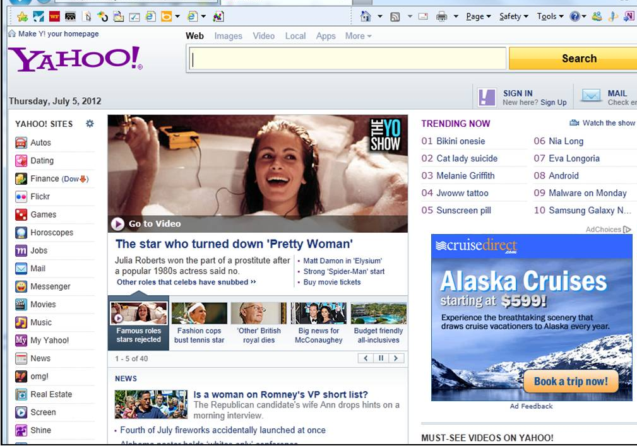
Online
HOLIDAY DISCOUNT
THE STELLAR CAFÉ
UO TO 30% OFF OF EVERY BAKED GOOD
PURCHASE

Slide 6
Sales promotion
20% OFF
The stellar
café
The stellar
café
j
Coupon is not valid past Jan. 12 2018

Slide 7
Broadcast Media
Where can you find marvelous coffee, tea and
pastries that are out of this world? Just around
east star street, the stellar café serves desserts
just like your grandma used to make and coffee
made to perfection. swing by soon for holiday
deals and download our app “the stellar café”
for more deals and coupons.

Slide 8
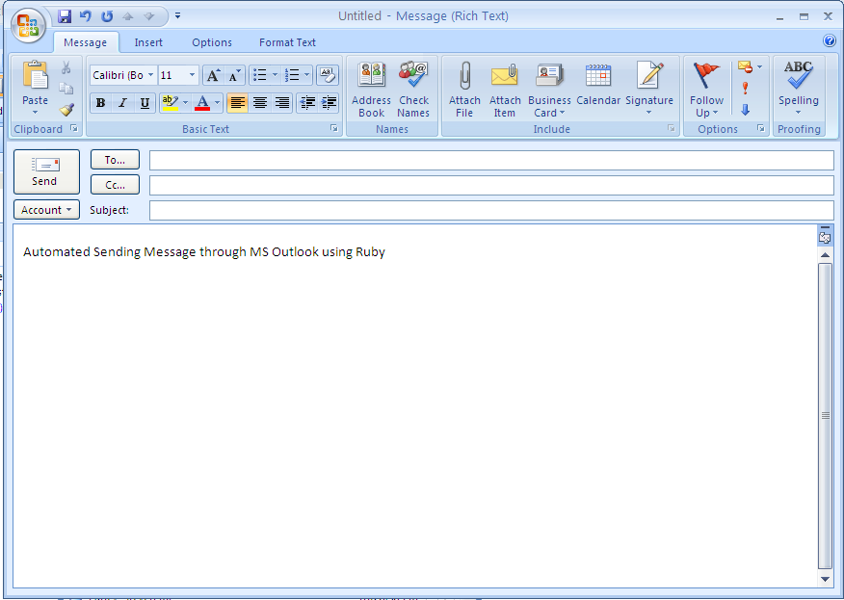
DIRECT MARKETING
Don’t miss out on our holiday deals up to 20% off on all baked good items
The Stellar Café
Dec. 10 – Dec. 21

Slide 9
direct marketing

Slide 10
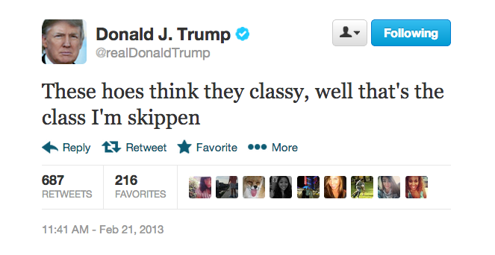
PUBLICITY
L
The Stellar Café is fantastic

Slide 11
PERSONAL SELLING
Hello, welcome to the stellar café , all of our pastry
items are currently 20% off and with any purchase
you may receive a free sample of our new coffee.
However the sale on our pastries end tonight at
8:30

Slide 12
PUBLIC RELATIONS
Louisville, Ky., Dec. 19, 2017 – The stellar cafe, America's largest fast casual cafe chain, announced today the opening of its newest franchised restaurant in Warner Robins, Georgia, marking the company's 4th location in the states. Located at 762 Highway 96, the restaurant will celebrate its grand opening with a VIP event on Dec. 26, starting with a ribbon cutting ceremony at 10 a.m. During the ribbon cutting, the restaurant will proudly make a donation to the Alzheimer's Association of Middle Georgia. The restaurant will be open to the public on Dec. 27 at 10:30 a.m. EDT.
The new restaurant is owned and operated by Allen Peake and Mike Chumbley, of C&P Restaurant Company, who currently have one location in Macon, Georgia. As former the stellar cafe franchisees in the 1990's, the pair was eager to re-join the brand under the leadership of Carl Howard. Having been franchisees of various concepts, Peake and Chumbley have a unique perspective of what works and what doesn't. They consider the key ingredient to franchise success is believing in the franchisor and the concept.
"As veterans of the foodservice industry, Mike and I were thrilled to be re-joining the stellar cafe family. We truly believe in the stellar cafe menu and are excited about the direction the company is heading under its new leadership," said Allen Peake, the stellar cafe franchisee. " , the stellar café is uniquely positioned in the fast casual arena, and we know that Warner Robins' residents will love our approach to serving quick, affordable food."
The expansion in Georgia is part of the brand's overall franchise development plans for this year, with a goal of opening three additional restaurants by the end of 2016. This announcement comes on the heels of significant growth for the stellar cafe, including 13 consecutive quarters of same-store sales growth – with franchisees boasting a 5.1 percent year-over-year same-store sales increase in July. In addition, the stellar cafe franchisees are experiencing nearly three times the industry average growth rate, with new franchised restaurants setting company-wide records. In fact, Peake and Chumbley's Macon, Georgia restaurant celebrated a record-breaking grand opening week with more than $80,000 in sales.
With nearly 220 restaurants in 24 states, the stellar cafe is America's largest café casual chain, serving freshly prepared entrees, Submarinos® sandwiches, salads and pizza. The stellar cafe franchisees are experiencing record sales growth, and the company is currently seeking single- and multi-unit operators to join the brand's rapid expansion. For more information about franchise opportunities, connect with the stellar cafe online at www.stellarcafe.com, www.ownastellarcafe.com, @thestellarcafe, and https://www.facebook.com/stellarcafe.
About the stellar café
With approximately 220 restaurants, the stellar cafe is America's largest cafe-casual chain, serving freshly prepared entrees, Submarinos® sandwiches, salads and pizza. One of the New York Post's five breakout fast-casual restaurants and a Fast Casual.com Brand of the Year, the stellar cafe franchisees are experiencing record sales growth. Visit www.ownafazolis.com for details on development opportunities

