Slide 1
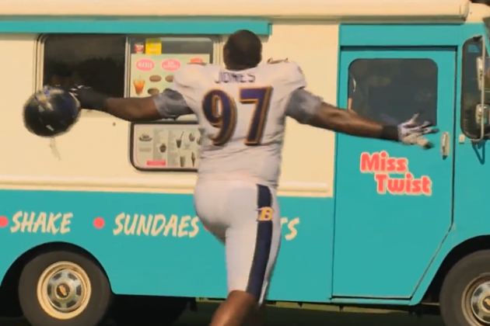
Ice
Burger

Slide 2
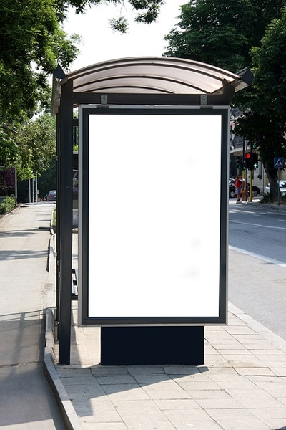
Ice Burger

Slide 3
Ice Burger

Slide 4
Ice Berger

Slide 5
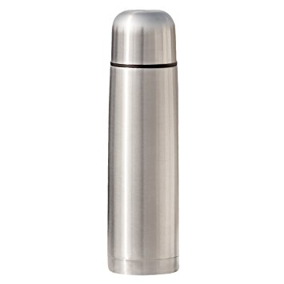
Ice Burger

Slide 6
Ice Burger
Ice Burger
Ice Burger

Slide 7
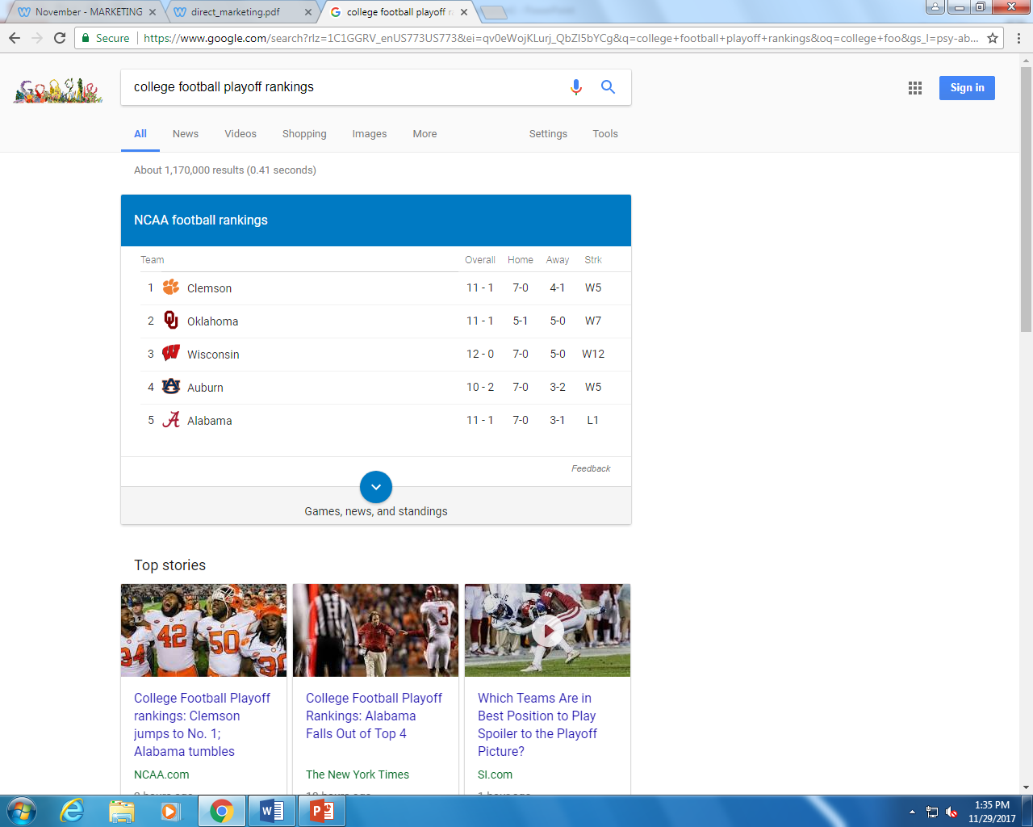
Ice Burger

Slide 8
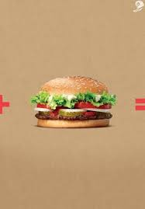
Ice Burger

Slide 9
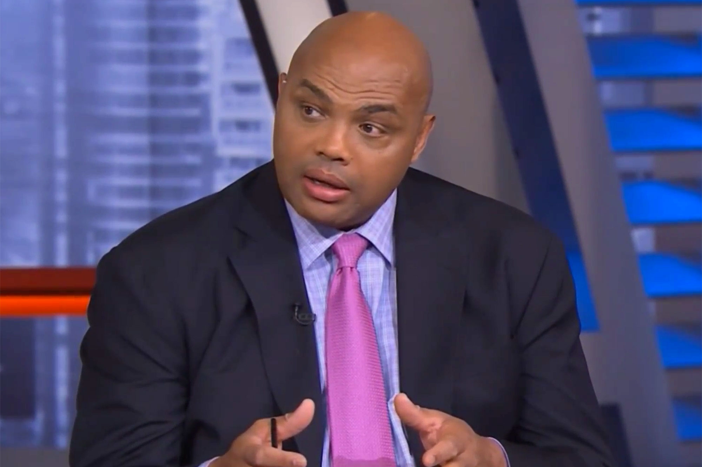
I ate at Ice Burger last night, and that was the best burger I’ve had in a while.

Slide 10
Greeting Script
Welcome to Ice Burger, my name is _______ and I will be taking your order today. Would you like to try our new Ice Cream Burger?

Slide 11
Ice Burger
Open 24 hours, 7 days a week
1252 Ice Way, Louisville, Kentucky

Slide 12
Philadelphia – December 18, 2016 – Philadelphia Eagles Pro Bowl Safety and former New Orleans Saints/Super Bowl Champion Malcolm Jenkins and The Ice Burger Foundation (TBIF) made the holidays brighter for New Orleans area families by providing holiday meal baskets for 135 Philadelphia families at the Foundation’s sixth annual ‘Holiday Dinner Basket Surprise’ on Saturday, December 17th in collaboration with College Track New Orleans and TMJF Project R.E.W.A.R.D.S. students. In keeping with the jersey number (27) that Jenkins wears on the field, The Ice Burger Foundation selected 27 local community organizations to serve as partners in identifying five (5) families from within the community their organization serves, in need of a festive blessing. Each partnering organization picked up the festive gifts during the event, and delivered them to their chosen families. The event took place at College Track New Orleans, hosted in partnership with TMJF’s Project R.E.W.A.R.D.S. Since 2012, in collaboration with College Track New Orleans, the Foundation offers a five-tiered life skills curriculum program for approximately 200 students in grades 9-12 emphasizing self-confidence, health and wellness, strategic thinking, leadership development and mentoring. Students meet weekly on Fridays for two hour increments and are offered guest speakers on a regular basis in addition to educational counseling and tutoring. College bound seniors who complete the program are eligible for scholarships, granted by The Ice Burger Foundation. As part of the Project R.E.W.A.R.D.S program, students volunteered their time to help pack the baskets for Holiday Dinner Basket Surprise. The collaboration underscores the spirit of giving during the holidays, and the importance of “giving back” to underserved communities in New Orleans. “When I think of the holidays, I think of family and getting together around the table for a special meal,” said Jenkins. “Not everyone has that luxury. Six years ago, we started the tradition of Holiday Dinner Basket Surprise to provide families in underserved communities in the New Orleans area with turkeys, stuffing, everything for a holiday meal. It was important to me to continue this tradition in New Orleans in addition to Philadelphia where I now play in the NFL, as the Louisiana community still holds a special place in my heart.” The Ice Burger Foundation’s Holiday Dinner Basket Surprise has served more than 800 families since 2011. Striving to make an impact in every city in which Jenkins has lived, worked, and played, the effort expanded from New Orleans to Philadelphia in 2015. Covering two cities, this year’s effort will feed a total of 275 families across the Greater New Orleans and Greater Philadelphia.

Slide 13
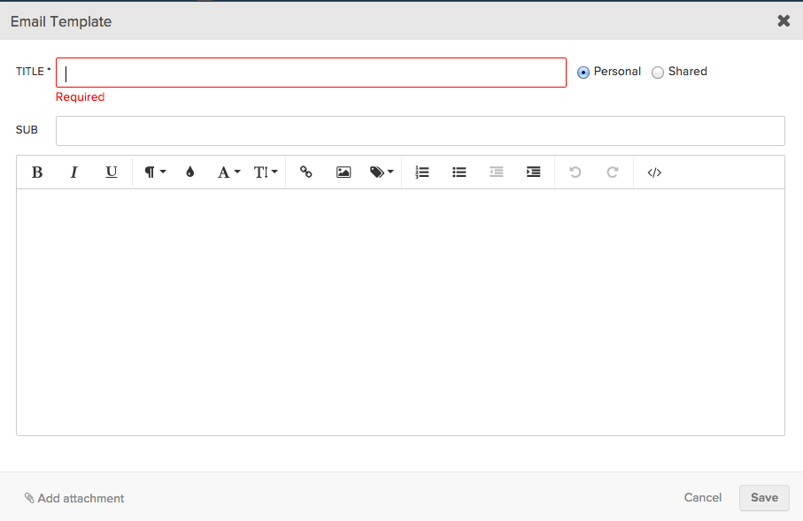
Visit Ice Burger today!
Ice Burger
Open 24 hours, 7 days a week
1252 Ice Way, Louisville, Kentucky

