Slide 1
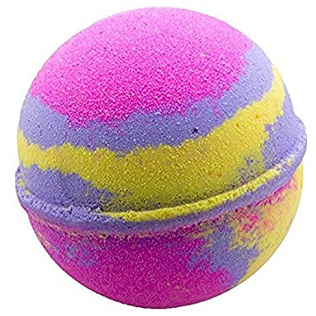
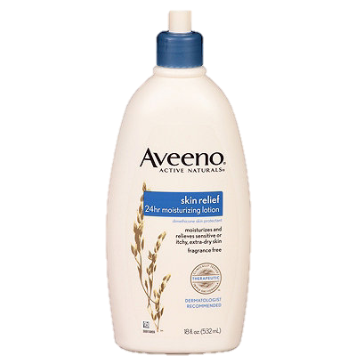
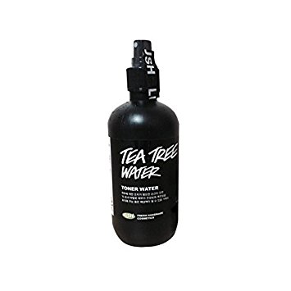
Snailmoo Cosmetics
Snailmoo
Snailmoo
Snailmoo
Founder – Cory Liner
Snailmoo
It plUmp.

Slide 2
Print Media
Snailmoo
Snailmoo

Slide 3
Sales Promotion
Snailmoo
Snailmoo
Snailmoo
Snailmoo
Snailmoo
Snailmoo
Snailmoo
Snailmoo

Slide 4
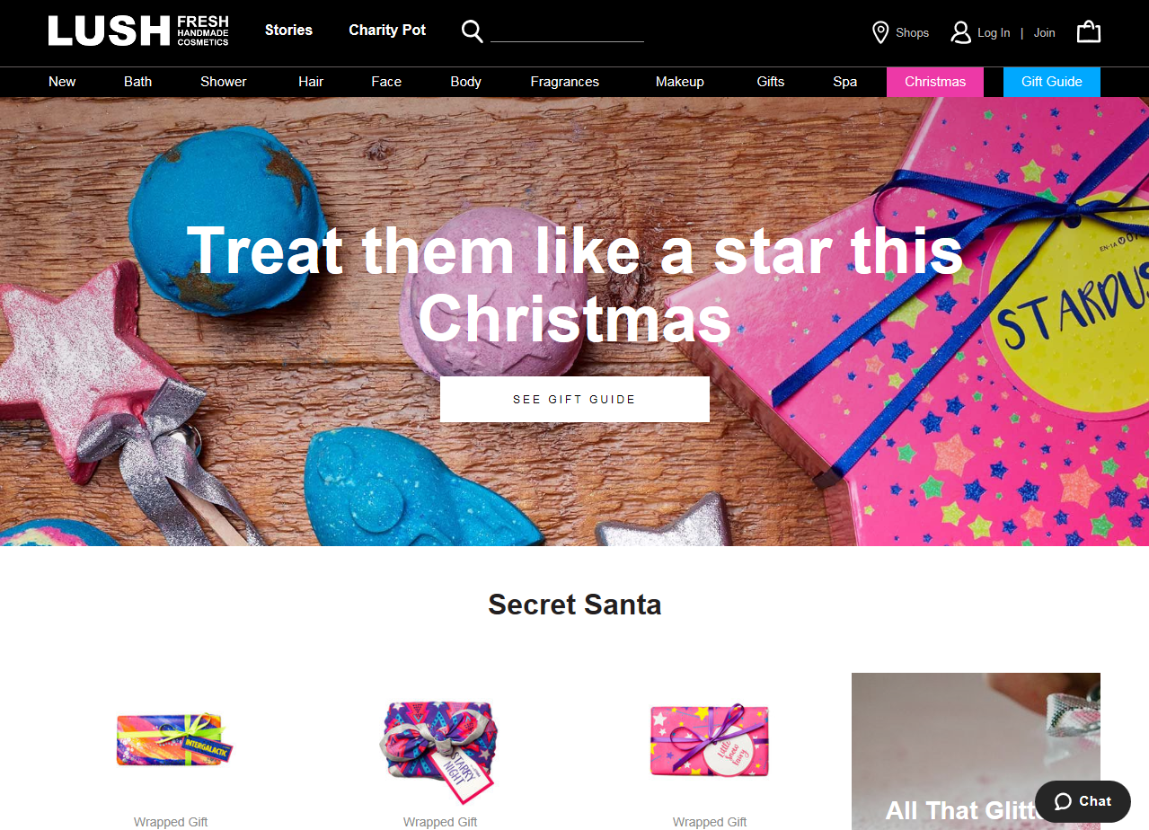
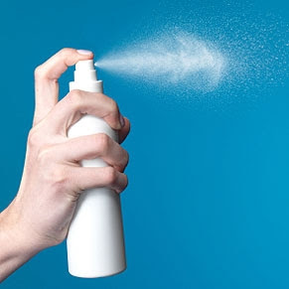
Online advertisement
it plUmp.
www.snailmoo.com

Slide 5
Specialty Media
www.snailmoo.com

Slide 6
Sales Promotion
Snailmoo
Snailmoo
Snailmoo

Slide 7
Publicity
had a great experience at snailmoo!
they have some dope hair products
that made my wig super “plump”!!

Slide 8
Radio Commercial
Is your hair flat? Do you wish the bags under your eyes would disappear? Well come on down to Snailmoo or visit www.snailmoo.com . We have everything you need from facemasks to hair products. Try our new Snailmoose to make that lifeless hair, big and plump. Stop by Snailmoo to start your year off correctly.

Slide 9
Snailmoo
Snailmoo
Direct Marketing
Snailmoo
Snailmoo
Snailmoo

Slide 10
Sales Promotion

Slide 11
“Hello I’m Sydney from Snailmoo cosmetics, could I take a moment of your time to inform you about our current sale?”

Slide 12
Public Relations
Snailmoo Cosmetics Adopt Record-Breaking 30,000 Pets During PetSmart Charities Most Successful National Adoption Weekend Ever.
PHOENIX – Sept. 21, 2017— Last weekend, Snailmoo Cosmetics welcomed 30,269 adoptable pets into their hearts and homes during PetSmart Charities’ third National Adoption Weekend of 2017 hosted at 1,500-plus PetSmart stores across the continent, making it the most successful National Adoption Weekend event ever for the leading funder of animal welfare and leading pet specialty retailer. With the help of more than 3,500 animal welfare organizations across the U.S. and Canada, PetSmart and PetSmart Charities found homes for a wide variety of adoptable pets, including dogs, cats, and even small pets such as rabbits, guinea pigs and birds.
In preparation for Hurricanes Harvey and Irma, animal welfare organizations across the country worked together to transport adoptable shelter pets from Florida and Texas to other areas of the country to help free up shelter space in the communities that were in the hurricanes’ paths. That way, pets displaced or left homeless by these storms would have access to shelter, food and veterinary care while they wait to be reunited with their pet parents and families.
Several of PetSmart Charities’ animal welfare partners, such as Last Chance Animal Rescue in Waldorf, Md., were able to bring adoptable pets from the southern U.S. to their East Coast community through pet transport programs. Not only did this make more room in Florida and Texas animal shelters, but it also gave the recently relocated pets a great chance at finding a forever home since adoption demand in many east coast states like Maryland is high.

Slide 13
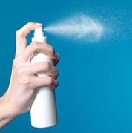
Print Media
Snailmoo
Snailmoo
Snailmoo
Snailmoo
Snailmoo
Snailmoo

