Slide 2
Print media
D brownies

Slide 3
D brownies

Slide 4
publicity
D’s brownies are so gooood.

Slide 5
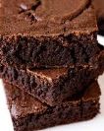
I cant stop eating D’s Brownies

Slide 6
Specialty
Hey you, go try D’s brownies

Slide 7
Go try D’s brownies they are fire

Slide 8
Sales promotion
Go try D’s Brownies

Slide 9
Sales Promotion
D’s Brownies 50% off after 9:00pm

Slide 10
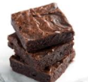
D’s Brownies rewards card

Slide 11
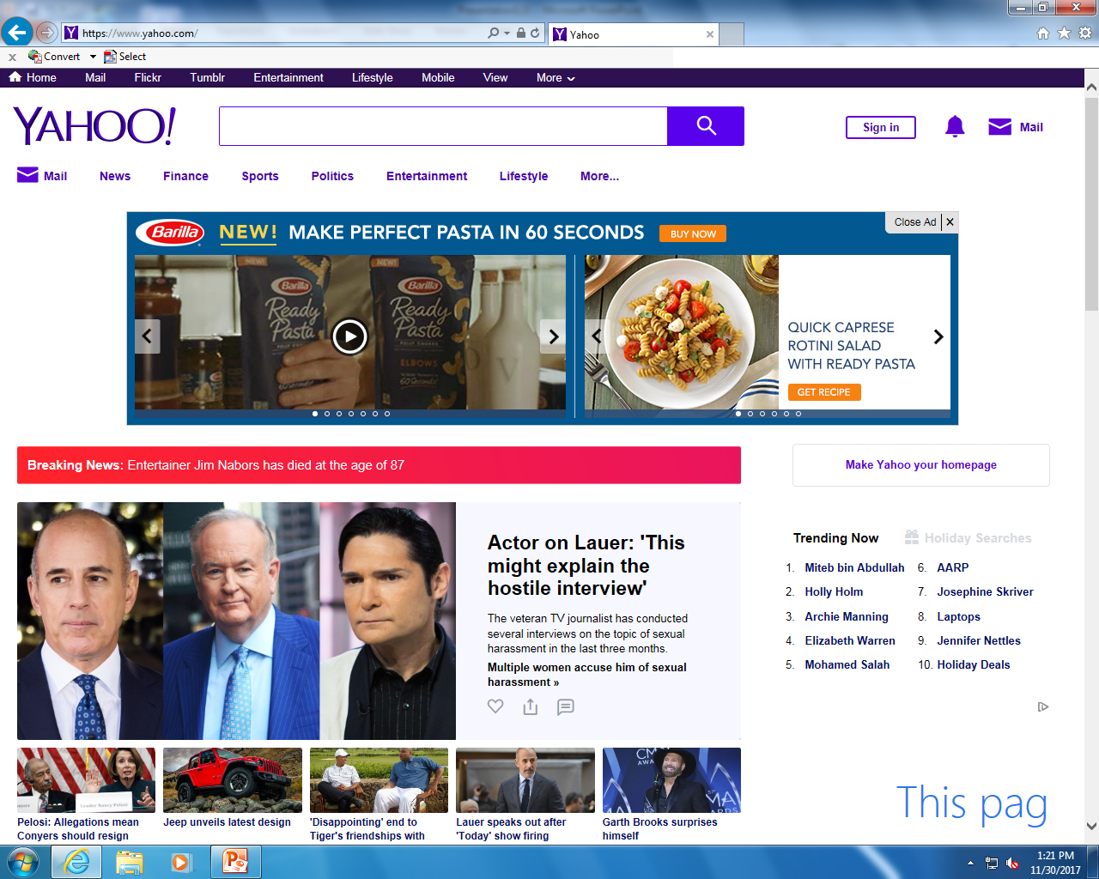
D’s Brownies are delicious

Slide 12
TRY D’S BROWNIES. THEY ARE DELICOIUS

Slide 13
D’s Brownies are delicious

