Slide 1
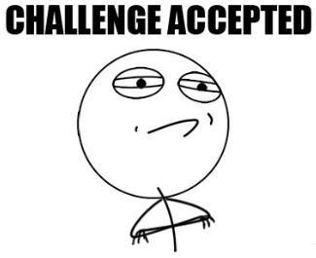


Eagle Challenge
Learning Target:
Describe market segmentation methods used to identify target market
How to protect intellectual property.
Standard OE3

Slide 2

Marketing Mix – 4Ps
Standard OE3
Product
Promotion
Price
Place

Slide 3


Customer Profile
A customer profile uses marketing segmentation to identify key factors and using them to break down the pool of customers to who would likely purchase the product or service.
This shows a company where to spend their advertising resources to get the most return on investment.
Target Market Segmentation
Geographic segmentation
Demographic segmentation
Psychographic segmentation
Behavioral (we will not discuss)
Standard OE3

Slide 4

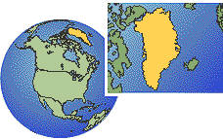
Geographic Segmentation:
Geographic Segmentation : is based on
  where consumers are located or climate
    ie: Regions – States – Cities - Rural Areas – Cold – Hot
Standard OE3

Slide 5
Demographic Segmentation
Segmentation based on statistical characteristics, such as:
  Gender: male, female
  Age: children, teenagers, young adult, middle age, senior, elderly
  Ethnicity: American, African, Indian, European, Asian, etc.
  Education: 8th grade or less, high school, some college, college degree
  Occupation: white collar, blue collar, service worker, farm worker
  Income: low, middle, high
  Life stage: single, married, with children, without children, older
Standard OE3

Slide 6



Psychographic Segmentation
Segmentation based on values, attitudes, personality, and lifestyle
People classified according to what they feel, what they believe, their way of life, and the products, services, and media they use
Standard OE3

Slide 7
Video

Slide 8
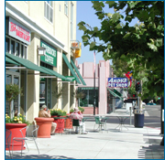

Basic Principles – The free enterprise system is based on:
Freedom of Ownership – We can own just about anything. The system encourages individuals to own businesses.
Standard OE3

Slide 9
Intellectual Property Rights
Are protected in a free enterprise system
Patents – If you patent an invention, you alone own the rights to that item or idea.
Trademark – A word, name, symbol, sound, or color that identifies a good or service and that cannot be used by anyone but the owner.
Copyright – Involves anything that is authored by an individual, such as writings, music, and artwork.
Standard OE3

Slide 10
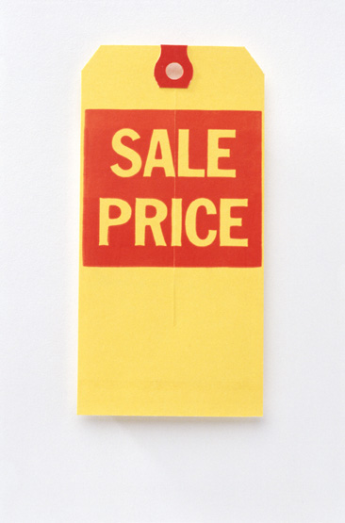

Competition – the struggle between companies for customers. Two kinds:
  Price Competition – focuses on the price
  Nonprice Competition – factors not related to price such as quality, service, location, reputation.

Slide 11
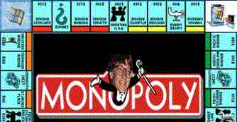
Monopolies
When there is no COMPETITION and one firm controls the whole market.
U.S. Government allows only a few, such as utility companies.
Standard OE3

Slide 12

Profit – the money earned from conducting business after all costs and expenses are paid.
  Profit is the motivation for taking a risk.
  Profits are high when sales are high and costs are low.
Standard OE3

Slide 13
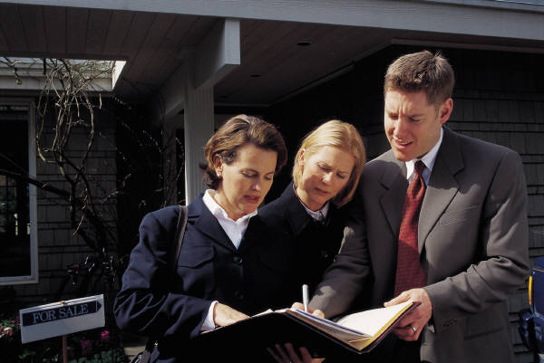
Marketing mix
“4 p’s of marketing”
Product
Price
Place
Promotion

