Slide 1
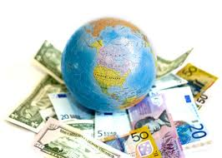
The Global Marketplace
Eagle Challenge
7minutes
Learning Target:
Explain the concept of economic resources (e.g., land, labor, capital, and entrepreneurship).
Standard OA2

Slide 2

Adding a credit card machine to Twinz Bakery increases what utility?
Time
Form
Place
Possession
Standard OA2

Slide 3
The idea that a business should strive to satisfy customers’ need and wants while generating a profit for the business.
Marketing Information Management
Marketing Mix
Selling
Marketing Concept
Standard OA2

Slide 4
Sometimes countries set up Trade Barriers to restrict trade because they want to sell and produce their own goods.
Trade Barriers include:
Tariff
Quota
Embargo
Notes:
Instructional Approach(s): The teacher should present the information on the slide.

Slide 5
Trade Barrier: Tariff
Tariffs are taxes placed on imported goods.
Tariffs cause the consumer to pay a higher price for an imported item, increasing the demand for a lower-priced item produced domestically.
Notes:
Instructional Approach(s): The teacher should present the information on the slide while the students summarize the important information on their graphic organizer.

Slide 6
Trade Barrier: Quotas
Quotas are limits on the amount of a good that can be imported into a country.
Quotas can cause shortages that cause prices to rise.
Notes:
Instructional Approach(s): The teacher should present the information on the slide while the students summarize the important information on their graphic organizer.

Slide 7
Trade Barrier:
Embargos
Embargoes forbid trade with another country.
The United States had a trade embargo with South Africa during apartheid.
Notes:
Instructional Approach(s): The teacher should present the information on the slide while the students summarize the important information on their graphic organizer.

Slide 8
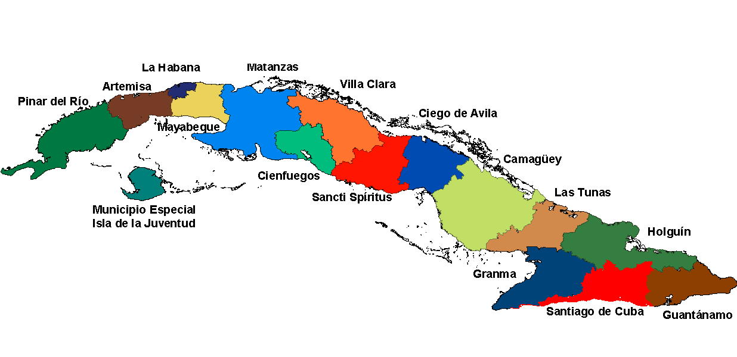
Cuba placed a ban on all imports/exports with the United States. The ban is referred to as
quota
embargo
tariff
limit
Standard OA2

Slide 9

What you will learn…
List forms of international trade
Identify political, economic, socio-cultural, and technological factors that affect international business
Suggest global marketing strategies
Standard OA2

Slide 10
Doing Business Internationally
The global marketplace has been growing with the advances in technology, and reduction of trade barriers.
These factors have encourages businesses to venture into foreign countries.

Slide 11
Importing
Purchasing goods from a foreign country
Products imported for the U.S. market must meet the same standards as domestic products.
Quota limits entry of certain goods. (Ex: cotton, peanuts, and sugar)
Any shipment in excess of quota is quarantined by U.S. Customs.
Standard OA2

Slide 12
Exporting
A domestic company that wishes to enter into the global marketplace with minimal risk and control might consider exporting.
Standard OA2

Slide 13
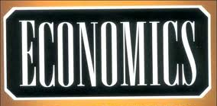
Economic Resources (Factors of Production)
Key economic factors relevant to doing business in another country include:
  Land
  Labor
  Capital
  Entrepreneurship
Standard OA2

Slide 14

Land “natural” Resources are things we get from nature.
Oil Coal Trees Water
Standard OA2

Slide 15
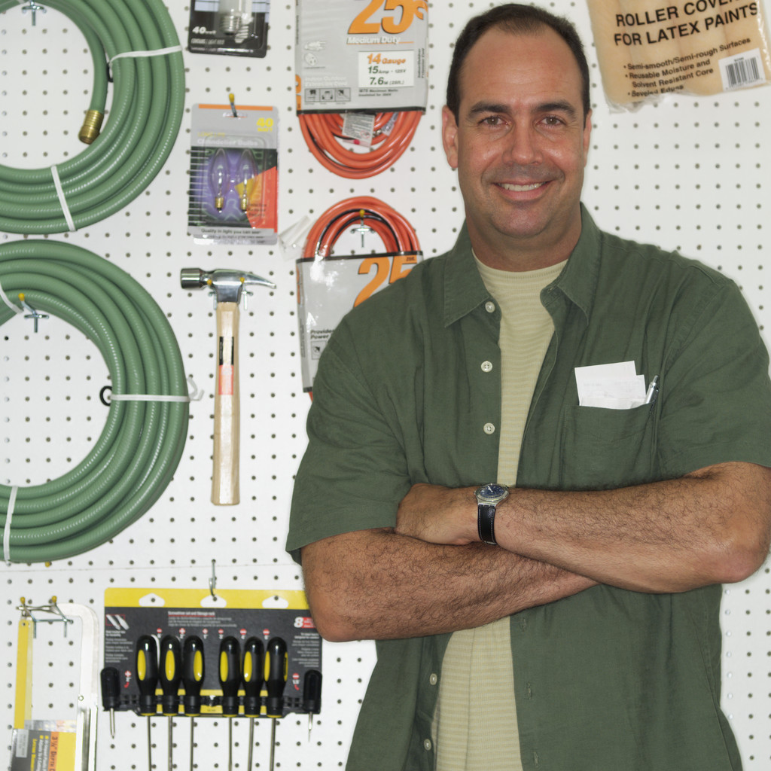
Labor resources are jobs done by humans at work.
Standard OA2

Slide 16
Capital resources are the machines, tools and buildings needed to do a job.
Standard OA2

Slide 17
International Trade
LT:
The benefits of international trade

Slide 18
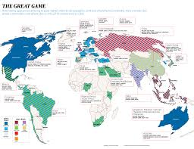
Global vs Domestic
Within your home nation (one country)
Multiple Countries

Slide 19
Learning Target
The interdependence of nations
The benefits of international trade
Government involvement in International trade
Balance of trade
Trade barriers
Trade agreements and alliances

Slide 20
International Trade
Involves the exchange of goods and services between nations.
Imports are goods and services purchased from other countries
Exports are goods and services sold to other countries.

Slide 21
Interdependence of Nations
Interdependence occurs because each nation possesses unique resources and capabilities.
Other nations may have a shortage of something that another has an abundance of.

Slide 22
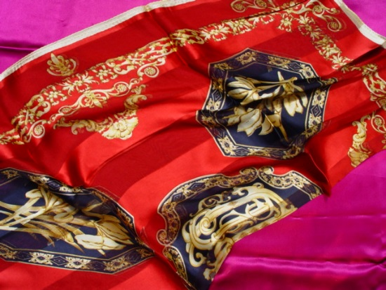
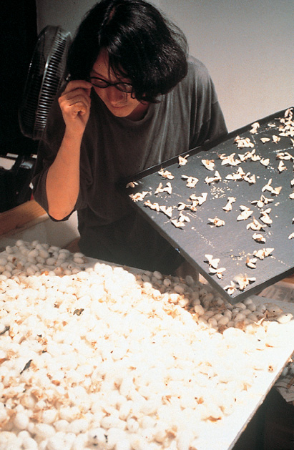
Absolute Advantage
When a country has a natural resource or ability that allow it to produce a product at the lowest cost possible.
  Example: China produces nearly 80% of all silk.
Trade is still valuable even when absolute advantage does not exist.

Slide 23
Comparative Advantage
The value that a nation gains by selling the goods that it produces most efficiently.
  Examples: High tech equipment and goods may be produced in the U.S. or Japan.
  Products that are labor intensive may be produced in emerging nations giving them a comparative advantage.

Slide 24
Benefits of International Trade
Consumers benefit because they can get high-quality goods at lower prices.
Producers have places to expand business.
Workers have jobs created by trade.
Economic alliances help to build political alliances.

Slide 25
Government Involvement
All nations control and monitor their trade with foreign businesses.

Slide 26
Balance of Trade
The difference in value between exports and imports of a nation
Trade Deficit – importing more than exporting
Trade Surplus – exporting more than importing

Slide 27
Trade Barriers
Free Trade – Many countries around the world favor and practice free trade.
Trade restrictions imposed by a nation’s government.
Three types:
  Tariffs
  Quotas
  Embargos

Slide 28
Tariff
Sometimes called a duty
A tax on an import

Slide 29
Quotas
A restriction on the quantity or monetary value of a product that may be imported.

Slide 30
Embargo
A total ban on specific goods coming into or leaving a nation.
  Health reasons
  Political reasons -political embargos can last a long time.

Slide 31
The World Trade Organization WTO
  Coalition of 148 countries
  Governs International Trade
  Formed in 1995
  Succeeded GATT
  Created by GATT to police agreements and resolve disputes.
  Addresses intellectual property rights, investment, and services.

Slide 32
North American Free Trade Agreement (NAFTA)
Agreement between U.S., Mexico, and Canada.
January 1, 1994
Increased trade with Mexico
Eliminated tariffs on more than 4,500 products.

Slide 33
Name the 7 Functions
Name the 5 Utilities
What is the Marketing Mix?
What are the 3 different Global Marketing Strategies?
What is the difference between for-profit and non-profit?
What are the 3 different market segments?
What is Market Share? How do you calculate the market share?
Small vs Large Business
Price Gouging
Whistleblowing
What are the 2 different types of competition?
What is monopoly? What can be a monopoly?
Know the following: copyright, patent and trademark
International Trade
Domestic vs Global
Government Regulators
Factors of Production
Licensing/Franchise

Slide 34

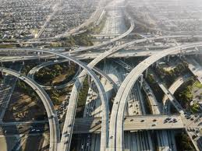
Infrastructure
Important relative to business
Things like undependable telephone service or inadequate roads would rule out a location for some businesses. Yet these same infrastructure factors would be an opportunity for companies involved in building roads, energy plants, and telecommunications systems.

