Slide 1
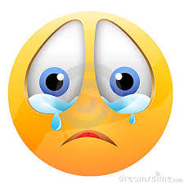
Principles of Marketing
Ethics
LT:
Explain the roles government plays in our free enterprise system
KOSSA Standard OA8

Slide 2
Building a house is an example of what utility?
Time
Form
Place
Possession

Slide 3
Selling flowers during Valentine’s Day is what utility?
Time
Form
Place
Possession

Slide 4
A television ad is know as what utility?
Advertising
Promotion
Information
Possession

Slide 5
Legal and Ethical Issues

Slide 6
Government and Laws
What You’ll Learn
The roles government plays in our free enterprise system
Identify federal regulatory agencies and laws that protect consumers, workers, investors, and the environment
About the impact of government on business

Slide 7
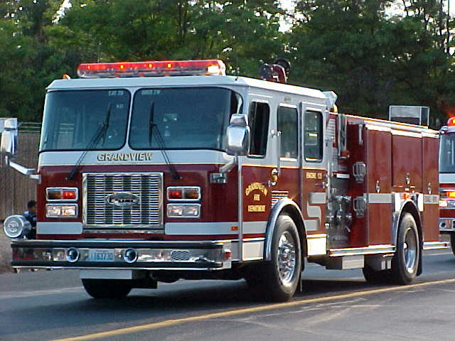
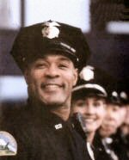
The Role of Government
Provider of Services – military, police, fire, education, transportation, etc.
Department of Homeland Security
Disaster recovery

Slide 8
The Role of Government
– Regulator -- laws to protect safety, health, and welfare of individuals

Slide 9
Protecting Consumers
Food and Drug Administration (FDA)
Regulates the labeling and safety of food, drugs, and cosmetics
Consumer Product Safety Commission (CPSC)
Responsible for overseeing the safety of products such as toys, electronics, and household furniture.

Slide 10
Protecting Workers
Equal Employment Opportunity Commission (EEOC)
Responsible for the fair and equitable treatment of employees with regard to hiring, firing and promotions.
Occupational Safety and Health Administration (OSHA)
Provides guidelines for workplace safety and enforces those regulations.

Slide 11
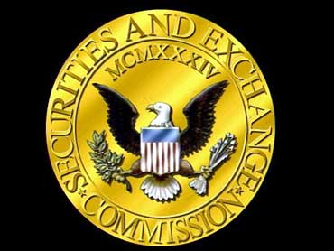
Protecting Investors
Securities and Exchange Commission (SEC)
Regulates the sale of securities (stocks and bonds).
Is responsible for licensing brokerage firms and financial advisors.

Slide 12
Protecting the Environment
Environmental Protection Agency (EPA)
Protects human health and our environment
Monitors and reduces air and water pollution
Oversees hazardous waste disposal and recycling

Slide 13
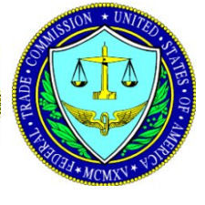
Enforcer of the Free Enterprise System
Federal Trade Commission (FTC) – has the responsibility of enforcing the principles of a free enterprise system and protecting consumers from unfair or deceptive business practices.
Bureau of Consumer Protection
Bureau of Competition
Bureau of Economics

Slide 14
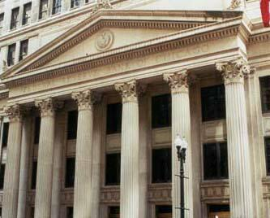
The Role of Government
Monitor of Our Economy
To ensure economic stability
Government monitors our economy and controls our monetary supply through the Federal Reserve System (our nation’s bank)

