Slide 1
The Global Marketplace
Eagle Challenge
7minutes
Learning Target:
Describe ways competition affects business decisions
Standard OA10

Slide 2
International Trade LT: The benefits of international trade

Slide 3
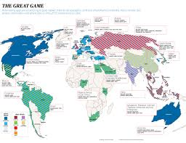
Global vs Domestic
Within your home nation (one country)
Multiple Countries

Slide 4
International Trade
Involves the exchange of goods and services between nations.
Imports are goods and services purchased from other countries
Exports are goods and services sold to other countries.

Slide 5
Absolute Advantage
When a country has a natural resource or ability that allow it to produce a product at the lowest cost possible.
Example: China produces nearly 80% of all silk.
Trade is still valuable even when absolute advantage does not exist.

Slide 6
Comparative Advantage
The value that a nation gains by selling the goods that it produces most efficiently.
Examples: High tech equipment and goods may be produced in the U.S. or Japan.
Products that are labor intensive may be produced in emerging nations giving them a comparative advantage.

Slide 7
Balance of Trade
The difference in value between exports and imports of a nation
Trade Deficit – importing more than exporting
Trade Surplus – exporting more than importing

Slide 8
Licensing
Involves letting another company (licensee) use a trademark, patent, special formula, company name, or some other intellectual property for a fee or royalty
With licensing, a foreign company make the product using the info or guidelines provided by the licensor.
If the product is a success in the foreign country, the licensor has gained entry with minimal risk.

Slide 9
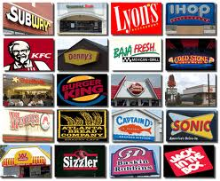
Franchising
A special type of licensing.
In a franchise agreement, a franchisor grants the franchisee the rights to operate under the company name.

Slide 10
Types of Businesses
Size and Scope
Large vs. Small – size – small businesses have less than 100 employees, large more.
Domestic vs. Global – domestic market is a single country, global is among nations.

Slide 11
Types of Businesses
Purpose
Profit (Microsoft, McDonald’s) vs. Nonprofit (YMCA, Boys/Girls Clubs of America)
Public (government services) vs. Private
Public organizations provide a non-profit service or are associated with the government.

Slide 12
Global Marketing Strategies
In planning and making decisions about the four P’s of the marketing mix, global marketers need to consider all the factors analyzed for the environmental scan.
The possibilities for marketing strategies that involve product and promotion decisions include globalization, adaptation, and customization.
Standard OA5

Slide 13
Globalization
Selling the same product and using the same promotion methods in all countries.
Only a small portion of products that are common to all global customers can use this marketing strategy.
Standard OA5

Slide 14
Adaptation
Is a company’s use of an existing product and/or promotion to which changes are made to better suit the characteristics of a country or region
Product adaptation is the change of a product to meet needs and/or to reflect the cultural differences in a foreign market.
Promotion adaptation is the changing of the advertising message to reflect the values, familiar images, and cultural differences in a foreign market.
Standard OA5

Slide 15
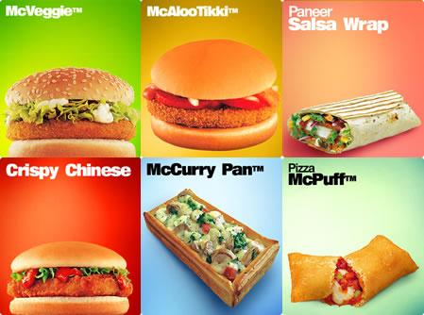
Visit McDonald’s
International!
Standard OA5

Slide 16
Customization
Involves creating specially designed products or promotions for certain countries or regions.
Each geographical area where a product is sold or a service is offered becomes a unique market segment.
Standard OA5

