Slide 1
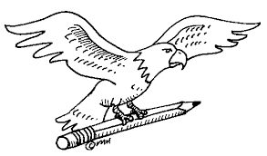



Welcome Back
Distribution
Math ☺
You need paper & pencil
You have to STUDY
LT: What is distribution?
OC 1 Differentiate between direct and indirect channels of distribution OC 2 Identify the channels of distribution members (e.g., manufacturer, wholesaler, retailer) OC 3 Identify the levels of distribution intensity (e.g., exclusive, selective, intensive)

Slide 2
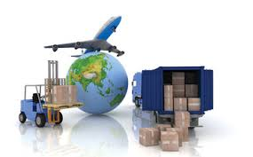
Distribution
  The concept of a channel of distribution
  Who channel members are
  Non-store retailing methods
  How channels of distribution differ for consumer and business-to-business products
OC 1 Differentiate between direct and indirect channels of distribution OC 2 Identify the channels of distribution members (e.g., manufacturer, wholesaler, retailer) OC 3 Identify the levels of distribution intensity (e.g., exclusive, selective, intensive)

Slide 3


Key Terms
  channel of distribution
  intermediaries
  wholesalers
  rack jobbers
  drop shippers
  retailers
  brick and mortar
  retailers
  e-tailing
  agents
  direct distribution
  indirect distribution
OC 1 Differentiate between direct and indirect channels of distribution OC 2 Identify the channels of distribution members (e.g., manufacturer, wholesaler, retailer) OC 3 Identify the levels of distribution intensity (e.g., exclusive, selective, intensive)

Slide 4
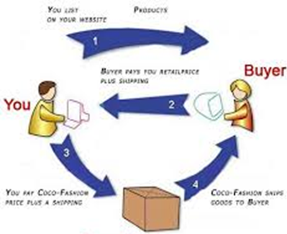
Distribution
Distribution—How It Works
The channel of distribution is the path a product takes from producer or manufacturer to final user. This is a place decision, one of the four Ps of the marketing mix.
Producer
OC 1 Differentiate between direct and indirect channels of distribution OC 2 Identify the channels of distribution members (e.g., manufacturer, wholesaler, retailer) OC 3 Identify the levels of distribution intensity (e.g., exclusive, selective, intensive)

Slide 5
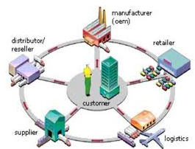
Channel Members
All the businesses involved in sales transactions that move products from the manufacturer to the final user are called intermediaries or middlemen. Intermediaries provide value to producers because they often have expertise in certain areas that producers do not have.
OC 1 Differentiate between direct and indirect channels of distribution OC 2 Identify the channels of distribution members (e.g., manufacturer, wholesaler, retailer) OC 3 Identify the levels of distribution intensity (e.g., exclusive, selective, intensive)

Slide 6
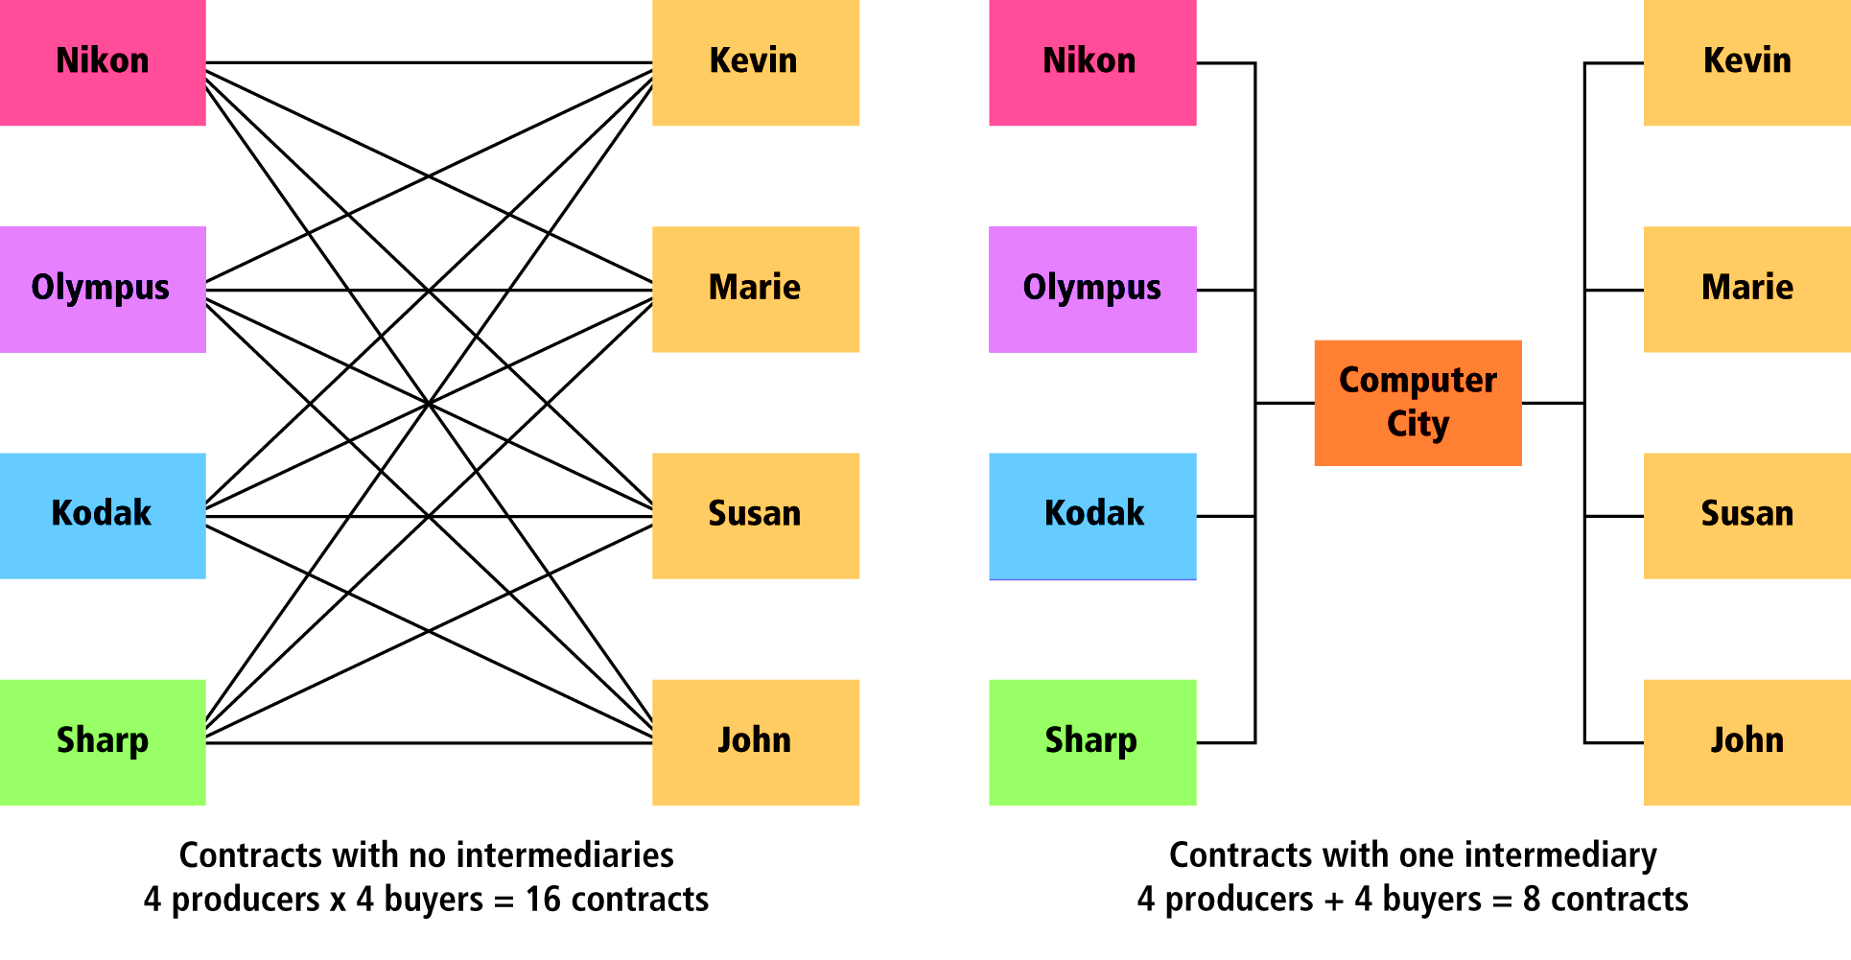
Distribution
Intermediaries
Intermediaries reduce the number of transactions required by manufacturers to reach their final customers. What expenses of doing business are lowered by this reduction in transactions?
OC 1 Differentiate between direct and indirect channels of distribution OC 2 Identify the channels of distribution members (e.g., manufacturer, wholesaler, retailer) OC 3 Identify the levels of distribution intensity (e.g., exclusive, selective, intensive)

Slide 7
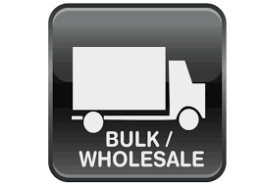
Wholesalers
  Wholesalers buy large quantities of goods (taking title) from manufacturers, store the goods, and then resell them to other businesses. Their customers are called retailers. They may be called distributors when their customers are professional or commercial users, manufacturers, governments, institutions, or other wholesalers.
OC 1 Differentiate between direct and indirect channels of distribution OC 2 Identify the channels of distribution members (e.g., manufacturer, wholesaler, retailer) OC 3 Identify the levels of distribution intensity (e.g., exclusive, selective, intensive)

Slide 8
Wholesalers
  Two specialized wholesalers are:
    rack jobbers
    drop shippers
  Rack jobbers manage inventory and merchandising for retailers by counting stock, filling it in when needed, and maintaining store displays. They provide the display racks and
  bill the retailer only for the goods sold.
Drop shippers deal in bulk items such as coal, lumber, and chemicals that require special handling. Drop shippers sell the goods to other businesses and have the producer ship the merchandise directly to the buyers. The products are owned, but never handled, by the drop shipper.

Slide 9
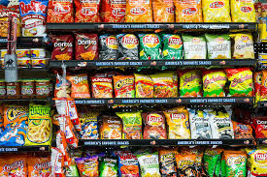
For example, the rack of chips in a store from Frito Lay would be a considered a rack jobber
OC 1 Differentiate between direct and indirect channels of distribution OC 2 Identify the channels of distribution members (e.g., manufacturer, wholesaler, retailer) OC 3 Identify the levels of distribution intensity (e.g., exclusive, selective, intensive)

Slide 10
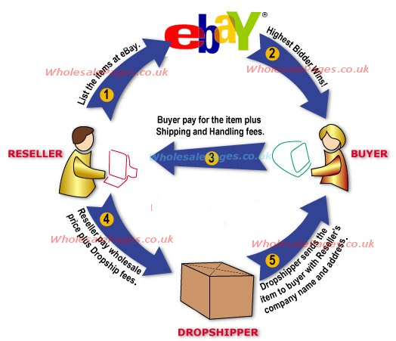
How It works
OC 1 Differentiate between direct and indirect channels of distribution OC 2 Identify the channels of distribution members (e.g., manufacturer, wholesaler, retailer) OC 3 Identify the levels of distribution intensity (e.g., exclusive, selective, intensive)

Slide 11
Retailers
  Retailers sell goods to the final consumer for personal use.
  Traditional retailers, called brick and mortar retailers, sell goods to the customer from their own physical stores.
  Non-store retailing operations include automatic retailing, direct mail and catalog retailing, TV home shopping, and online retailing (e-tailing).
OC 1 Differentiate between direct and indirect channels of distribution OC 2 Identify the channels of distribution members (e.g., manufacturer, wholesaler, retailer) OC 3 Identify the levels of distribution intensity (e.g., exclusive, selective, intensive)

Slide 12
Shopping on the Web
Top e-tailing sectors
MILLIONS OF DOLLARS
Note the millions of dollars attributed to online sales by
e-tailers in one month. Which three sectors lead the list? How might this list be changed if the month was December?
Air Travel
Books
Hardware
Software
Apparel
Hotels
Toys/games
Music
Health, beauty
Electronics
$318
$224
$224
$187
$182
$164
$146
$143
$143
$126
Source: Dow Jones
OC 1 Differentiate between direct and indirect channels of distribution OC 2 Identify the channels of distribution members (e.g., manufacturer, wholesaler, retailer) OC 3 Identify the levels of distribution intensity (e.g., exclusive, selective, intensive)

Slide 13
Agents
  Unlike wholesalers and retailers, agents
  do not own the goods they sell. Agents act
  as intermediaries by bringing buyers and
  sellers together.
Example Real estate agents, food brokers,
independent manufacturer’s representatives.
OC 1 Differentiate between direct and indirect channels of distribution OC 2 Identify the channels of distribution members (e.g., manufacturer, wholesaler, retailer) OC 3 Identify the levels of distribution intensity (e.g., exclusive, selective, intensive)

Slide 14
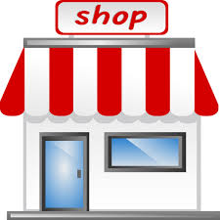
Direct and Indirect Channels
  Channels of distribution are classified as direct
  or indirect.
  Direct distribution occurs when the goods or services are sold from the producer directly to the customer; no intermediaries are involved.
  Indirect distribution involves one or more intermediaries.
OC 1 Differentiate between direct and indirect channels of distribution OC 2 Identify the channels of distribution members (e.g., manufacturer, wholesaler, retailer) OC 3 Identify the levels of distribution intensity (e.g., exclusive, selective, intensive)

Slide 15
Reviewing Key Terms and Concepts
  1. What is a channel of distribution?
  2. Name two major types of merchant intermediaries.
  3. What type of intermediary is a rack jobber? A drop shipper?
  4. Distinguish between brick and mortar and online retailers.
  5. Which type of distribution channel—direct or indirect—is used more frequently for consumer products? For industrial products?
OC 1 Differentiate between direct and indirect channels of distribution OC 2 Identify the channels of distribution members (e.g., manufacturer, wholesaler, retailer) OC 3 Identify the levels of distribution intensity (e.g., exclusive, selective, intensive)

Slide 16
Channel Management
OC 1 Differentiate between direct and indirect channels of distribution OC 2 Identify the channels of distribution members (e.g., manufacturer, wholesaler, retailer) OC 3 Identify the levels of distribution intensity (e.g., exclusive, selective, intensive)

Slide 17
Understanding Distribution Planning
Key Considerations in Distribution Planning
Involves decisions about a product’s physical movement and transfer of ownership from producer to consumer
The decisions affect a firm’s marketing program.
Some of the major considerations follow:

Slide 18


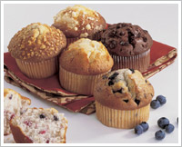
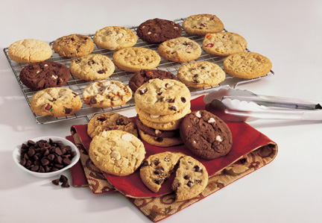
Understanding Distribution Planning
Multiple Distribution – used when a product fits the needs of both industrial and customer markets.
“We're #1 in every foodservice segment: K-12 Schools, College/University, Healthcare, Business Dining, Lodging, and Restaurants!“ You can also buy this brand in your local grocery store.

Slide 19
Understanding Distribution Planning
Control vs. Costs – Producers must weigh the control they want to keep
  Who does the selling?
    A direct sales force is costly.
    With an agent, a manufacturer loses some of its control over how sales are made

Slide 20


Distribution Intensity
Exclusive Distribution – involves protected territories in a given geographic area.
Prestige, image, channel control, and a high profit margin for both the manufacturer and intermediaries.
Click the receiver to see the number of dealers in your area.

Slide 21
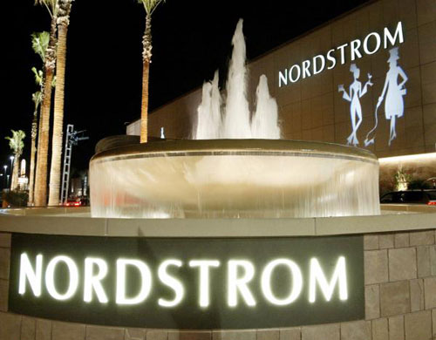

Distribution Intensity
Selective Distribution – means that a limited number of outlets in a given geographic area are used to sell the product.
The intermediaries chosen are selected for their ability to cater to the final users that the manufacturer wants to attract.

Slide 22
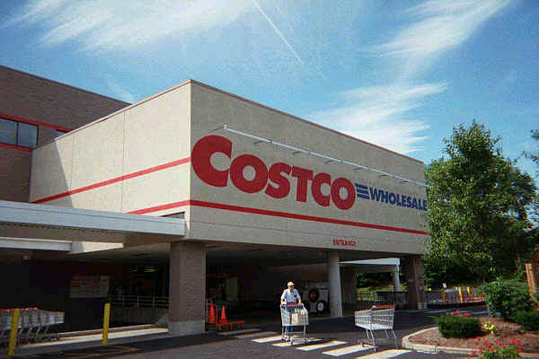
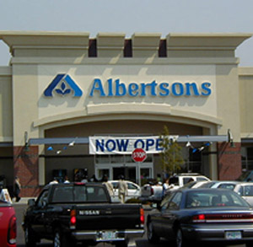

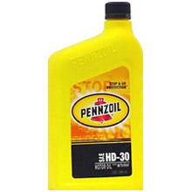
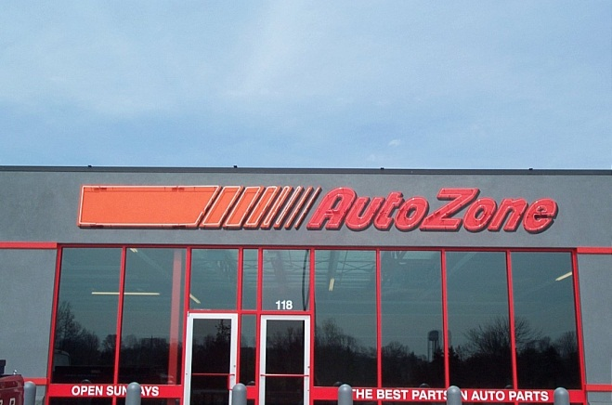
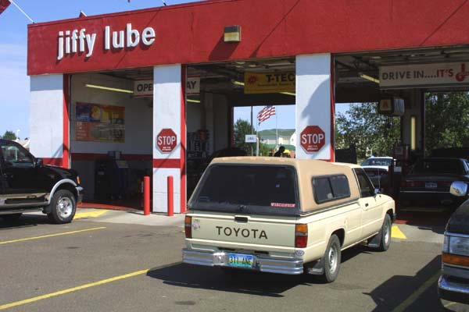
Distribution Intensity
Intensive Distribution – involves the use of all suitable outlets to sell a product.
The goal is complete market coverage

Slide 23
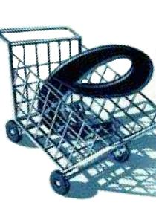
Distribution Intensity
E-Commerce – products are sold to customers and industrial users through the use of the Internet.
B2B operations provide one-stop shopping and substantial savings for industrial buyers.

Slide 24
Physical Distribution
PHYSICAL DISTRIBUTION
LOGISTICS
All activities involved
in moving the right product
to the right place
at the right time

Slide 25
Physical Distribution
Reduce
costs
Gain
Differential
advantage
Fulfillment
In
E-commerce
Supply
Chain
Management
Coordinated
logistics

Slide 26
Strategic Use of Physical Distribution
Improve
Customer
Service
Reduce
Distribution
Costs
Create
Time and Place
Utilities
Stabilize
Prices
Influence
Channel
Decisions
Control
Shipping
Costs

Slide 27
Physical Distribution
Order
Processing
Inventory
Control
Electronic
Data
Interchange
Customer
Service

Slide 28
Inventory Location and Warehousing
Types
of
Warehouses
Public
Private
Materials
Handling

Slide 29
Transportation
Major
Modes
Intermodal
Transportation
Freight
Forwarders
Package-
delivery

Slide 30
Physical Distribution
  Storage The storage function facilitates the actual movement of products through the distribution channel as products are sold.
  Stock Handling Receiving, checking, and marking items for sale are an important step in the physical distribution system.
  Inventory Control Proper inventory control ensures that products are kept
  in sufficient quantities and available
  when requested by customers.

Slide 31
Transportation Systems and Services
Types of Transportation
  Transportation is the marketing function of moving products from a seller to a buyer. There are five major transportation forms that move products:
    motor carriers
    railroads
    waterways
    pipelines
    air carriers

Slide 32
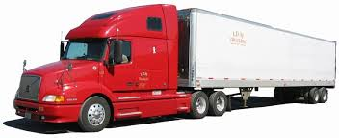
Trucking
(Road)
  Trucks (or motor carriers) are the most frequently used form of transportation. They carry higher-valued products that are expensive to carry in inventory. Businesses use trucks for virtually all intracity (within a city) shipping and for 26 percent of the intercity (between cities) freight traffic in the United States.

Slide 33
Types of Carriers
  Businesses that use trucks to move their products can use:
    for-hire carriers
    private carriers
    a combination of both

Slide 34
Types of Carriers
  For-hire carriers include common carriers and contract carriers.
    Common carriers provide transportation services to any business in its operating area for a fee.
    A contract carrier provides equipment and drivers for specific routes, according to agreements with the shipper.
    Private carriers transport goods for an individual business.

Slide 35
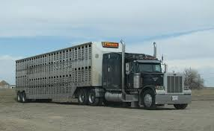
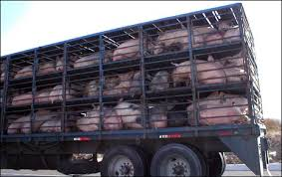
Exempt carriers, which commonly carry agricultural products, are free from direct regulation of rates and operating procedures. Exempt carrier status can also be granted
to local transportation firms that make
short-distance deliveries within specified trading areas in cities.

Slide 36
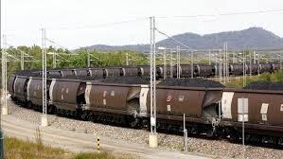
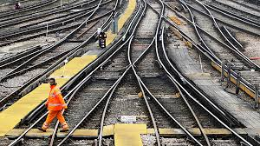
Rail Transportation
Trains transport nearly 38 percent of the total intercity ton-miles (the movement of one ton of freight one mile) of freight. Trains are important for moving heavy and bulky freight, such as coal, steel, lumber, chemicals, grain, farm equipment, and automobiles, over long distances.

Slide 37
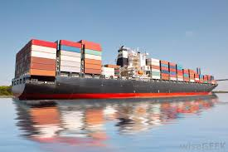
Water Transportation
Shipment over water is one of the oldest methods of transporting merchandise. The United States Maritime Commission regulates U.S. water transportation.

Slide 38
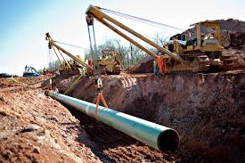
Pipelines
Pipelines are normally owned by the company using them, so they are usually considered private carriers. There are more than 200,000 miles of pipelines in the United States. Pipelines are most frequently used
to transport oil and natural gas.

Slide 39

Air Transportation
  Currently, air transportation is less than
  1 percent of the total ton-miles of freight shipped. Items shipped by air include:
    overnight mail
    emergency parts
    precisions instruments
    medicines
    perishable food products

Slide 40
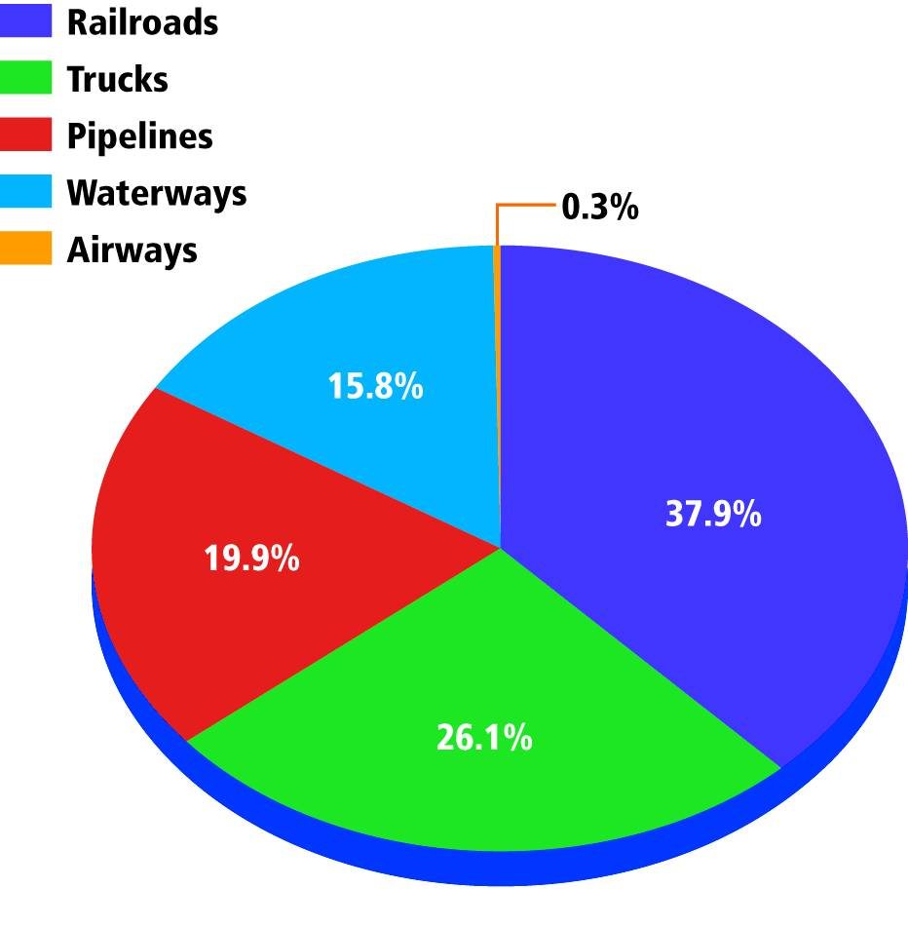
The Importance and Size of
Transportation Systems
  The chart shows the amount of freight in ton miles shipped by each form of transportation. Why is the percentage spent on airlines small in relation to other types of transportation?

Slide 41
ASSESSMENT
Reviewing Key Terms and Concepts
  1. What is physical distribution?
  2. What function does transportation play in marketing a product?
  3. Identify five transportation systems for the distribution of products.
  4. What is the difference between a common and a contract carrier?
  5. List four different examples of transportation service companies.
Thinking Critically
  6. Many retail distribution and transportation executives support federal legislation that would reduce state trucking regulations. What do you see as potential benefits and disadvantages of this effort?

