Slide 1
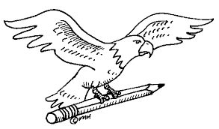



Welcome Back
Distribution
Math ☺
You need paper & pencil
You have to STUDY
LT: What is distribution?
OC 1 Differentiate between direct and indirect channels of distribution OC 2 Identify the channels of distribution members (e.g., manufacturer, wholesaler, retailer) OC 3 Identify the levels of distribution intensity (e.g., exclusive, selective, intensive)

Slide 2
Wholesalers
  Two specialized wholesalers are:
    rack jobbers
    drop shippers
  Rack jobbers manage inventory and merchandising for retailers by counting stock, filling it in when needed, and maintaining store displays. They provide the display racks and
  bill the retailer only for the goods sold.
Drop shippers deal in bulk items such as coal, lumber, and chemicals that require special handling. Drop shippers sell the goods to other businesses and have the producer ship the merchandise directly to the buyers. The products are owned, but never handled, by the drop shipper.

Slide 3
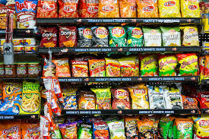
For example, the rack of chips in a store from Frito Lay would be a considered a rack jobber
OC 1 Differentiate between direct and indirect channels of distribution OC 2 Identify the channels of distribution members (e.g., manufacturer, wholesaler, retailer) OC 3 Identify the levels of distribution intensity (e.g., exclusive, selective, intensive)

Slide 4


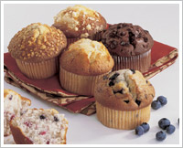
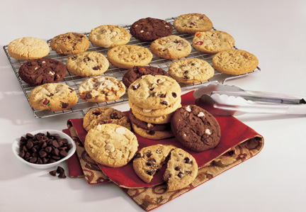
Understanding Distribution Planning
Multiple Distribution – used when a product fits the needs of both industrial and customer markets.
“We're #1 in every foodservice segment: K-12 Schools, College/University, Healthcare, Business Dining, Lodging, and Restaurants!“ You can also buy this brand in your local grocery store.

Slide 5


Distribution Intensity
Exclusive Distribution – involves protected territories in a given geographic area.
Prestige, image, channel control, and a high profit margin for both the manufacturer and intermediaries.
Click the receiver to see the number of dealers in your area.

Slide 6
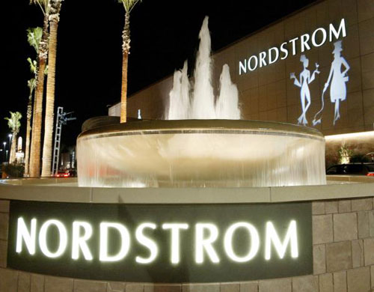

Distribution Intensity
Selective Distribution – means that a limited number of outlets in a given geographic area are used to sell the product.
The intermediaries chosen are selected for their ability to cater to the final users that the manufacturer wants to attract.

Slide 7
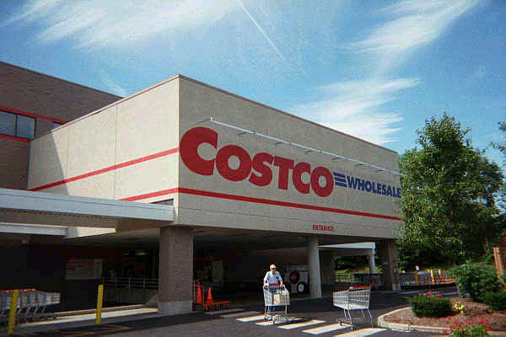
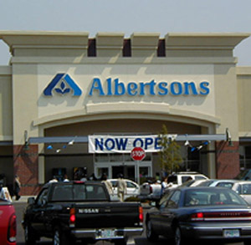

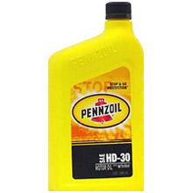
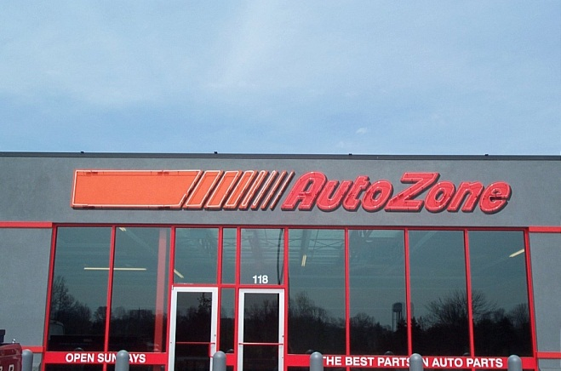
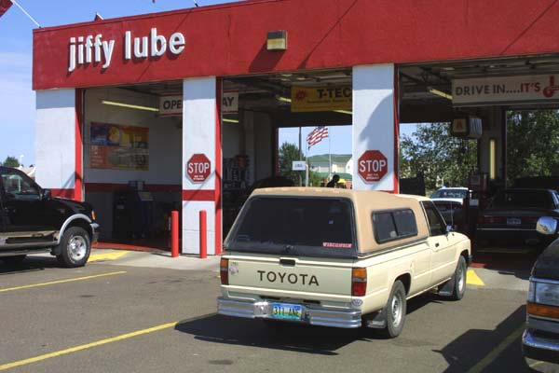
Distribution Intensity
Intensive Distribution – involves the use of all suitable outlets to sell a product.
The goal is complete market coverage

Slide 8
Physical Distribution
  Storage The storage function facilitates the actual movement of products through the distribution channel as products are sold.
  Stock Handling Receiving, checking, and marking items for sale are an important step in the physical distribution system.
  Inventory Control Proper inventory control ensures that products are kept
  in sufficient quantities and available
  when requested by customers.

Slide 9
Transportation Systems and Services
Types of Transportation
  Transportation is the marketing function of moving products from a seller to a buyer. There are five major transportation forms that move products:
    motor carriers
    railroads
    waterways
    pipelines
    air carriers

Slide 10
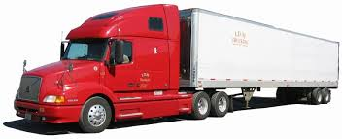
Trucking
(Road)
  Trucks (or motor carriers) are the most frequently used form of transportation. They carry higher-valued products that are expensive to carry in inventory. Businesses use trucks for virtually all intracity (within a city) shipping and for 26 percent of the intercity (between cities) freight traffic in the United States.

Slide 11
Types of Carriers
  Businesses that use trucks to move their products can use:
    for-hire carriers
    private carriers
    a combination of both

Slide 12
Types of Carriers
  For-hire carriers include common carriers and contract carriers.
    Common carriers provide transportation services to any business in its operating area for a fee.
    A contract carrier provides equipment and drivers for specific routes, according to agreements with the shipper.
    Private carriers transport goods for an individual business.

Slide 13
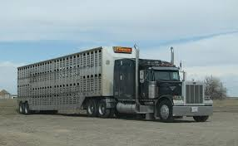
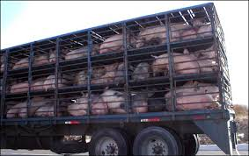
Exempt carriers, which commonly carry agricultural products, are free from direct regulation of rates and operating procedures. Exempt carrier status can also be granted
to local transportation firms that make
short-distance deliveries within specified trading areas in cities.

Slide 14
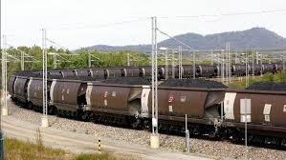
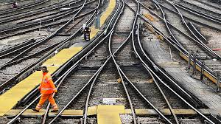
Rail Transportation
Trains transport nearly 38 percent of the total intercity ton-miles (the movement of one ton of freight one mile) of freight. Trains are important for moving heavy and bulky freight, such as coal, steel, lumber, chemicals, grain, farm equipment, and automobiles, over long distances.

Slide 15
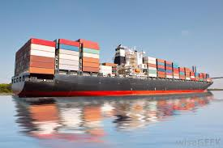
Water Transportation
Shipment over water is one of the oldest methods of transporting merchandise. The United States Maritime Commission regulates U.S. water transportation.

Slide 16
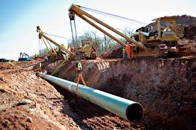
Pipelines
Pipelines are normally owned by the company using them, so they are usually considered private carriers. There are more than 200,000 miles of pipelines in the United States. Pipelines are most frequently used
to transport oil and natural gas.

Slide 17

Air Transportation
  Currently, air transportation is less than
  1 percent of the total ton-miles of freight shipped. Items shipped by air include:
    overnight mail
    emergency parts
    precisions instruments
    medicines
    perishable food products

Slide 18
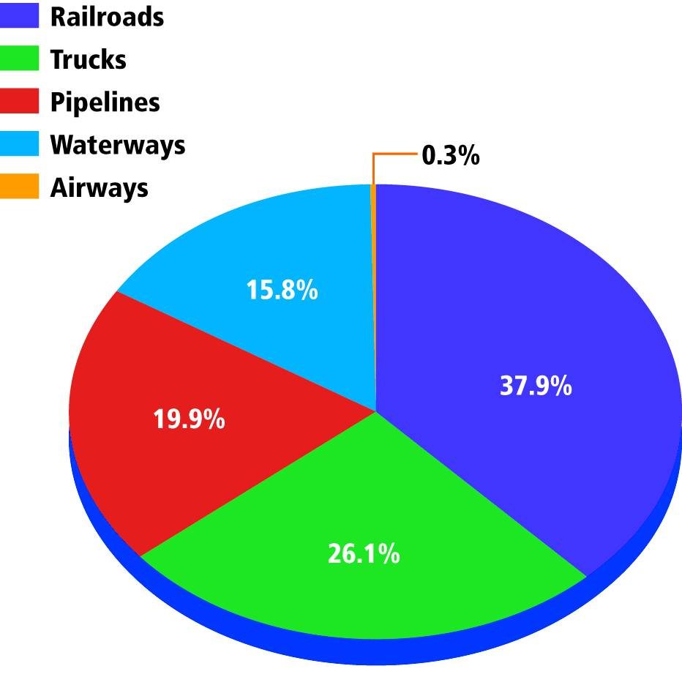
The Importance and Size of
Transportation Systems
  The chart shows the amount of freight in ton miles shipped by each form of transportation. Why is the percentage spent on airlines small in relation to other types of transportation?

Slide 19
ASSESSMENT
Reviewing Key Terms and Concepts
  1. What is physical distribution?
  2. What function does transportation play in marketing a product?
  3. Identify five transportation systems for the distribution of products.
  4. What is the difference between a common and a contract carrier?
  5. List four different examples of transportation service companies.
Thinking Critically
  6. Many retail distribution and transportation executives support federal legislation that would reduce state trucking regulations. What do you see as potential benefits and disadvantages of this effort?

