Slide 1

The Global Marketplace
Eagle Challenge
7minutes
Learning Target:
Explain the concept of economic resources (e.g., land, labor, capital, and entrepreneurship).

Slide 2

Adding a credit card machine to Twinz Bakery increases what utility?
Time
Form
Place
Possession

Slide 3
The idea that a business should strive to satisfy customers’ need and wants while generating a profit for the business.
Marketing Information Management
Marketing Mix
Selling
Marketing Concept

Slide 4
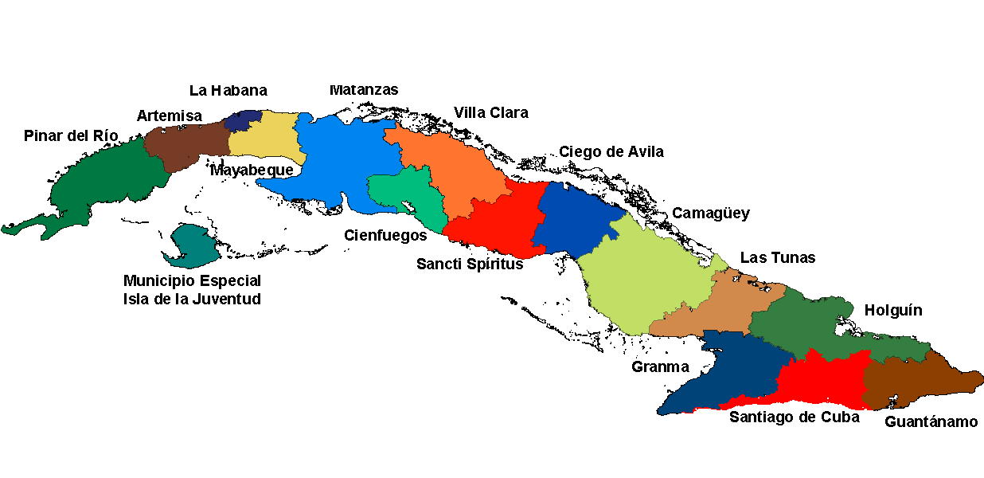
Cuba placed a ban on all imports/exports with the United States. The ban is referred to as
quota
embargo
tariff
limit

Slide 5

What you will learn…
List forms of international trade
Identify political, economic, socio-cultural, and technological factors that affect international business
Suggest global marketing strategies

Slide 6
Doing Business Internationally
The global marketplace has been growing with the advances in technology, and reduction of trade barriers.
These factors have encourages businesses to venture into foreign countries.

Slide 7
Importing
Purchasing goods from a foreign country
Products imported for the U.S. market must meet the same standards as domestic products.
Quota limits entry of certain goods. (Ex: cotton, peanuts, and sugar)
Any shipment in excess of quota is quarantined by U.S. Customs.

Slide 8
Exporting
A domestic company that wishes to enter into the global marketplace with minimal risk and control might consider exporting.

Slide 9

Licensing
Involves letting another company (licensee) use a trademark, patent, special formula, company name, or some other intellectual property for a fee or royalty
With licensing, a foreign company make the product using the info or guidelines provided by the licensor.
If the product is a success in the foreign country, the licensor has gained entry with minimal risk.

Slide 10
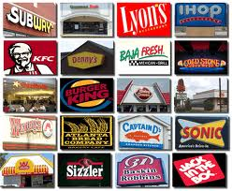

Franchising
A special type of licensing.
In a franchise agreement, a franchisor grants the franchisee the rights to operate under the company name.

Slide 11

Economic Resources (Factors of Production)
Key economic factors relevant to doing business in another country include:
  Land
  Labor
  Capital
  Entrepreneurship

Slide 12

Land “natural” Resources are things we get from nature.
Oil Coal Trees Water

Slide 13

Labor resources are jobs done by humans at work.

Slide 14
Capital resources are the machines, tools and buildings needed to do a job.

Slide 15

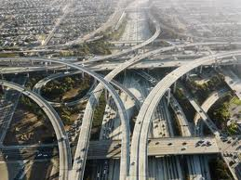
Infrastructure
Important relative to business
Things like undependable telephone service or inadequate roads would rule out a location for some businesses. Yet these same infrastructure factors would be an opportunity for companies involved in building roads, energy plants, and telecommunications systems.

Slide 16

Global Marketing Strategies
In planning and making decisions about the four P’s of the marketing mix, global marketers need to consider all the factors analyzed for the environmental scan.
The possibilities for marketing strategies that involve product and promotion decisions include globalization, adaptation, and customization.

Slide 17

Globalization
Selling the same product and using the same promotion methods in all countries.
Only a small portion of products that are common to all global customers can use this marketing strategy.

Slide 18
Adaptation
Is a company’s use of an existing product and/or promotion to which changes are made to better suit the characteristics of a country or region
Product adaptation is the change of a product to meet needs and/or to reflect the cultural differences in a foreign market.
Promotion adaptation is the changing of the advertising message to reflect the values, familiar images, and cultural differences in a foreign market.

Slide 19
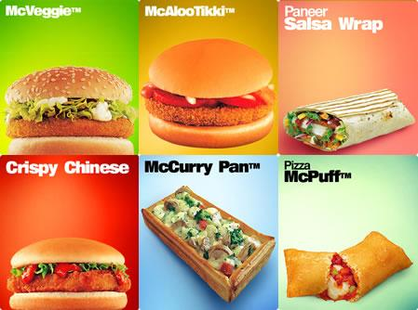
Visit McDonald’s
International!

Slide 20

Customization
Involves creating specially designed products or promotions for certain countries or regions.
Each geographical area where a product is sold or a service is offered becomes a unique market segment.

