Slide 1
Understanding Economic Systems
Communism, Socialism, Capitalism
Standard OA6
Explain the types of economic systems (e.g., capitalism, socialism, communism)

Slide 2
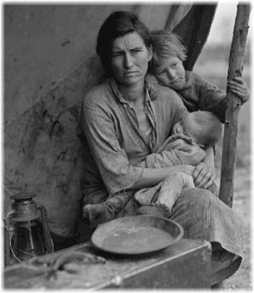
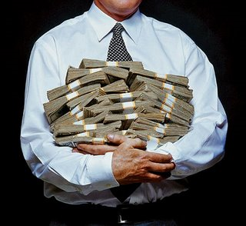
Warm Up Question #1
What standard of living do you hope to attain in life? How do you plan to accomplish this goal?
Standard of living refers to the level of wealth, comfort, material goods, and necessities available to a certain socioeconomic class in a certain geographic area, usually a country

Slide 3
Main Idea
Economies vary when it comes to government involvement. The relationship between government and the economy has been debated since America’s historical beginnings.

Slide 4
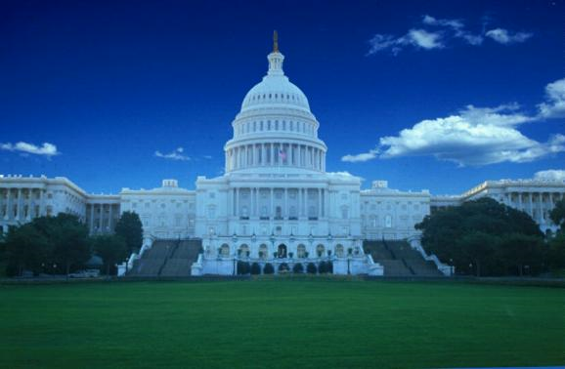
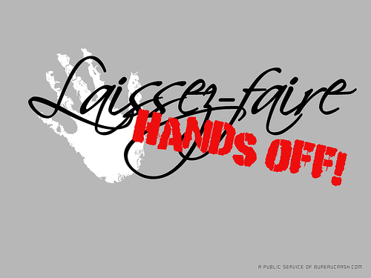
Essential Question
What role should a government play in an economy?

Slide 5
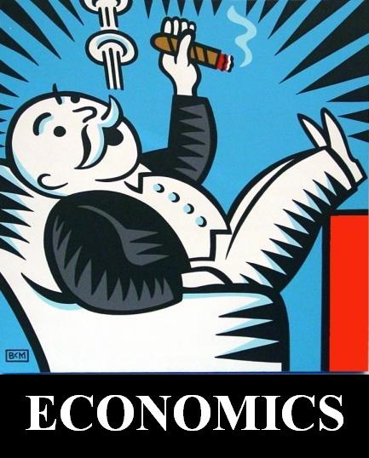
I. Understanding Economic Systems
A. Economics – the social science that analyzes the production, distribution, and consumption of goods and services.
B. Many different economic systems in the world
C. Helps formulate our understanding of Modern American History

Slide 6
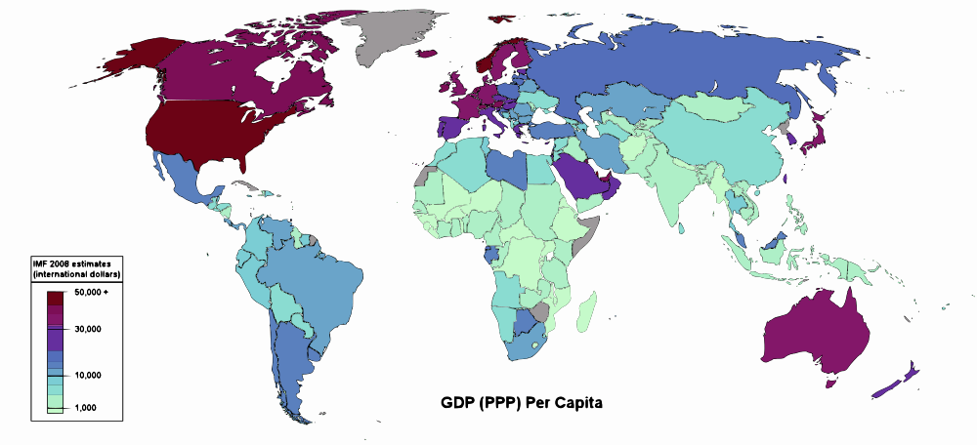
Economies of the World - 2008

Slide 7
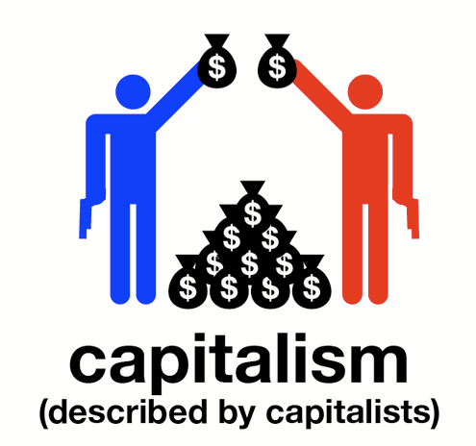
II. Economic Systems
Capitalism
An economic system in which factories, equipment, or other means of production are privately owned rather than controlled by the government.

Slide 8
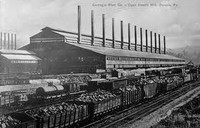
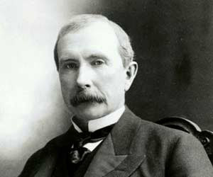
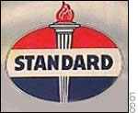
Laissez-Faire
Capitalism (continued)
A. The idea that the free market, through supply and demand, will regulate itself if government does not interfere
B. Government should be “hands off” with big business
C. Highest form of capitalism
D. Ex. Rise of Industry in America in 19th Century
John D. Rockefeller founder of Standard Oil had a net worth of $668 Billion

Slide 9
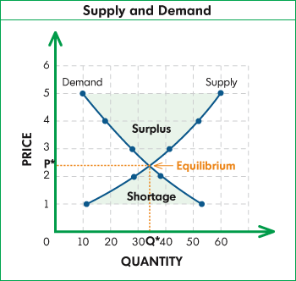
Supply & Demand
Capitalism (continued)
The way a market regulates itself in a capitalist society
In your Social Studies Journal add the following visualization.
So how does this work?

Slide 10
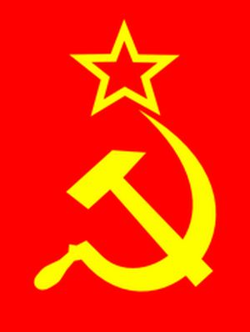
Socialism
A political and economic theory that advocates ownership of the means of production, such as factories and farms, by the people rather than by capitalists and land owners.
Power belongs to the working class
Ex –, Yugoslavia (parts of U.S.S.R.)
The symbol of the Soviet Union featured the hammer and sickle symbols of laborers for centuries

Slide 11
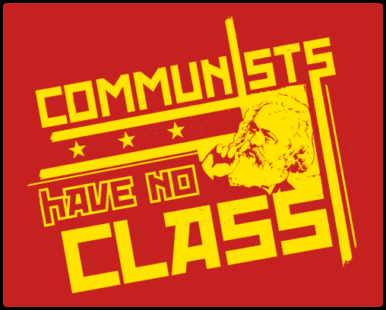
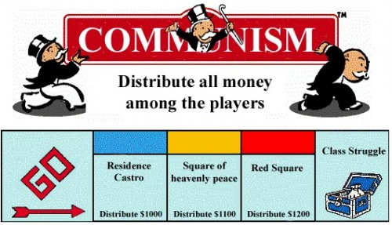
Communism
An economic or political system in which the state or the community owns all property and the means of production, and all citizens share the wealth.
Creates a classless society (theoretically
Ex – Vietnam, Cuba, U.S.S.R.

Slide 12
 | Capitalism (Market economy) | Socialism (mixed economy) | Communism (Command economy)
Ownership and control
Competition
Standard of Living
Basic means of production owned and managed by government
Private ownership, with regulation, of businesses
Individuals control means of production
Market determines what goods will be sold at what price
Government owns means of production
Government determines what goods will be sold at what price
Competition keeps prices low and quality high
No competition, lower quality goods
Cooperation stressed over competition
high standard of living and economic security
Individuals free to earn profits, but may risk losses
high standard of living and economic security
High taxes provide free health care and education
Goal is equality for everybody, enforced by the government

