Slide 1
Corkeys BBQ
Elijah smiley

Slide 2
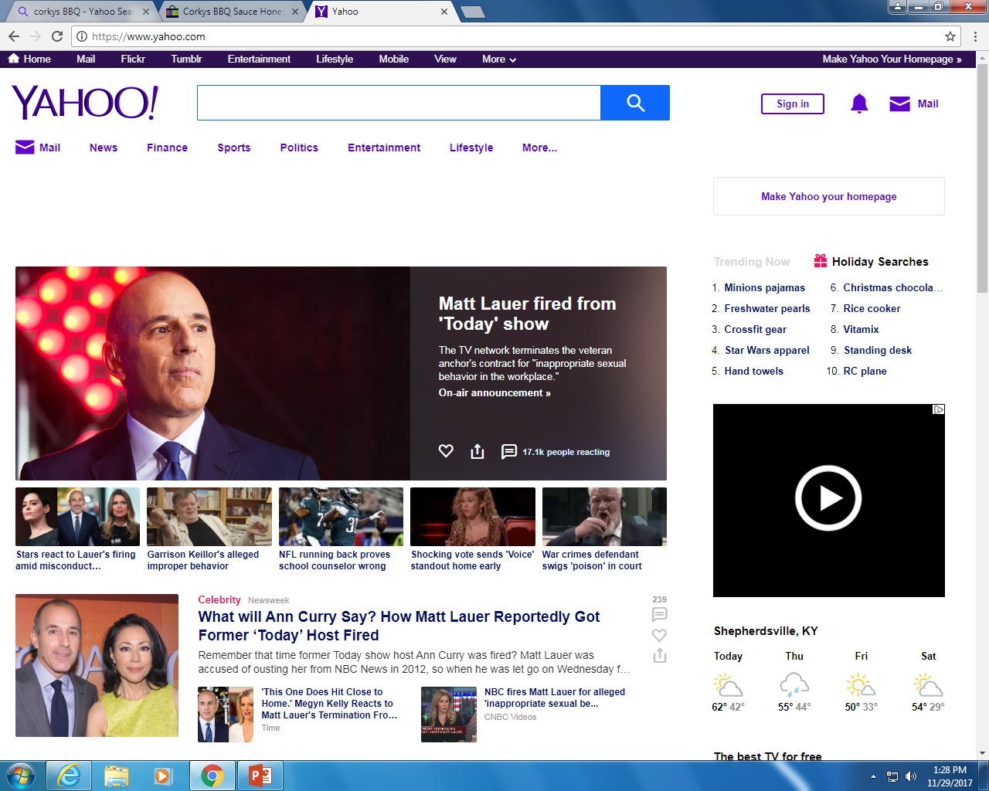
Advertising
Corkys BBQ
3954 Buba lane Sherpersville, Kentucky
Licensed to grill

Slide 3
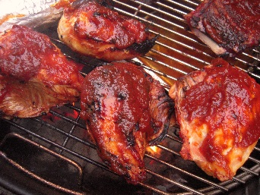
Magazine ad
Come on in to Corkeys BBQ to have a good time at a great price
Licensed to grill
3954 Bubba lane, Shepherdsville,
Kentucky

Slide 4
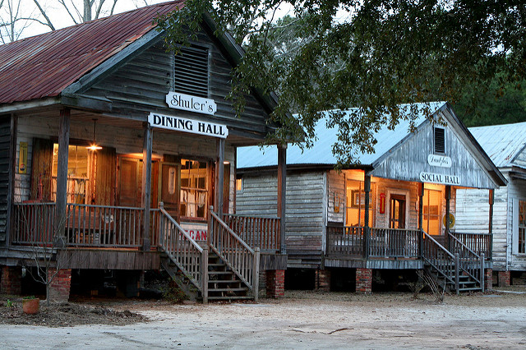
Broadcast media
Corkeys BBQ is great.

Slide 5
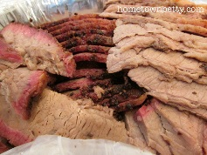
Print media
corkys BBQ
Licensed to grill
3954 Buba lane
Shepherdsville, Kentucky

Slide 6
Specialty media
Corkeys BBQ

Slide 7
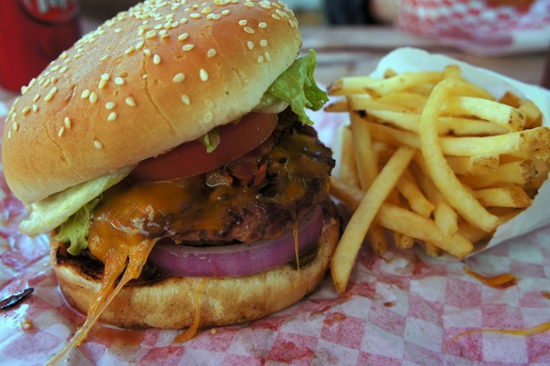
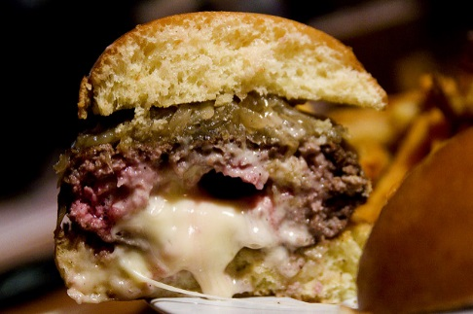
Sales promotion
coupon
25% off when you buy a burger

Slide 8
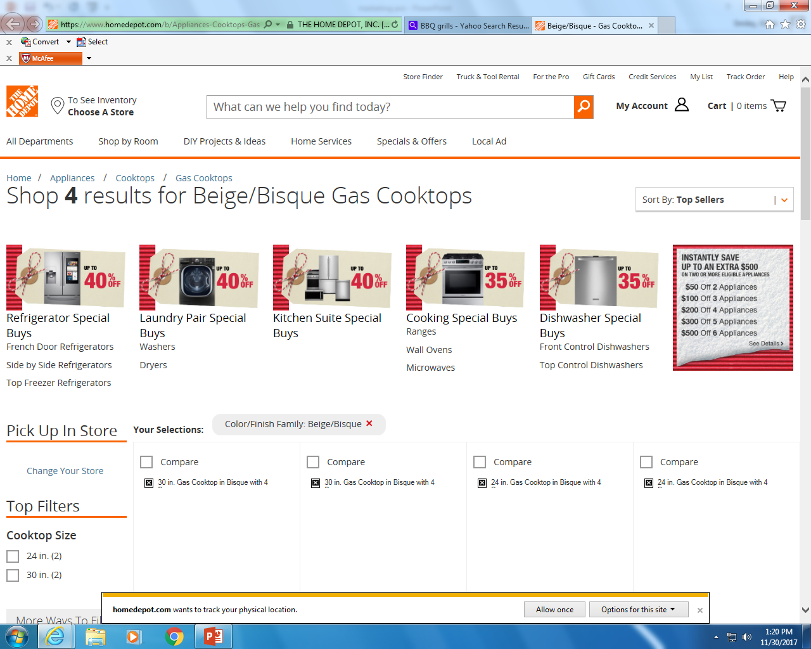
Sponsorship
Corkeys BBQ now sponsoring by home depot

Slide 9
Loyalty marketing program
Corkeys BBQ

Slide 10
Premiums
Spend more than $60 in our store then you get a free bottle of corkeys sauce
Corkys sauce

Slide 11
Direct marketing
hj
3954 Buba lane, Shepherdsville, Kentucky
Corkeys BBQ

Slide 12
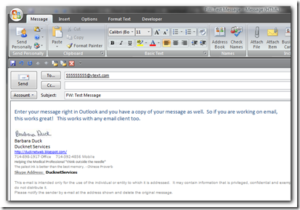
email
Marla.morris@stu.bullet.kychools.us
Corkeys BBQ@ gmail.com
Come and visit our famous BBQ place.
3954 Bubba lane,
Shepervlle, Kentucky

Slide 13
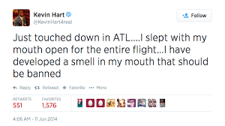
Publicity
EVERYBODY come and check out Corkeys BBQ

Slide 14
Personal selling
This is corkeys BBQ. How may I help you?
I would like to hear what specials you have going on.
Corkeys BBQ

Slide 15
Public relations
On Monday, January 3rd. Corkeys BBQ will be hosting a fundraiser for the make a wish foundation

