Slide 1
Jackal Sporting goods
Real Sport fans wear Jackal Sporting Goods
CEO Ethan Talbott

Slide 2
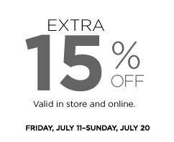
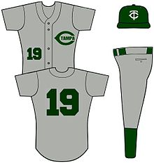
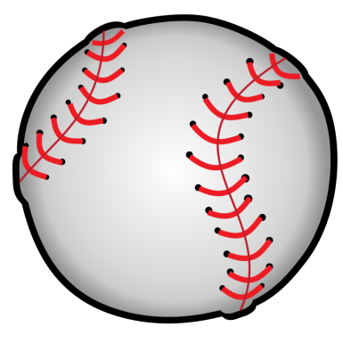
Sales Promotion
Jackal Sports
If you buy 3 Fishing rods you get the next one half off with some free bait
In every baseball outfit set, you get a free baseball inside
Jackal

Slide 3
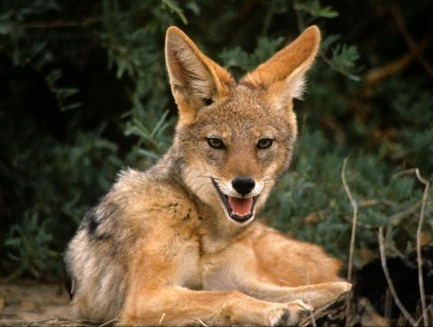
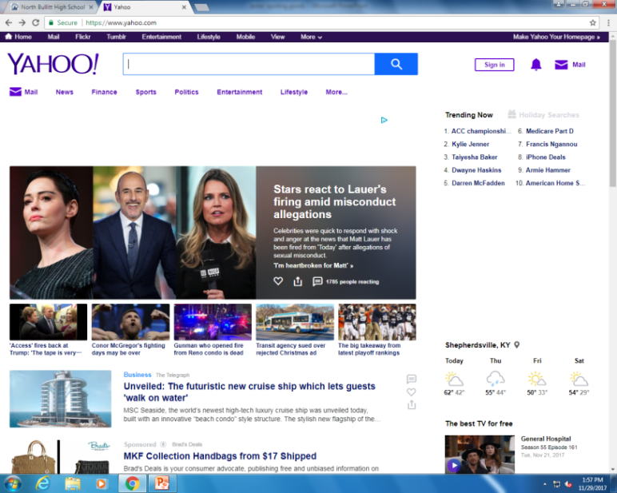
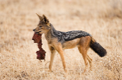
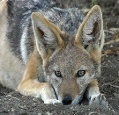
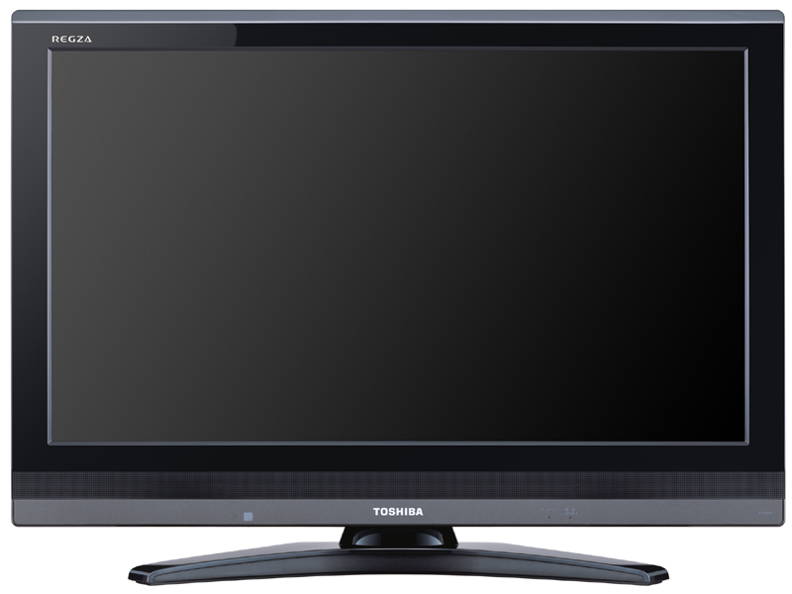
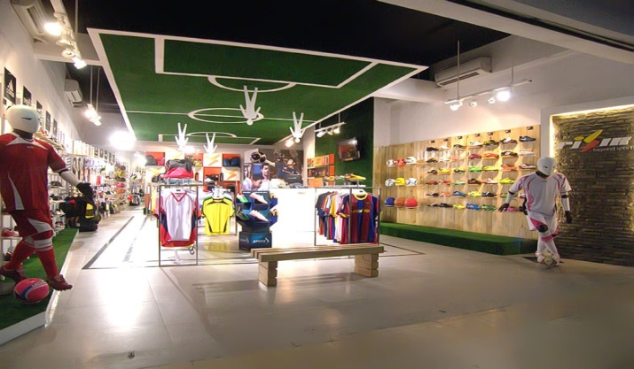
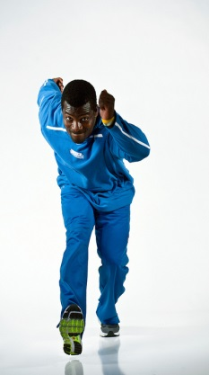
Advertising
Jackal Sporting Goods
Jackal Sporting Goods
Fear the Jackal
The best Sporting Goods store in Kentucky
Jackal Sporting Goods is amazing
Jackal Sporting Goods

Slide 4
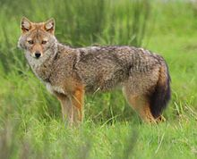
Direct Marketing
Jackal Sporting Goods at 1234 ayy st
Jackal Sporting Goods 1234 ayy st

Slide 5
Personal Selling
I would like to know if you sell Footballs
This is Jackal Sporting Goods How May I Help You?

Slide 6
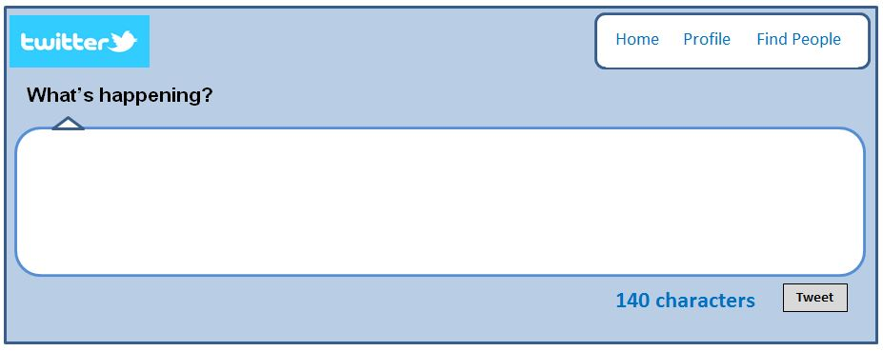
Publicity
Tim Wells
Just found my Favorite sporting goods Store. @Jackal Sporting Goods

Slide 7
Public Relations
On Friday Dec 1ST Jackal Sporting Goods is hosting it’s 5TH Annual Meat for the Poor fundraiser
Ethan

