Slide 1
WELCOME
to
marketIng

Slide 2
Syllabus
Digital copy can be found on my webpage
marlamorris.weebly.com
WEEKLY Quizzes
Weighted GRADES

Slide 3
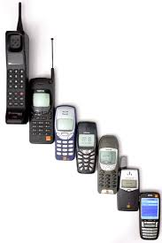
Cell phones
Not during LECTURE. ☺
This is your 1ST warning…
2nd Warning: Email to parents & referral process.
3rd Warning: Referral goes to OFFICE.

Slide 4
aRRIVAL
Chromebook
Pen/Pencil
Paper
On Time
If not
1st Period: ABSENT
All Other Periods: Absent then TARDY

Slide 5
DISMISSAL
NO
STANDING
Throw TRASH away
Push in Chair.

Slide 6
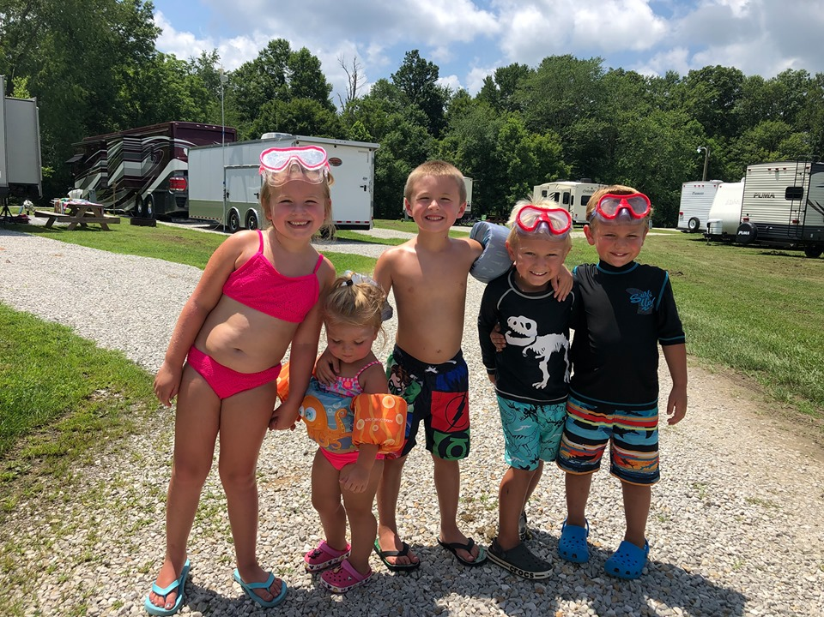
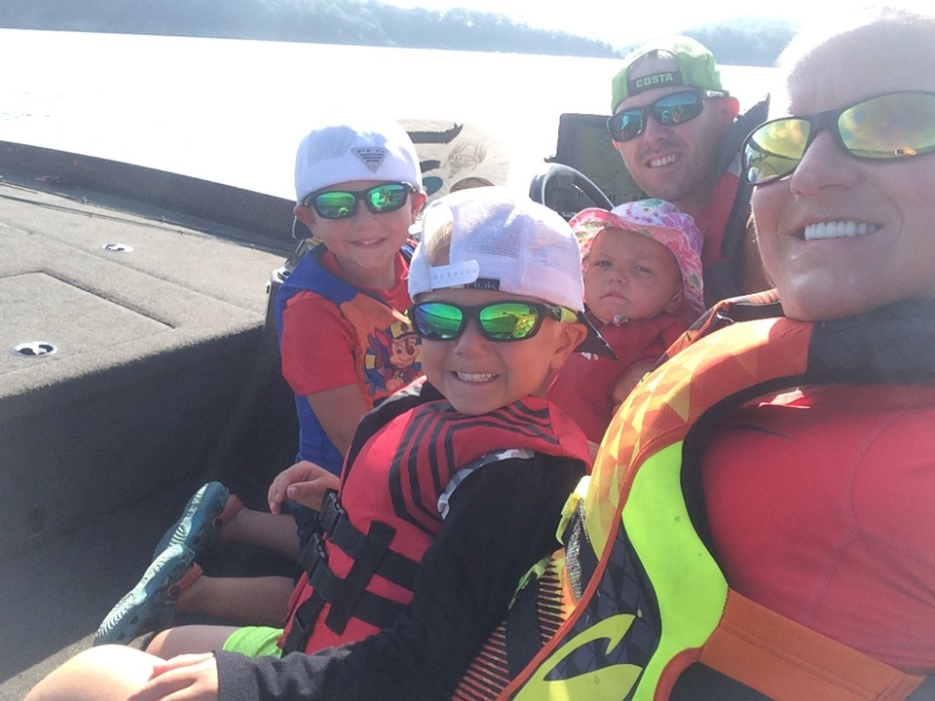
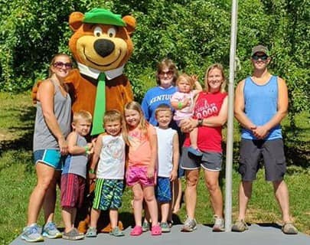
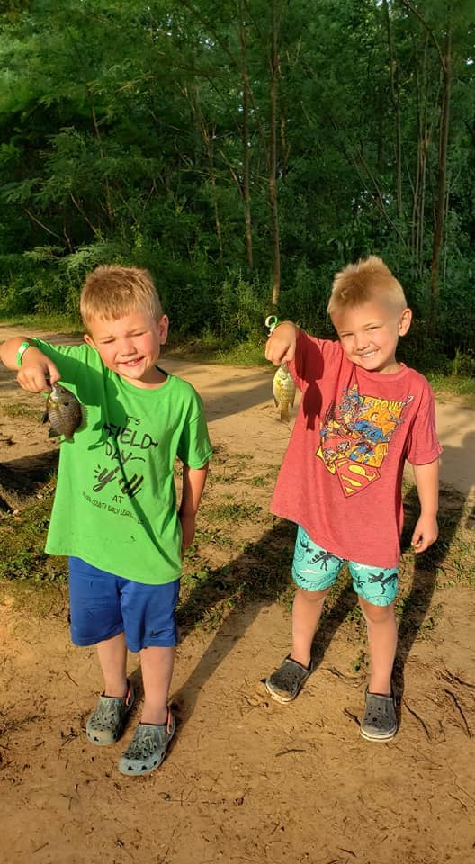
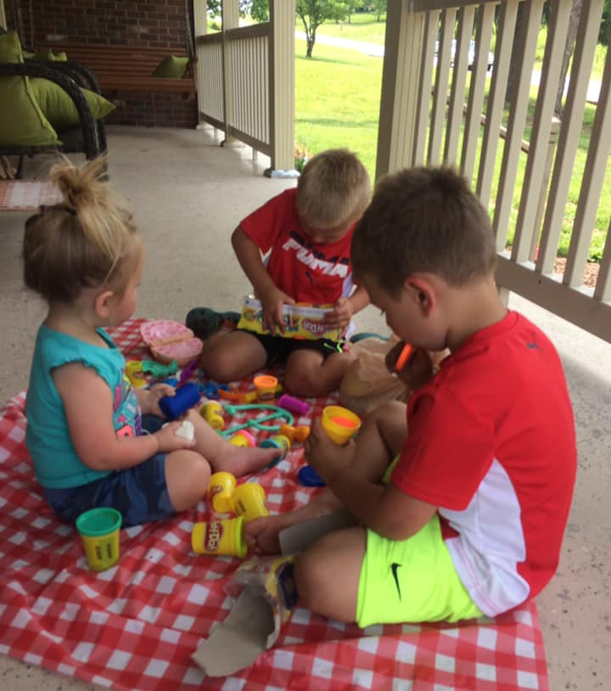
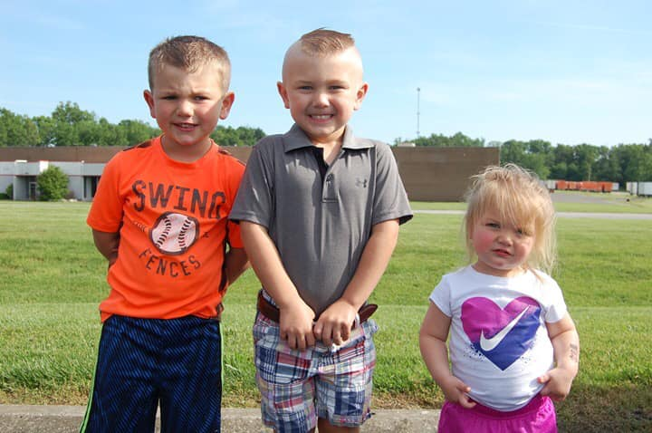
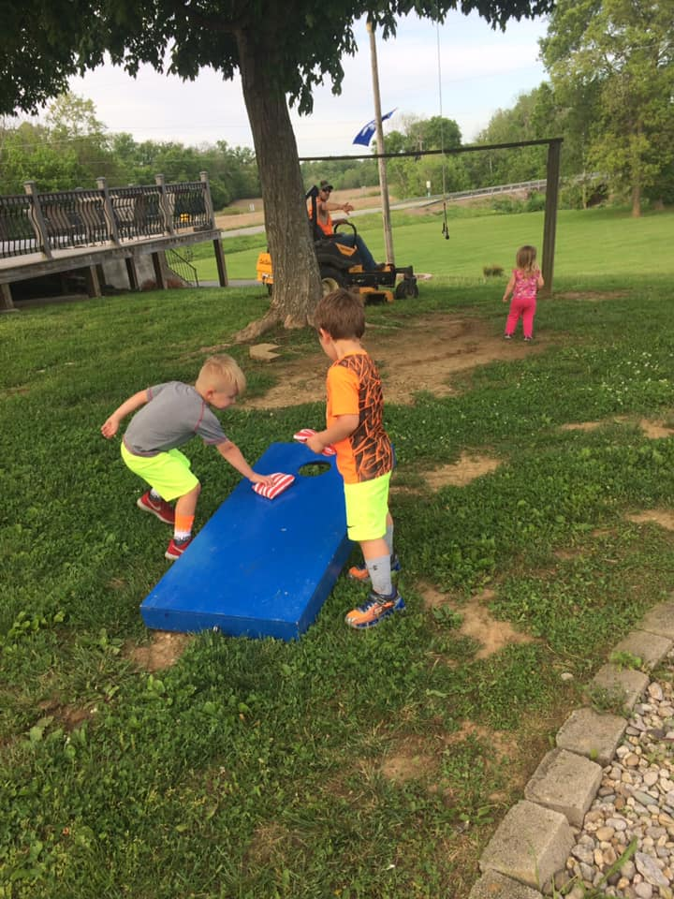
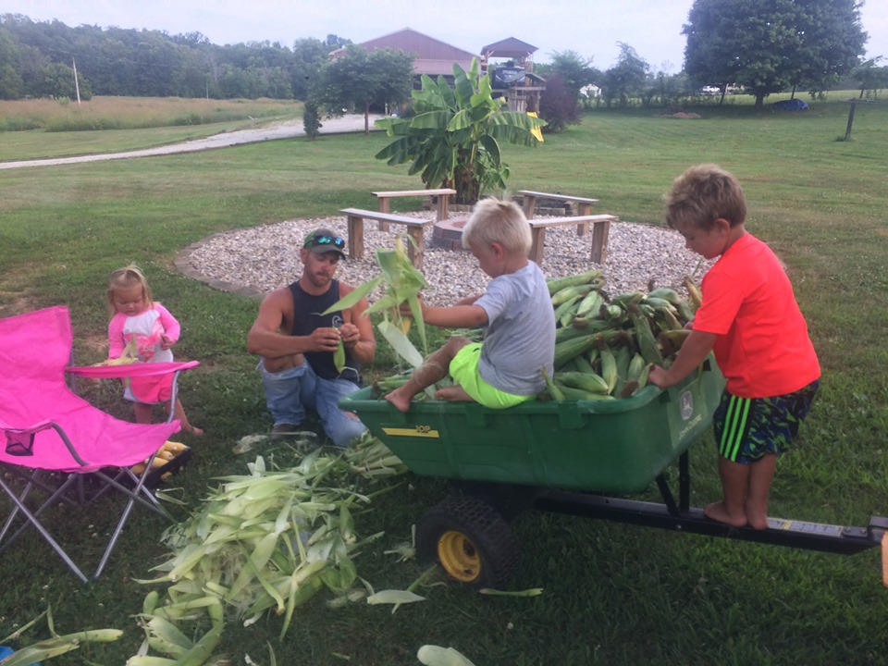
famIly
Hunter 6, Eli 5, Chey 2

