Slide 1
The Global Marketplace
Quiz DAY
Learning Target:
Describe the concept of economics.

Slide 2
Doing Business Internationally
The global marketplace has been growing with the advances in technology, and reduction of trade barriers.
These factors have encourages businesses to venture into foreign countries.

Slide 3
Licensing
Involves letting another company (licensee) use a trademark, patent, special formula, company name, or some other intellectual property for a fee or royalty
With licensing, a foreign company make the product using the info or guidelines provided by the licensor.
If the product is a success in the foreign country, the licensor has gained entry with minimal risk.

Slide 4
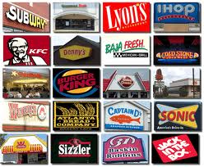
Franchising
A special type of licensing.
In a franchise agreement, a franchisor grants the franchisee the rights to operate under the company name.

Slide 5
Contract Manufacturing (outsourcing)
Involves hiring a foreign manufacturer to make your products, according to your specifications.
Major benefit is lower wages, which allow companies to be more competitive with their pricing
One pitfall is that proprietary information must be given to these companies.

Slide 6
Joint Ventures
A business enterprise that companies set up together
In some countries, foreign investors are not permitted to own 100 percent of a business.
Domestic business partners know the market and procedures for conducting business in their own country.

Slide 7
Multinationals and Mini-nationals
Multinationals are large corporations that have operations in several countries.
Mini-nationals are midsize or smaller companies that have operations in foreign countries.
All of these investments are referred to as FDIs.

Slide 8
Global Marketing Strategies
In planning and making decisions about the four P’s of the marketing mix, global marketers need to consider all the factors analyzed for the environmental scan.
The possibilities for marketing strategies that involve product and promotion decisions include globalization, adaptation, and customization.

Slide 9
Globalization
Selling the same product and using the same promotion methods in all countries.
Only a small portion of products that are common to all global customers can use this marketing strategy.

Slide 10
Adaptation
Is a company’s use of an existing product and/or promotion to which changes are made to better suit the characteristics of a country or region
Product adaptation is the change of a product to meet needs and/or to reflect the cultural differences in a foreign market.
Promotion adaptation is the changing of the advertising message to reflect the values, familiar images, and cultural differences in a foreign market.

Slide 11
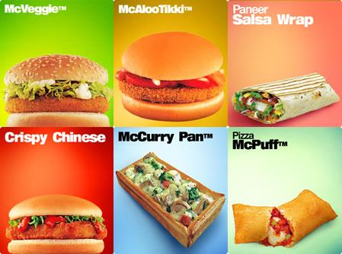
Visit McDonald’s
International!

Slide 12
Customization
Involves creating specially designed products or promotions for certain countries or regions.
Each geographical area where a product is sold or a service is offered becomes a unique market segment.

