Slide 1
Promotional Campaign
Hannah Harris

Slide 2
Print Media
- Billboard

Slide 3
Print Media
- Blimp

Slide 4
Online ad

Slide 5
Specialty Media

Slide 6
Personal selling
Thank you for calling Handy Helpers today. My name is Hannah, How may I help you?

Slide 8
Sales promotion
-free sample

Slide 9
Direct Marketing
-email

Slide 10
Direct Marketing
-postcard

Slide 11
Publicity

Slide 12
contest
Free trip to Hawaii

Slide 13
Public Relations
Handy Helpers! We are donating money to cancer research debating on how may shares and likes this post gets!!! LIKE AND SHARE

Slide 14
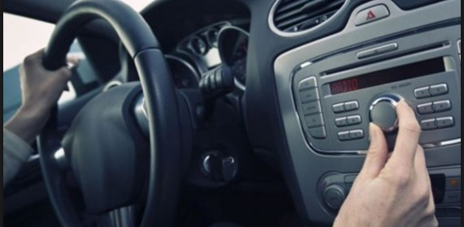
Broadcast Media
Handy helpers do it best
! Get your car fixed quick and fast! On hill view bld right beside hill view vet clinic! Any questions call us at (502)-726-1246

