Slide 1
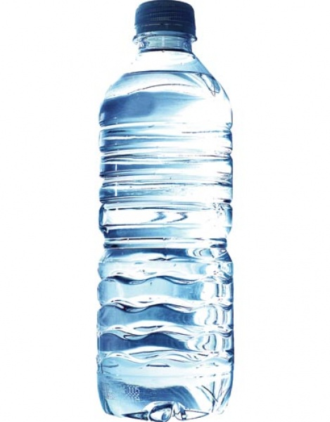
Big k’s flavored water
Kenton skaggs

Slide 2
Try big k’s flavored water off of exit 116
Big k’s flavored water

Slide 3
25% off any perges of big k’s water

Slide 4
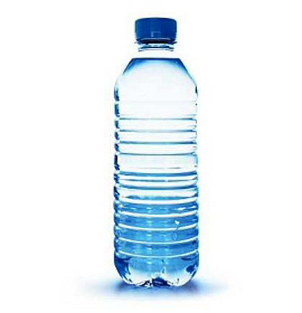

Slide 5
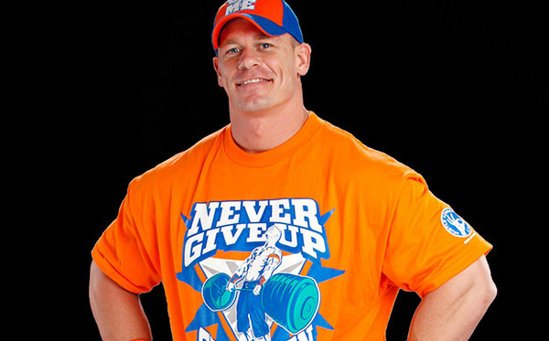
Big k’s water is the best water I ever had
Big k’s water is the best water I ever had

Slide 6
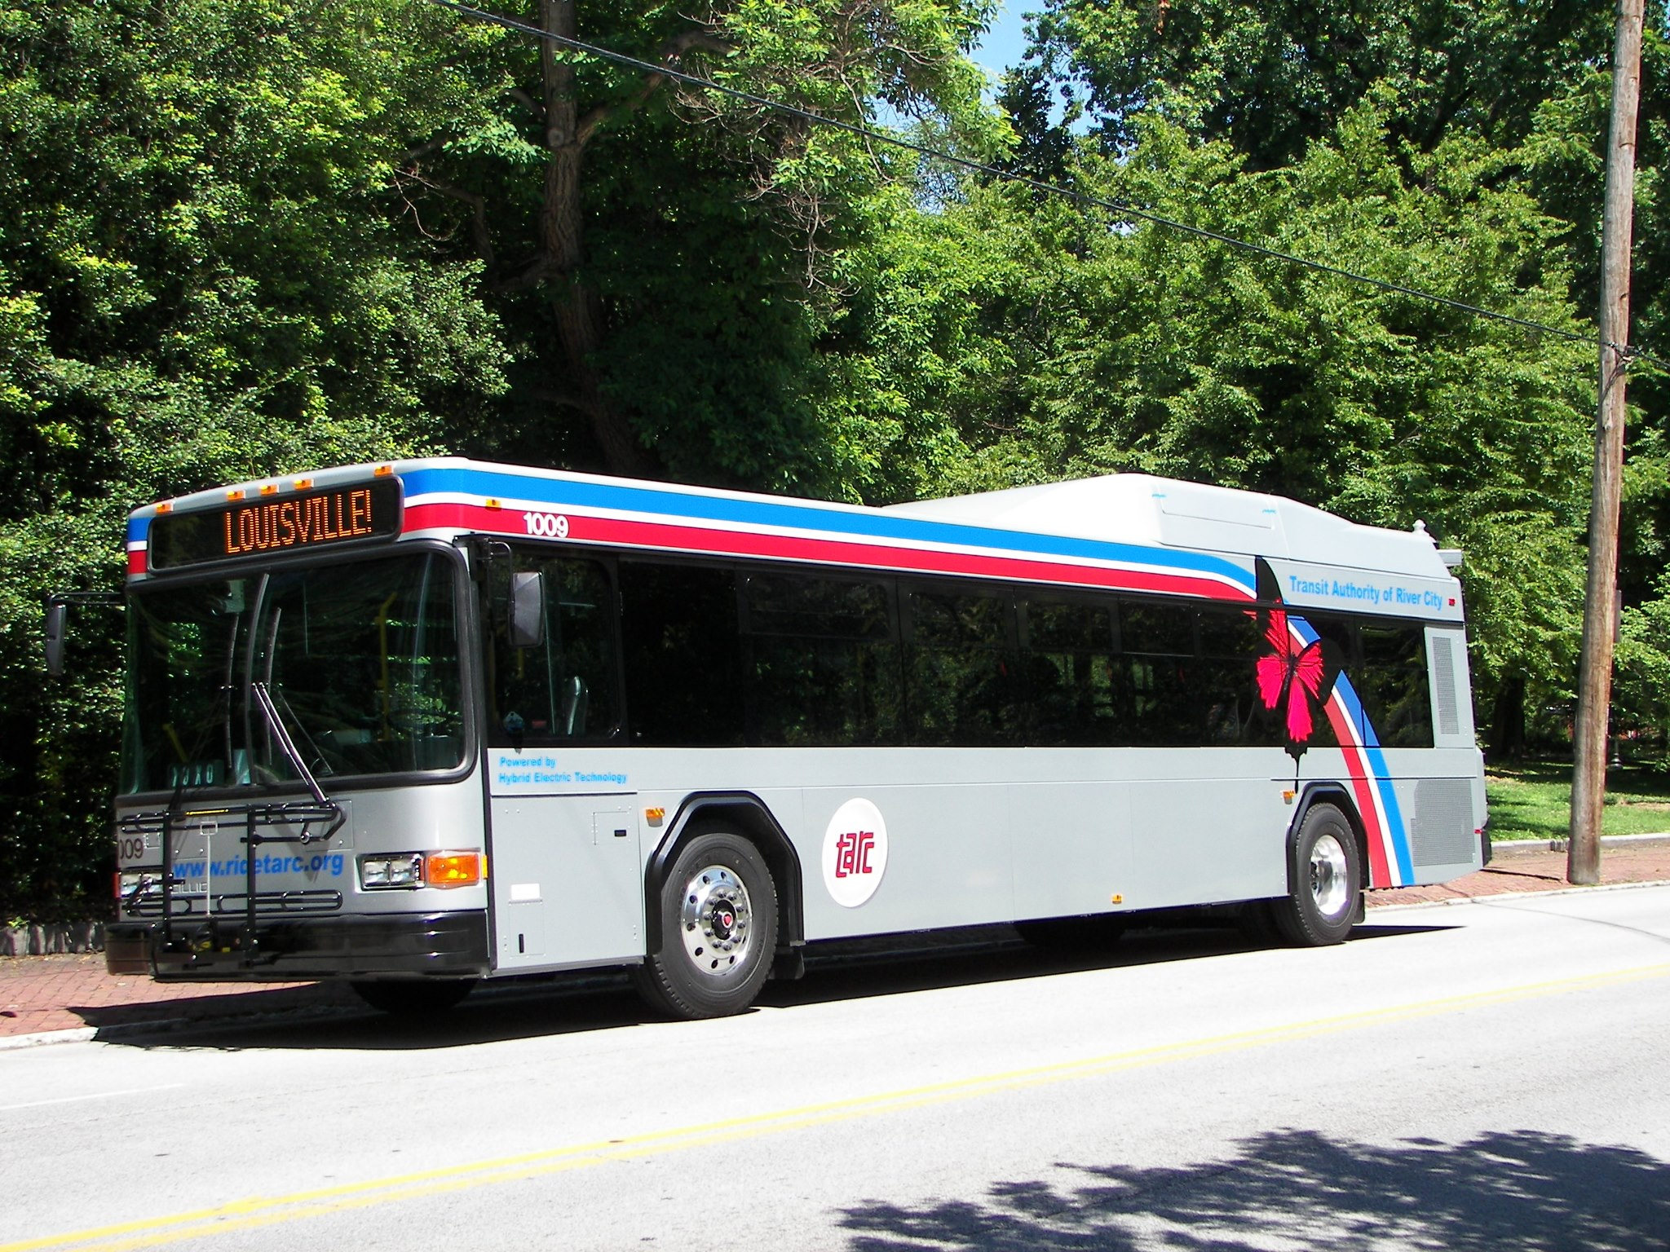
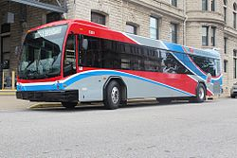
Try big k’s flavored water

