Slide 1
COMPLEX COMPUTERS
By Lonnie Compton

Slide 2
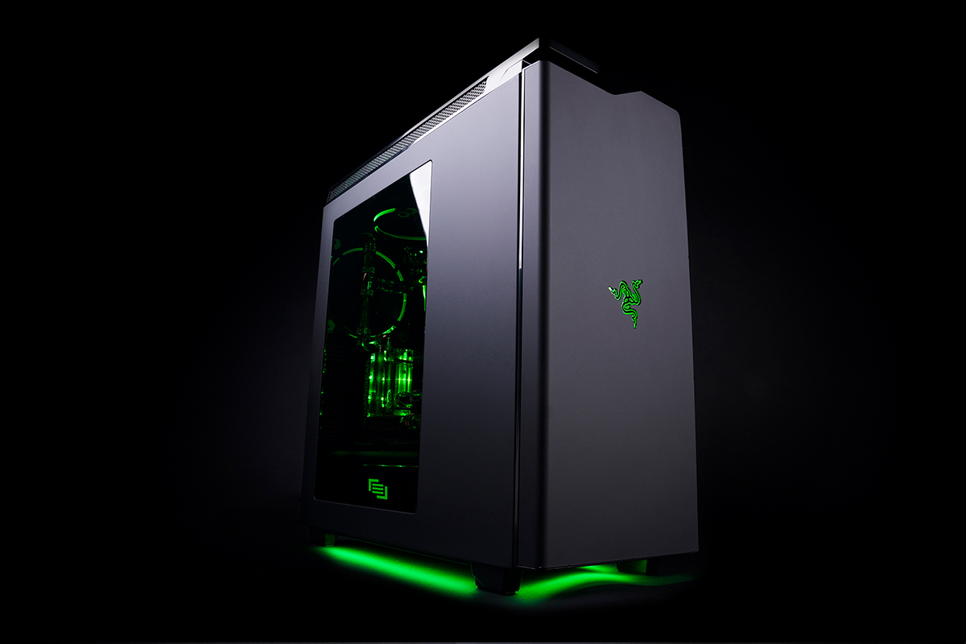
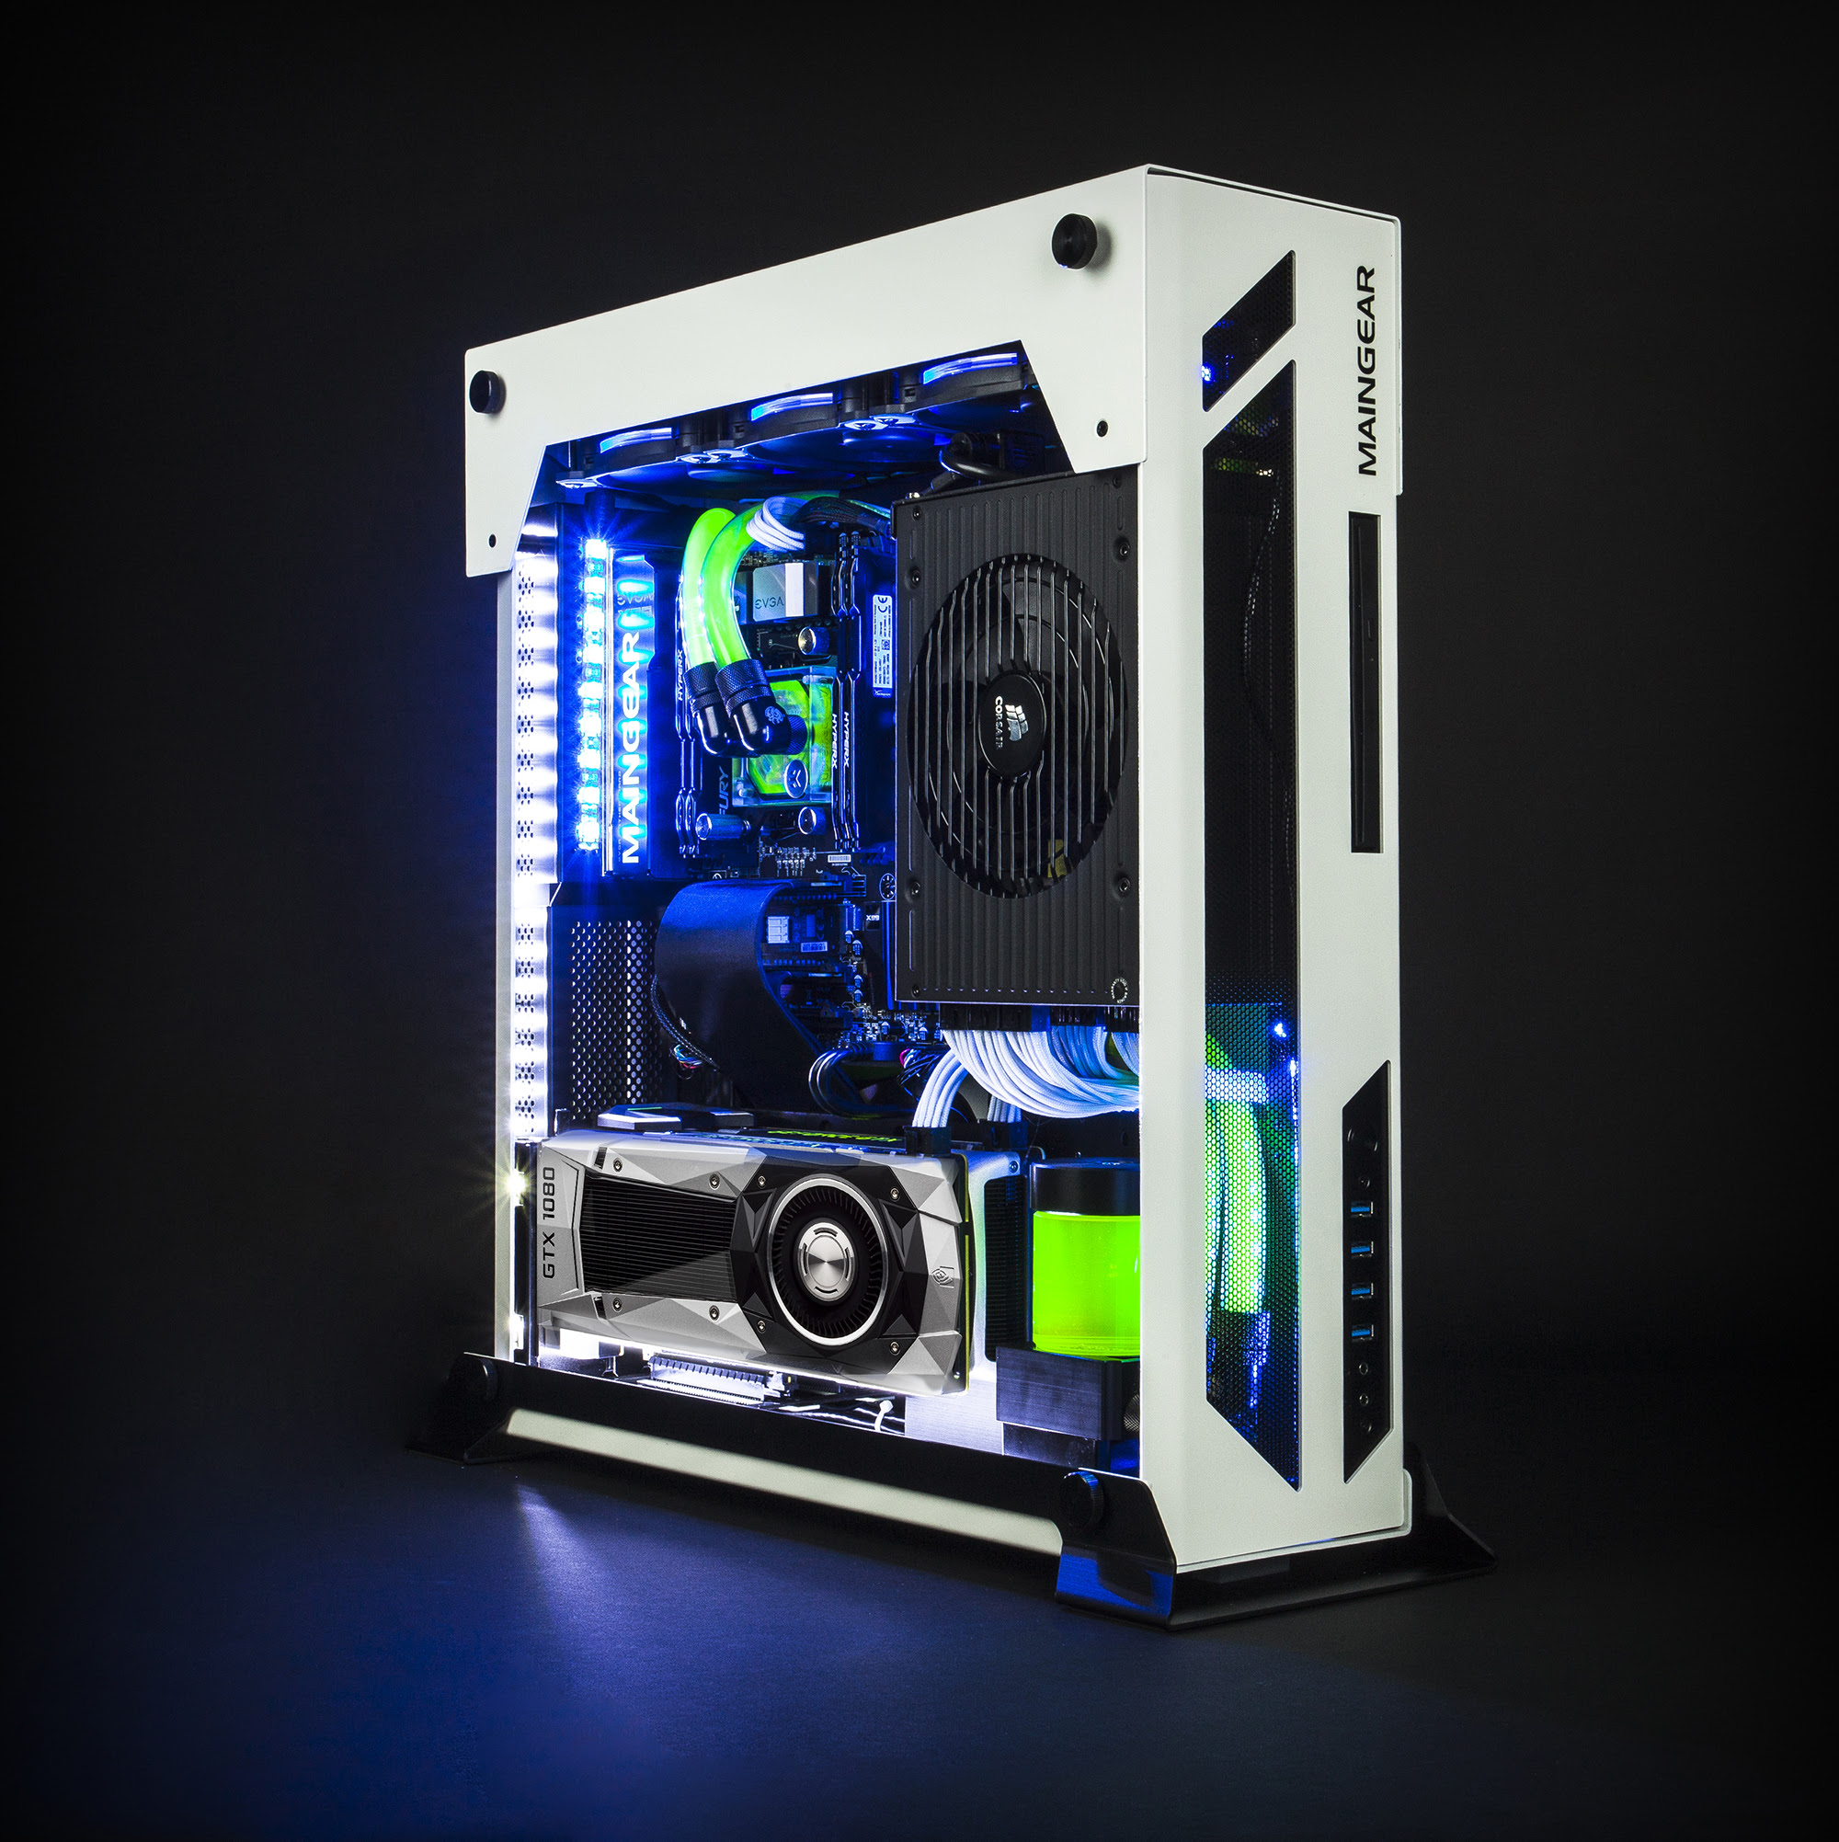
Print media
^{complex compuTERS}
^{THE BEST COMPUTERS AROUND}
CC

Slide 3
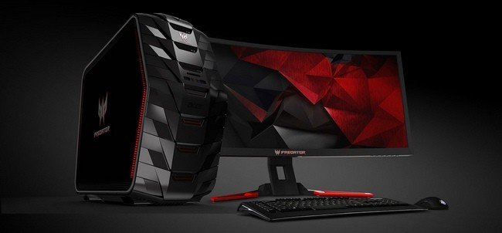
GGG
COMPLEX COMPUTERS
11256 computer ave
Visit us today!

Slide 4
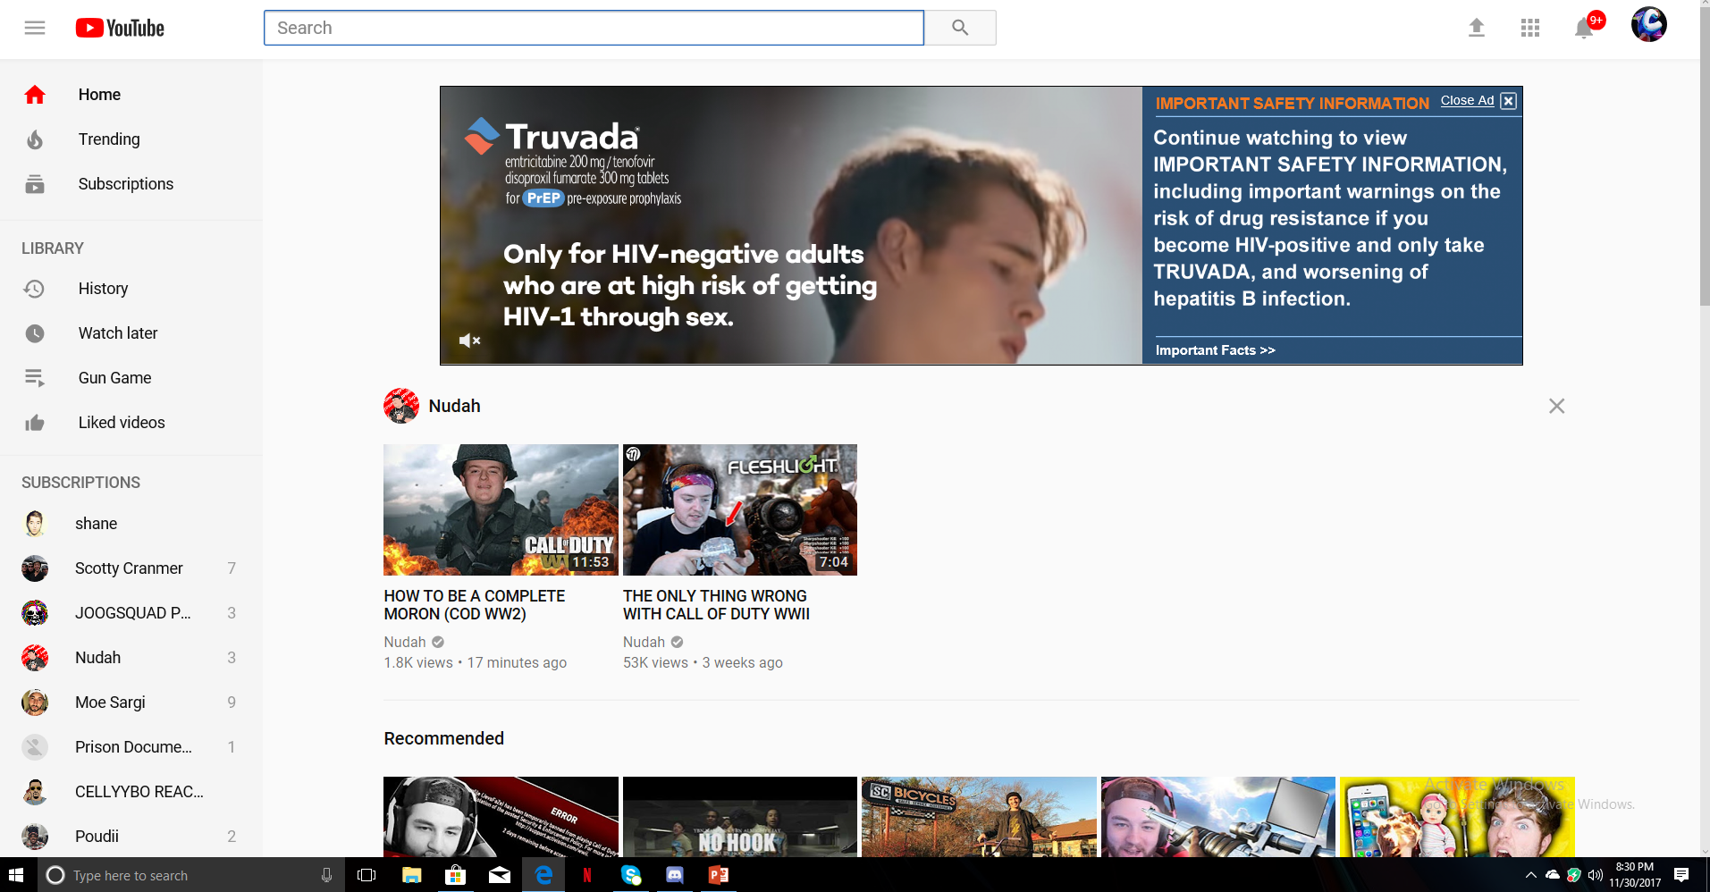
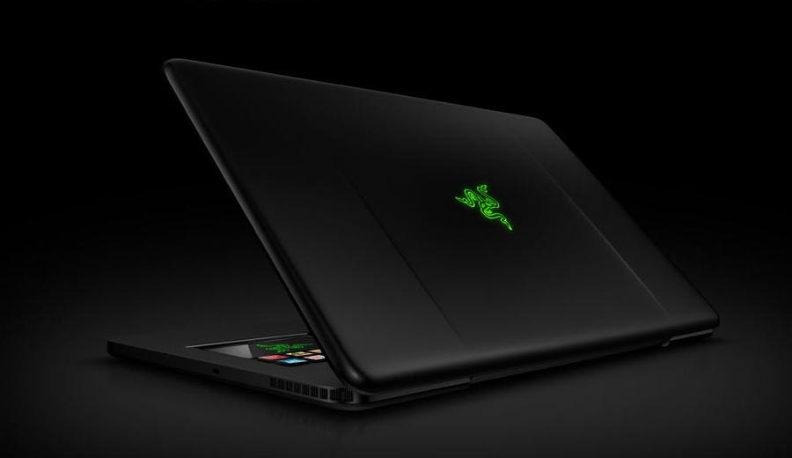
ONLINE
Shop Complex Computers today to find the best priced computers around town!

Slide 5
SPECIALTY MEDIA
COMPLEX COMPUTERS

Slide 6
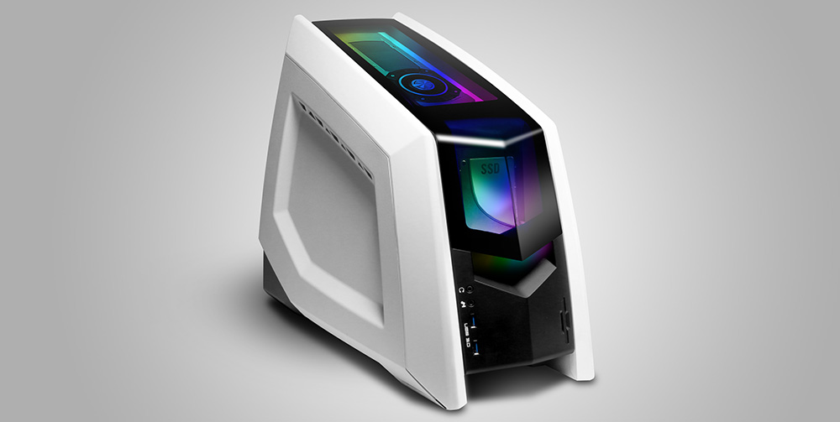
BROADCAST MEDIA
Call 403-485-5218 or see us in person at 11256 computer ave Today!
Best computers around!!!!
Price match guaranteed
Lowest prices

Slide 7
Sales promotion
COUPON!!!
COMPLEX COMPUTERS!
$200 OFF ANY PURCHASE $1000 OR MORE!
Coupon only works at 11256 computer ave! expires 12/21/17

Slide 8
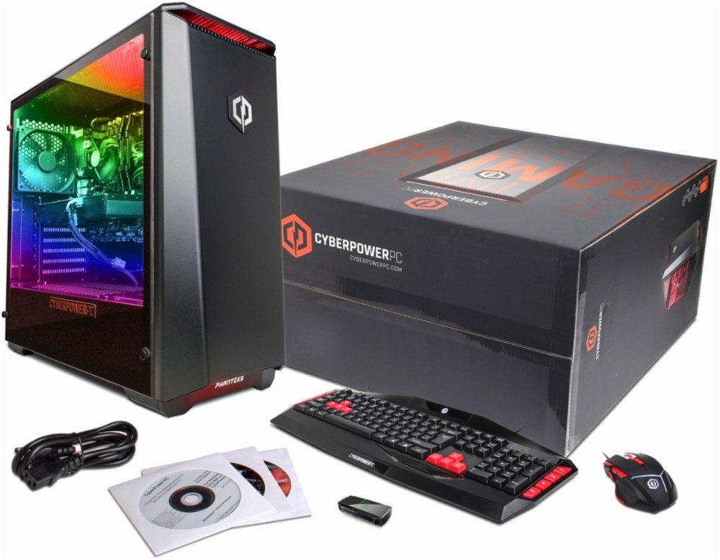
SALES PROMOTION
BUY NOW AND GET A FREE KEYBOARD AND MOUSE FOR FREE!!
CC

Slide 9
SALES PROMOTION
ENTER TO WIN A FREE GAMING PC!!!
FULL NAME:
GENDER:
ADDRESS:
DATE OF BIRTH:
EMAIL:
PHONE NUMBER:

Slide 10
PERSONAL SELLING
When speaking to customer on the phone: Hi this is Complex Computers bringing you the best deals on computers around town, anything specific you are calling for?

Slide 11
publicity
Just stopped by @ComplexComputers to get this amazing new computer for the cheapest price around town. If you are in need of a new computer I highly suggest going to ComplexComputers.

Slide 12
Public relations
The company known as ComplexComputers donates $500,000 to hurricane victims in Florida.

Slide 13
Direct marketing
Hey this is ComplexComputers letting you know about our sale we are having on…

Slide 14
Direct marketing
CC
CC

