Slide 1
Aero football

Slide 2
Print media
Go to aero sports & outdoors to get the best equipment now

Slide 3
Print media
Aero Sports & outdoors

Slide 4
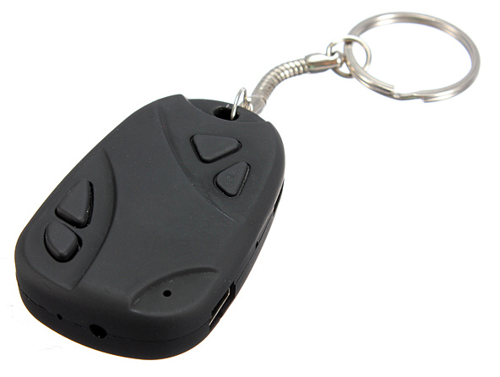
Specialty media
Aero Sports & Outdoors

Slide 5
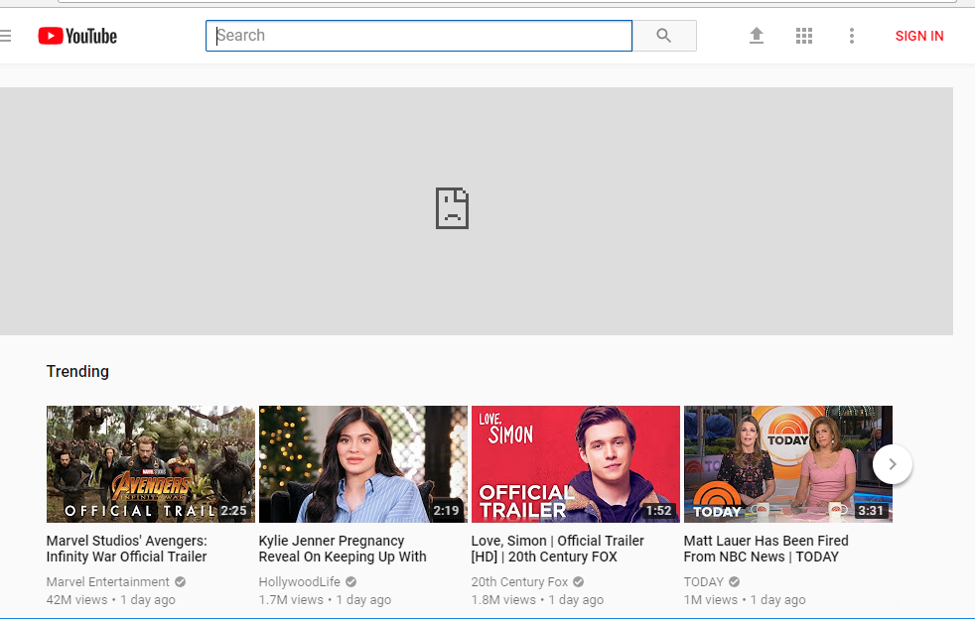
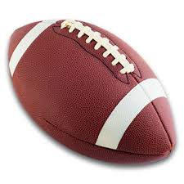
online
Aerosports.com
Special cyber Monday sale everything online 15% off and any order over $50 is an extra 25% off

Slide 6
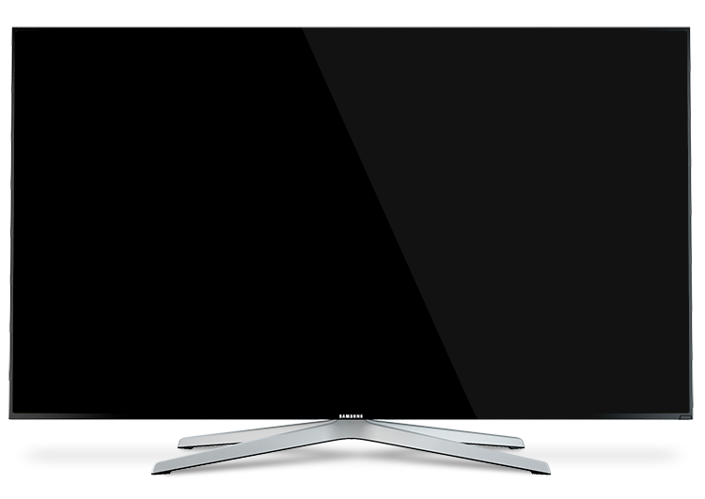
Broadcast media
Come to aero sports and outdoors now!!

Slide 7
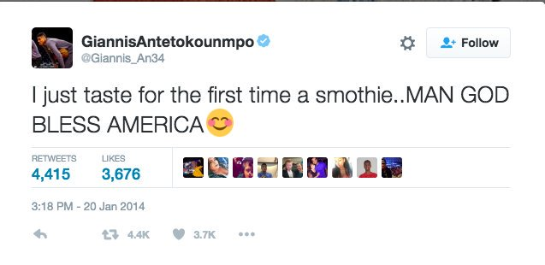
Publicity
Just went out to Aero Sports for some new gear that you might see on the court soon???? #GETEWITHTHEGAME

Slide 8
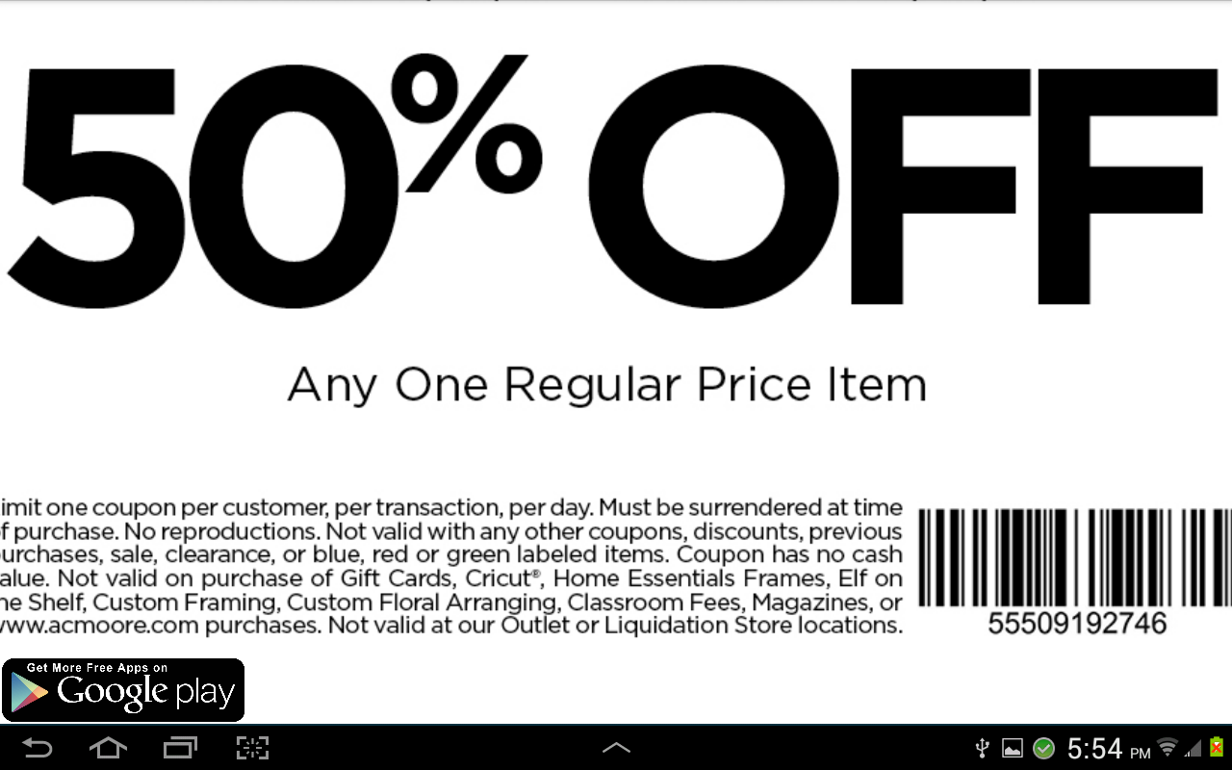
Coupon
Aero sports
Any order of $100 or more

Slide 9
Loyalty marketing program
Aero
REWARDS

Slide 10
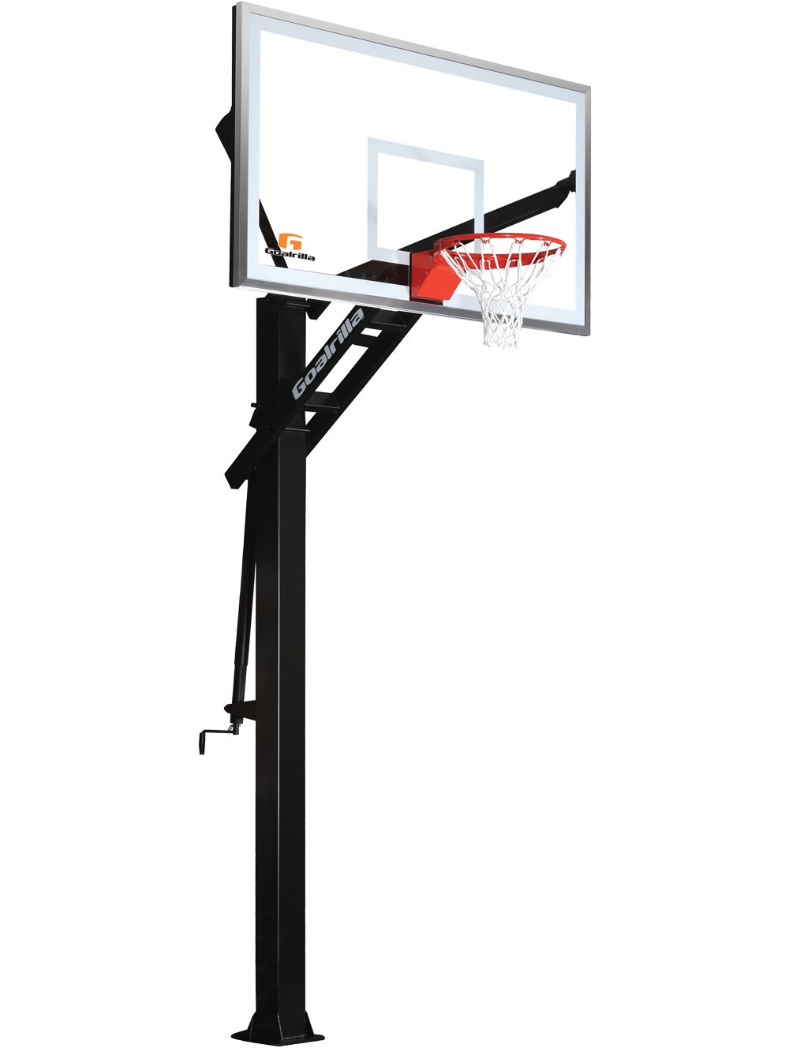
Incentives
Everytiem you go in store or online and spend $150 or more you are entered in a sweepstakes for a FREE Basketball goal

Slide 11
PR
2017
AERO
SPORTS

Slide 12
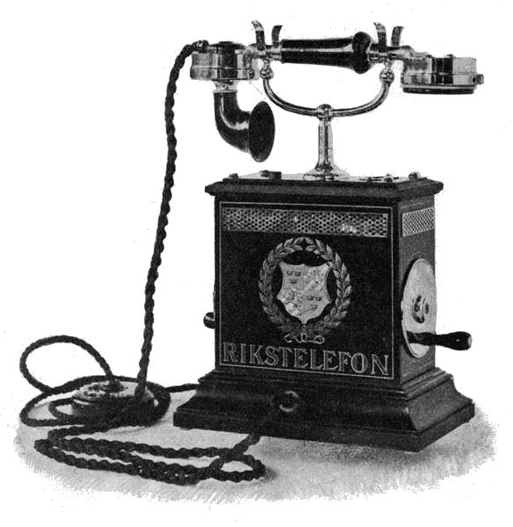
Personal selling
Hello thanks for calling aero sports what can I help you with today?

Slide 13
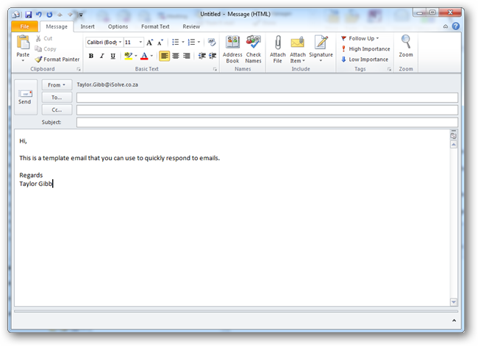
Direct marketing
Someguy@123.com
hello,
Today I'm emailing you about the new aero sports store in Miami Florida we have some great new things in the tore as you may be aware Miami has some of the best high school football teams so today you might be intr4ested in some new football stuff

Slide 14
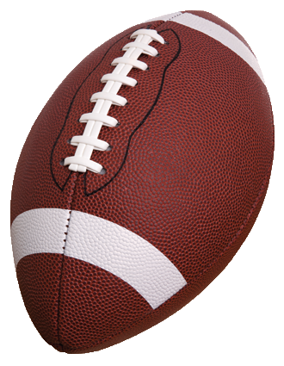
Direct marketing
Aero sports & outdoors
Get 25% off of any purchase of over $50

