Slide 1
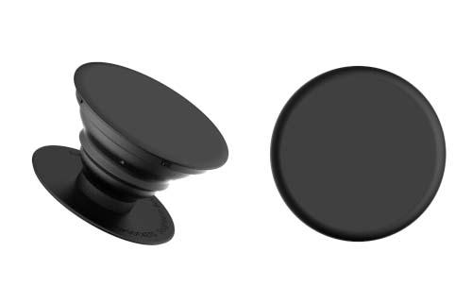
Sales Promotion
Product Placement
Off to Twinz Bakery, Pups
Coupon
1-800-555-TWIN
TB
Twinz Bakery
Loyalty Marketing
Program
Specialty Media/
Traffic Builder

Slide 2
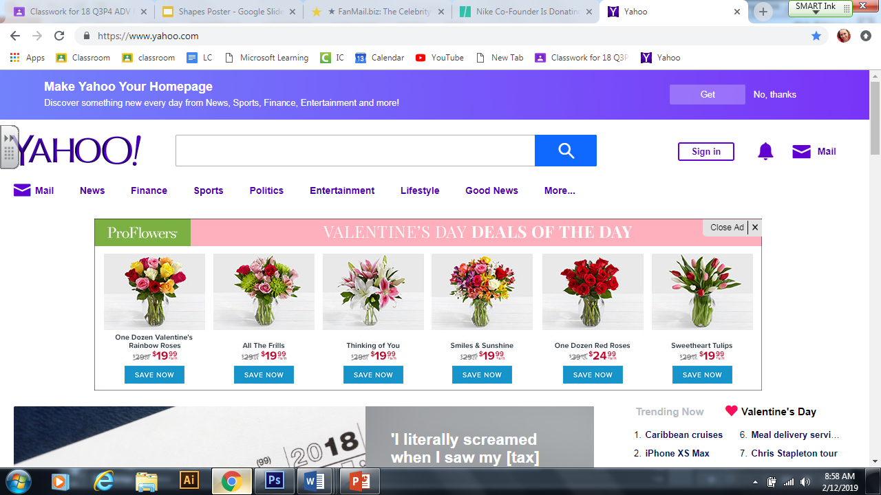
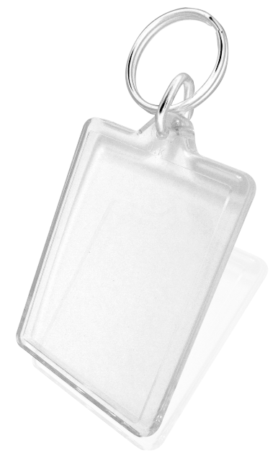
Advertising
Print Media: Transit
Specialty Media/
Traffic Building
Online
Print Media: Billboard
Broadcast Media

Slide 3
Personal Selling

Slide 4
PR and Publicity
On this VDAY I am buying Zac cupcakes from TWINZ BAKERY #ILOVETWINZBAKERY

Slide 5
Direct Marketing
Front
Back

