Slide 1
Promotional Campaign
Brock Snead

Slide 2
Advertising- Print Media
Come to our local store between noon and 2 P.M. to receive a 20% discount!
Visit Us At Velocity Sports!

Slide 3
Online
Get up to 35% off on our new products!

Slide 4
Specialty Media
Velocity Sports
Call 1-800-VSPORTS

Slide 5
Broadcast Media
" Enter your local Velocity Sports today, or enter promo code SPEED online to get a 25% discount on all products! "

Slide 6
Personal Selling
Customer- "I'm looking for any kind of sportswear."
Employee- "Well, at this Velocity Sports store only, if you buy two shirts, you get one free!"
Customer- "That's great! I'll go find three and then you can ring me up!"

Slide 7
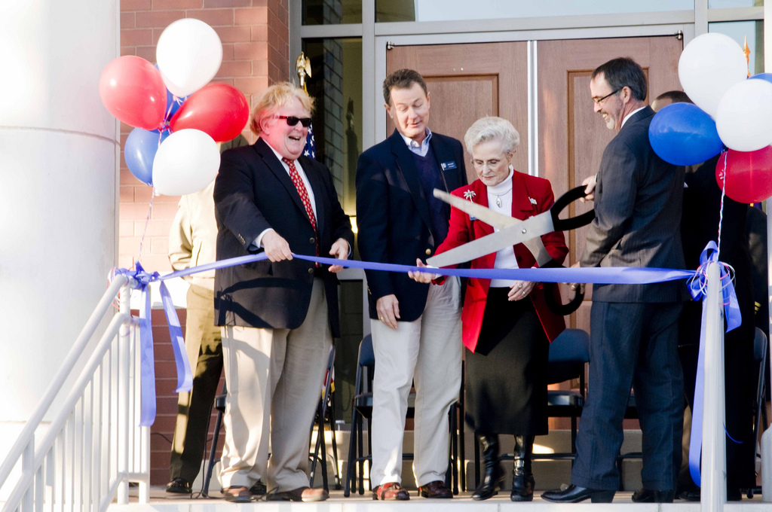
Publicity
Velocity Sports Grand Opening Was A Huge Success.

Slide 8
Public Relations- Press Release
Hometown Velocity Sports Hosts Annual Basketball Camp
STARKVILLE, MS, June 11, 2015 /24-7PressRelease/ -- Hit Velocity Sports Center and see the buckets, dribbles, hoops, alley-hoops and sounds of gym shoes on the gym floor Velocity Sports is hosting the annual The Elite “Velocity Sports" Basic Skills and Fundamentals Basketball Camp -June 23-25, 2015----in Starkville, MS in the Velocity Sports Center located at the Starkville Sportsplex, 405 Lynn Lane from 8a.m.-12 noon. This is a three-day event with the cost for attendance being $75.00. The Elite Camp gives lovers of basketball the opportunity to receive instructions and practice the basic skills and fundamentals of basketball. The camp boasts of high school and college coaches, as well as professional players and trainers teaching young basketball enthusiasts the basic skills needed to improve their game. Different strategies used in the camp will be team-building exercises, dribbling, defensive techniques, working on fundamentals and of course shooting drills. The camp sessions are open to all girls and boys in grades 6-12. Space is limited with early registration available until June 22, 2015. One of the goals of the Elite basketball camp is that each camper will have fun and learn to become the best player that he or she can possibly be. The staff works toward both of these goals in every camp activity. ALL coaches involved desire to help ALL campers develop into confident individuals who are mentally prepared for LIFE and BASKETBALL. Last year we saw some great athletes and the turnout was amazing! We are looking for even greater achievements this year. Airades Public Relations is a full service public relations group that brings your story to the public. We focus on public relations, social media, crisis management and events. APR creatively brands you with our personal touch & strategic thinking. We understand the importance of personal attention and the bond we establish with our clients so much that we go above & beyond the call of duty. We are savvy, smart & honest group that believes in you.

Slide 9
Sales Promotion- Coupon
Velocity Sports
2018

Slide 10
Contest
If you make 10 or more free throws in a row, you get any pair of shoes in the store you want, for free!

Slide 11
Traffic Builder
Get a free pen with a purchase of any item in the store.

Slide 12
Direct Marketing- Email
customer@gmail.com
Velocity Sports Now Open
We want to inform you that our Shepardsville location is now open. We are having a kick-off weekend sale where you can receive up to 40% off on our new products!

Slide 13
Direct Marketing- Mail
Velocity Sports
Shepardsville, KY
Joe Smith
836 Copperhead Rd.
Shepardsville, KY

