Slide 1
Marketing

Slide 2
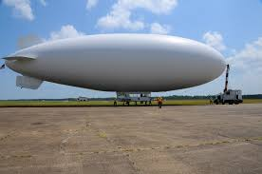
Print Media
Wacky BBQ
WACKY BBQ

Slide 3
Specialty Media
Broadcast Media
Wacky BBQ
Wacky BBQ
Wacky BBQ
Visit us at : 123 BBQ lane
Contact- 501-123-4567

Slide 4
Sales Promotion
FREE PIECE OF CHICKEN AT WACKY BBQ
BBQ REWARDS CARD

Slide 5
WACKY BBQ
Wacky BBQ

Slide 7
Personal Selling
Hello!! This is his/her name at Wacky BBQ how may I help you?

Slide 8
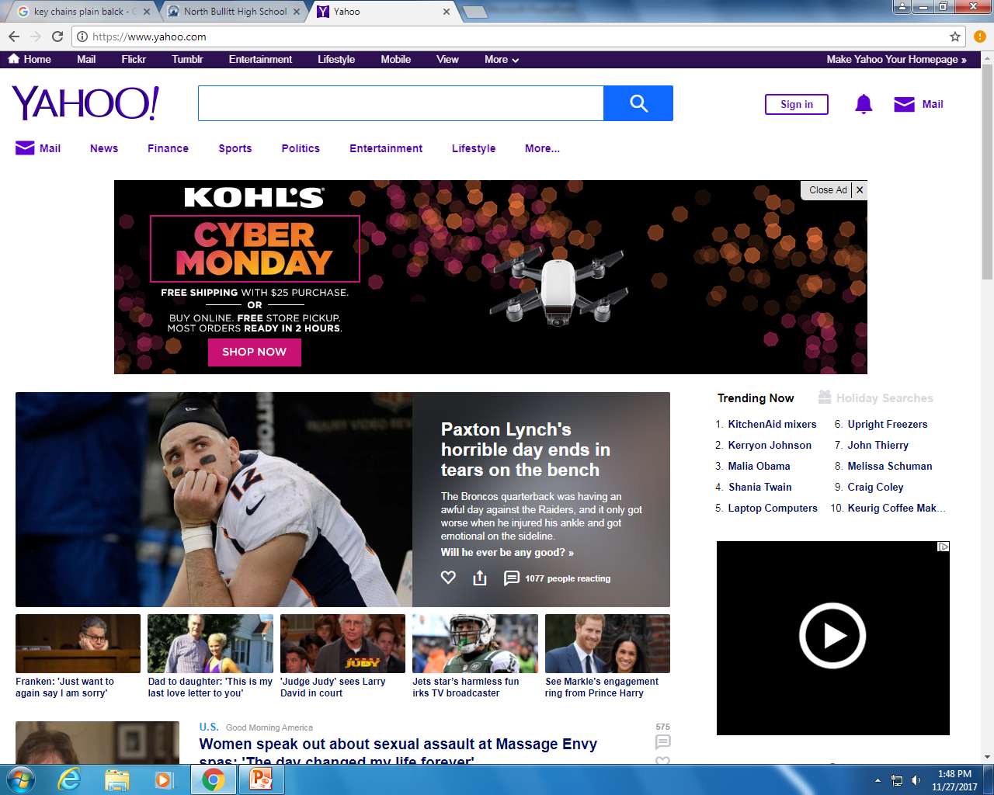
Wacky BBQ
Visit At: 123 BBQ Court
Best BBQ in town

Slide 9
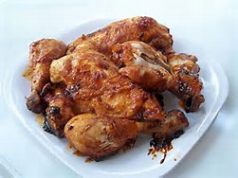
Wacky BBQ
Call at: 502-123-456
Visit at: 123 BBQ Court
To: Judy Williams
197 Briar St
Louisville, KY 40229

Slide 10
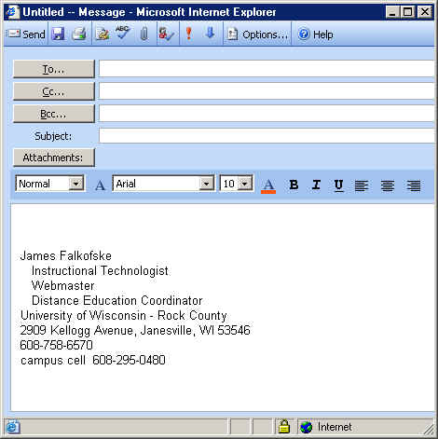
<<customers>>
Robbie Ross
Wacky BBQ
Swing by!!! And get 15% off your first bucket of chicken. Oh and don’t forget you don’t have to bring your teeth!!

Slide 11
Public Relations
During the month of December
Wacky BBQ will donate 45% of profits
to Kosair’s for Children to support diseases.

