Slide 1
Joiner's Drywall
Family owned since 2007 and union promoted.

Slide 2
Our quality builds your reputation!
Here at Joiner's drywall, Our quality and customer satisfaction is the most important thing to us. If we want our walls to look smooth as butter, we will give you the same treatment that we give to ourselves.

Slide 3
Union Protected
For us to get fairly paid and for the customers to be fairly treated, we are union protected to ensure the people working for you is fairly paid and you're getting the maximum amount of effort in your walls, flores

Slide 4
Example of one of our advertisements (billboard)

Slide 5
Continued (Newspaper ad)
Call for a quota
(123)456-7890

Slide 6
Continued (Online ad)
Call for a quota today (123)456-7890

Slide 7
Our shout out
Thanks again to “Joiner’s Drywall” for building my new house! A very reasonable price.

Slide 8
Direct marketing
Hello my name is ________ I am a representative of Joiners Drywall, we are here to please you in the best way you need. Please, if you would like to. Schedule an appointment for a free consultation.

Slide 9
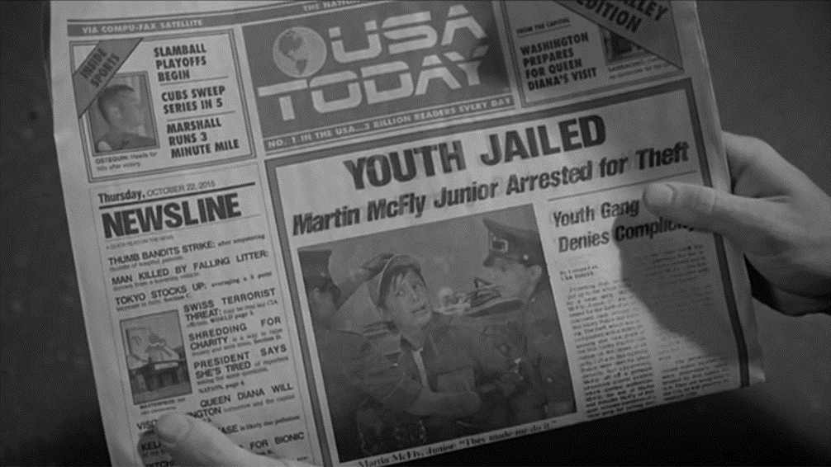
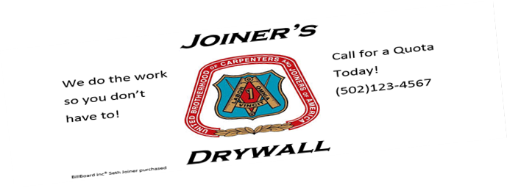
Newspaper publicity
Joiner dry wall promoted for great customer care!

Slide 10
Sales promotion
Tense Labor Rush Cupon
Buy 1 package get another free
50% off of any package

Slide 11
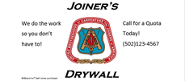
Direct marketing pt2

