Slide 1
Stock Handling
REFLECT What do stores do to prepare their merchandise for sale?
Describe the receiving process.
Explain stock handling techniques used in receiving deliveries.
All businesses must have a stock handling process in place to receive deliveries of materials or products. This process affects maintenance of inventory levels.

Slide 2
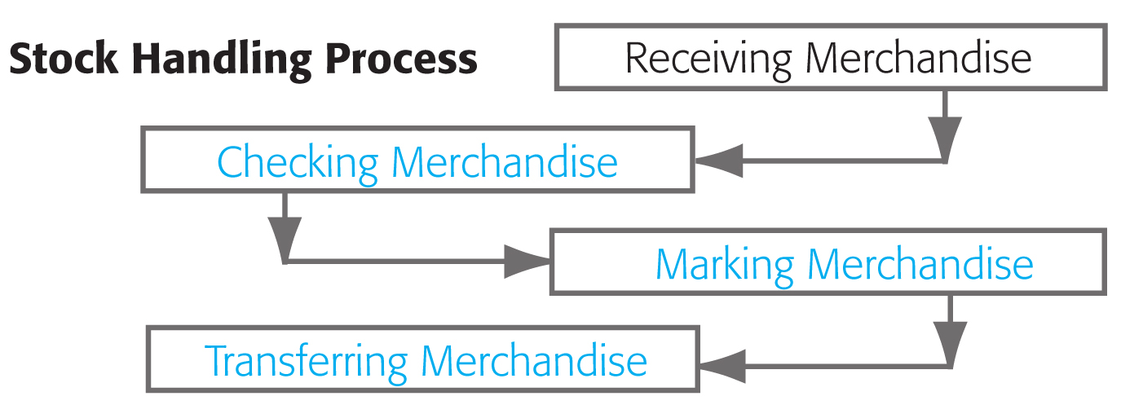
Stock Handling
Key Steps in the Stock Handling Process

Slide 3
Stock Handling
Receiving Merchandise
The store manager is aware that a shipment is coming.
Merchandise is received by a receiving clerk.
The size of the receiving facility depends on the size of the business.
Information on the receiving record is entered either manually or electronically.
receiving record
Information recorded by businesses about the goods they receive.

Slide 4
Stock Handling
Methods of Checking Merchandise
blind check method
A method of checking whereby the receiver writes the description of the merchandise, counts the quantities received, and lists them on a blank form or dummy invoice. The list is then compared to the actual invoice after the blind check is made.
spot check method
A random checking method of one carton in a shipment for quantity, and one item in the carton is inspected for quality; if the item is as stated on invoice, remaining cartons are assumed to be in the same condition.
direct check method
A method of checking in which the merchandise is checked directly against the actual invoice or purchase order.
quality check method
A checking method that inspects workmanship and general characteristics of the received merchandise.

Slide 5
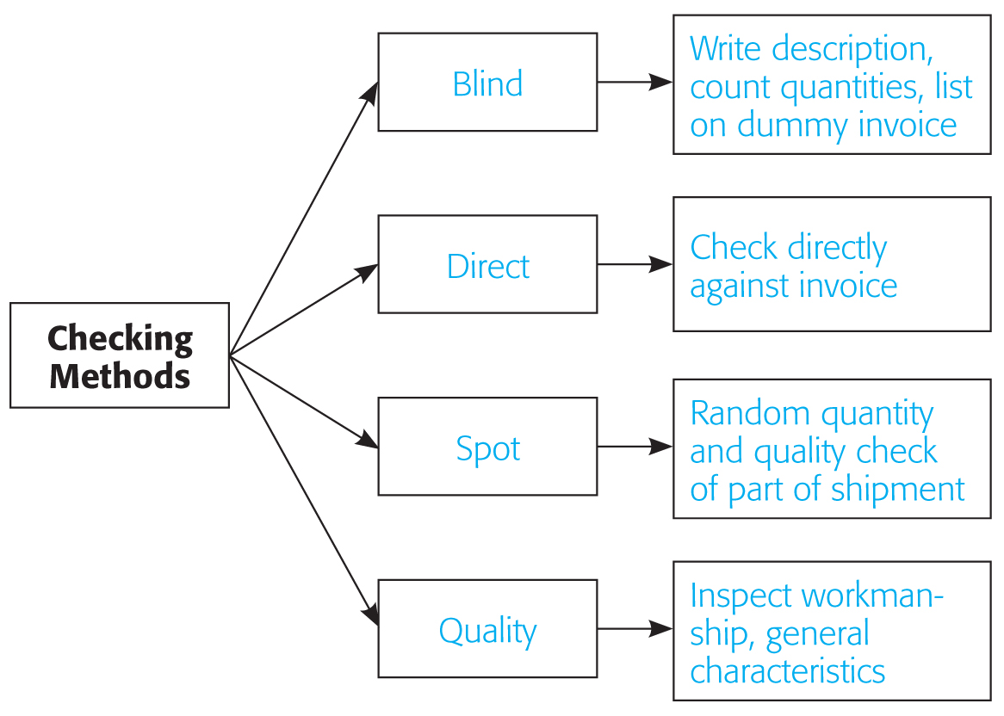
Stock Handling
Section 24.1
Stock Handling
Checking Methods and Facts About Each Method

Slide 6
Short Version ☺

Slide 7
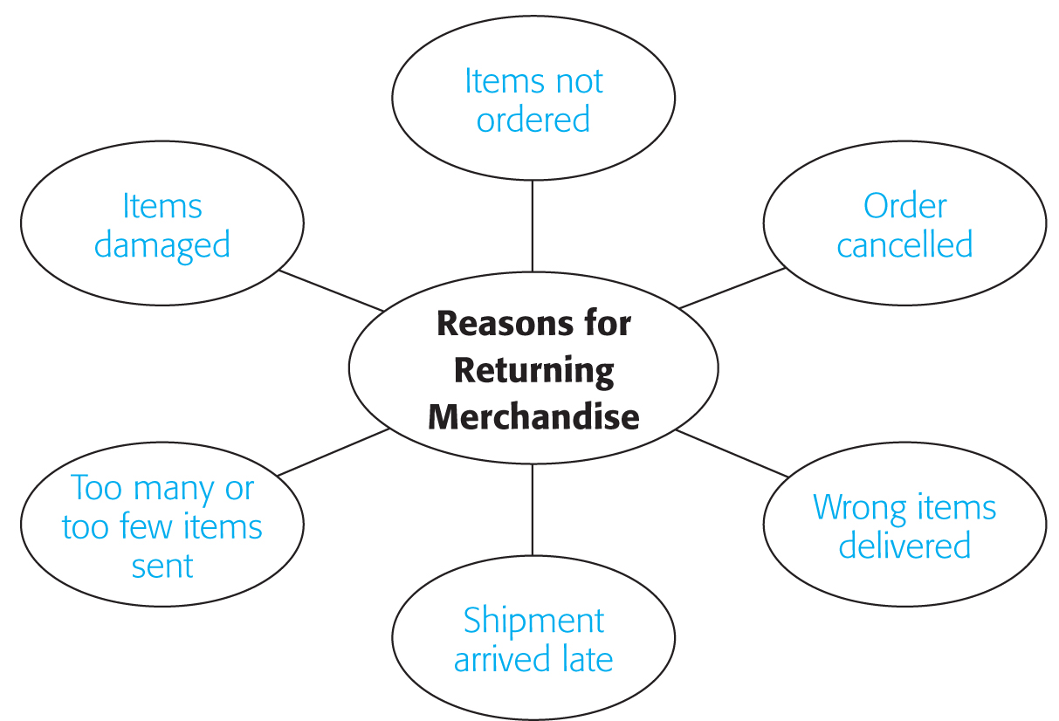
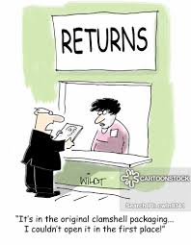
Reasons for Returning Merchandise

Slide 8
Stock Handling
source marking
Method used by sellers or manufacturers to mark the price before delivering the merchandise to the retailer.
Universal Product Code (UPC)
Source Marking
Marking Methods
Pretailing Marking Method
preretailing marking method
A method of marking in which the pricing information is marked in advance on the purchase order, then entered into the buyer’s computer system, and prices are available for marking as soon as merchandise is received.
Price Tickets

Slide 9
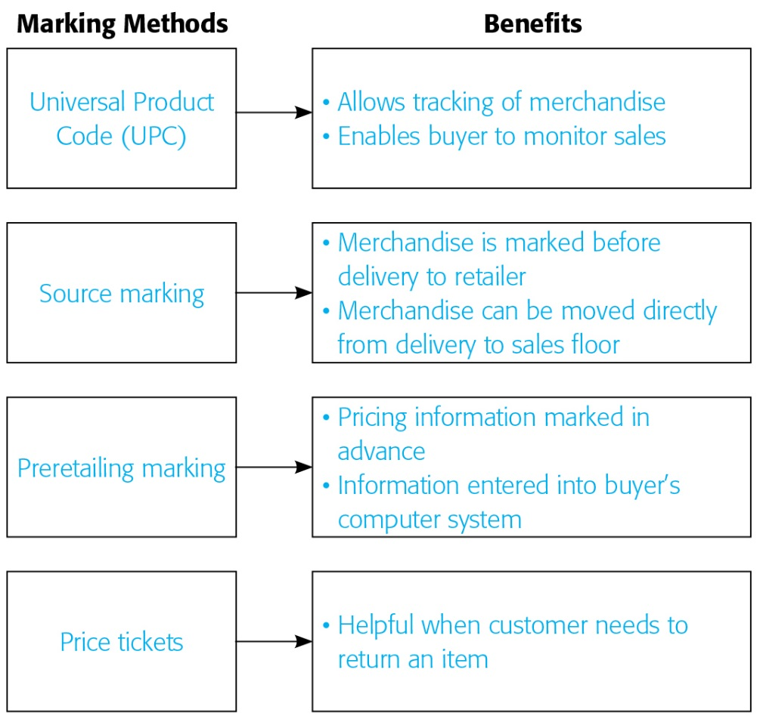
Stock Handling
The Different Methods of Marking Merchandise and the Benefits of Each Method

Slide 10
Stock Handling
Types of Stock Transfers
Transfers Between Departments
Transfers Between Stores
Transfers From a Store to a Distribution Center
JUST FYI

Slide 11
1. Explain why a receiving record is important.
A receiving record describes the goods received by a business. It is important because it serves as a permanent record of delivery.
2. List the four methods used for checking merchandise.
Blind check, direct check, spot check, and quality check are used for checking merchandise.
3. Explain how UPC codes assist in marking merchandise.
UPC barcodes allow the store to track sales and inventory levels. They also allow customers to spend less time at checkout when purchasing items.

Slide 12
Inventory Control
Inventory owned by a business represents a capital investment until the products are sold. Effective inventory management and accurate inventory systems increase profits.

Slide 13
Questions:
1. A shipment containing computer monitors and disk drives arrived at a store later than expected and without an invoice. The salespeople needed to have the merchandise on the floor quickly in anticipation of a big weekend sale. What method should be used to ensure quick and accurate merchandise checking?
2. What is the purpose of an electronic data interchange?

