Slide 1
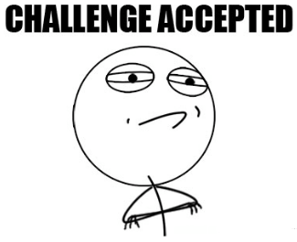
Eagle Challenge
Learning Target:
Describe market segmentation methods used to identify target market
How to protect intellectual property.
Standard OE3

Slide 2
Marketing Mix – 4Ps
Standard OE3
Product
Promotion
Price
Place

Slide 3
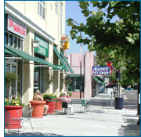
Basic Principles – The free enterprise system is based on:
Freedom of Ownership – We can own just about anything. The system encourages individuals to own businesses.
Standard OE3

Slide 4
Intellectual Property Rights
Are protected in a free enterprise system
Patents – If you patent an invention, you alone own the rights to that item or idea.
Trademark – A word, name, symbol, sound, or color that identifies a good or service and that cannot be used by anyone but the owner.
Copyright – Involves anything that is authored by an individual, such as writings, music, and artwork.
Standard OE3

